Slide 1
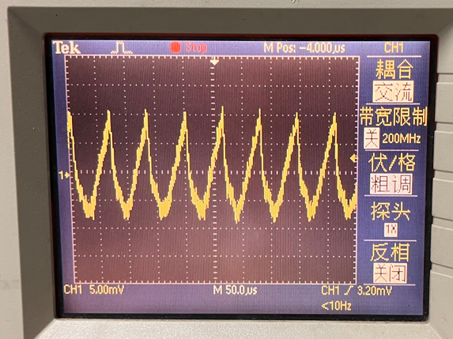
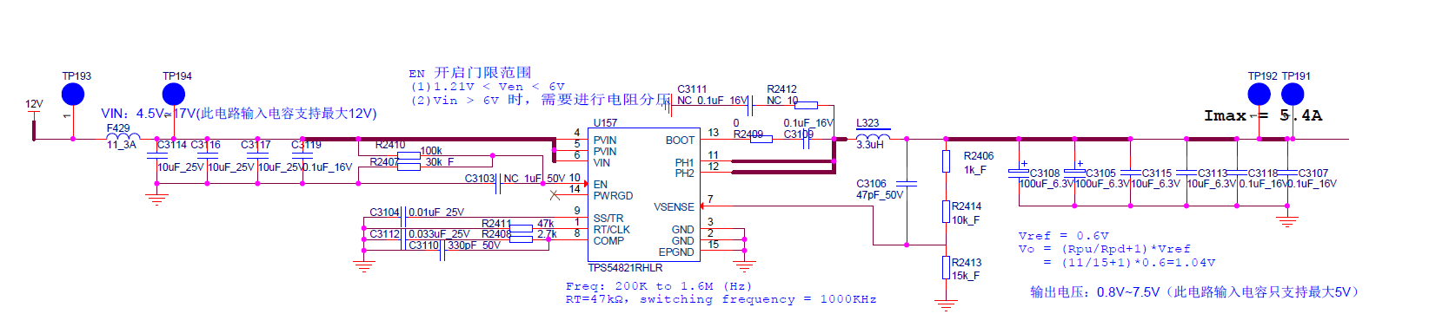
Ripple waveform measured under 0.7A load
SCH

Slide 2
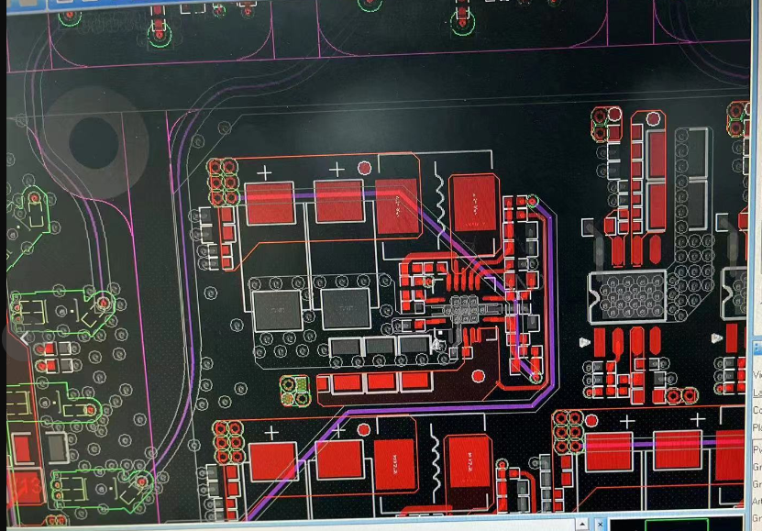
Layout

Slide 3
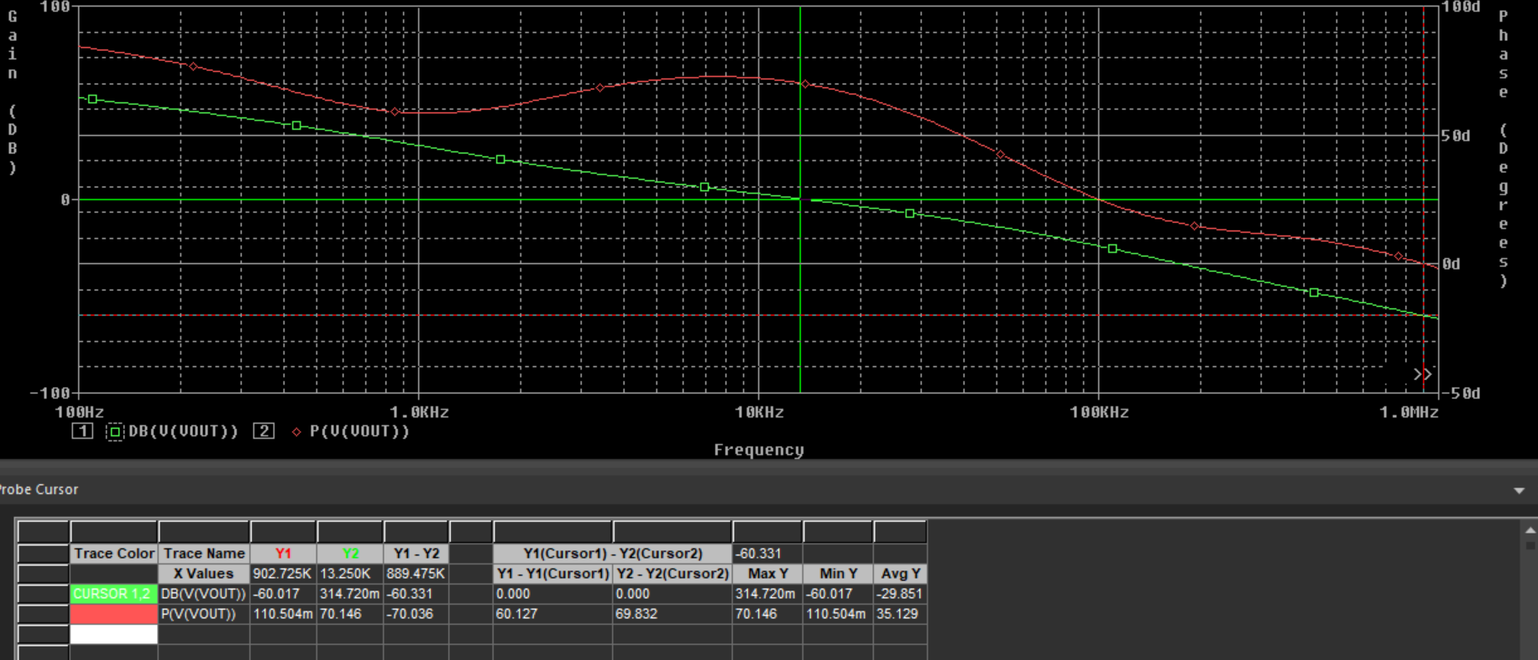
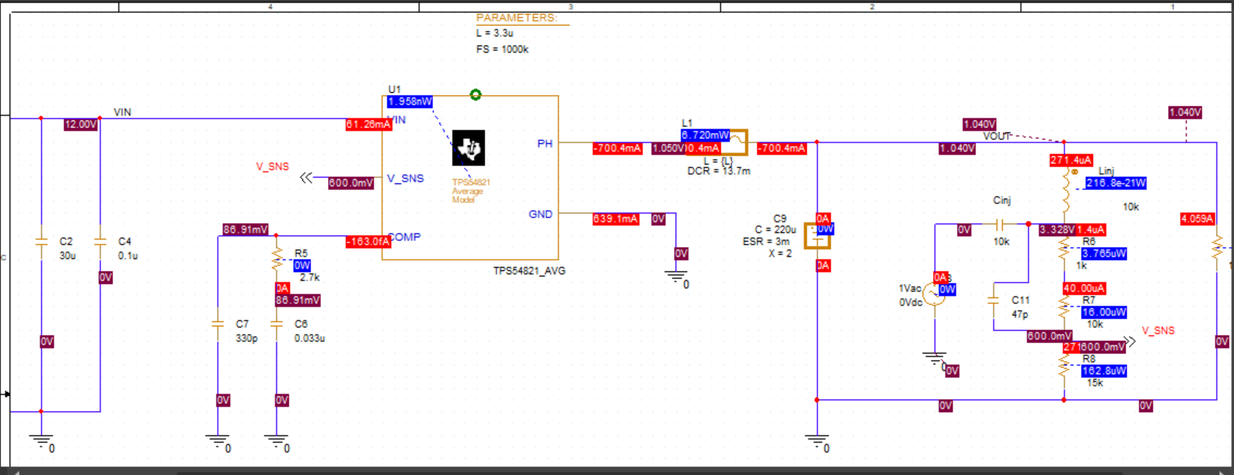
Bode analysis

Slide 4
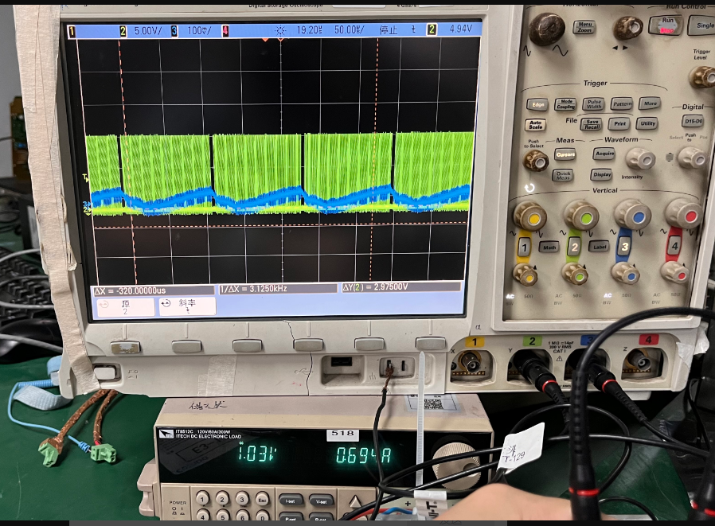
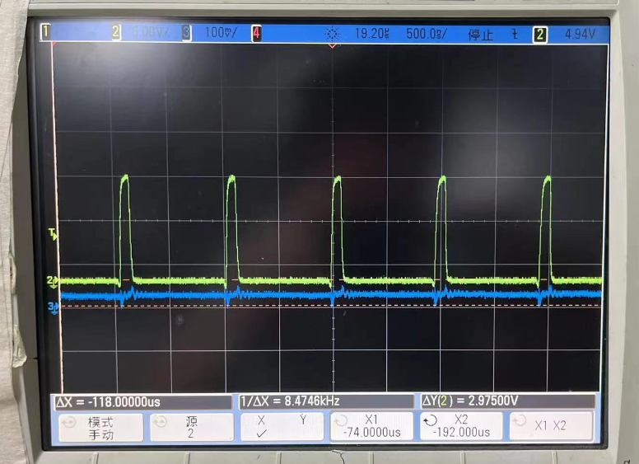
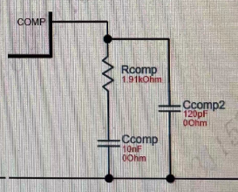
Then we try to use the Comp parameters with webench, and delete feed forward Cap as C3106, the SW frequency is around 8.5Khz
Even we set the SW as 1000Mhz, but we still found the SW will disconnect and not reaching to 1000Mhz as 1.04V/0.7A.

Slide 5
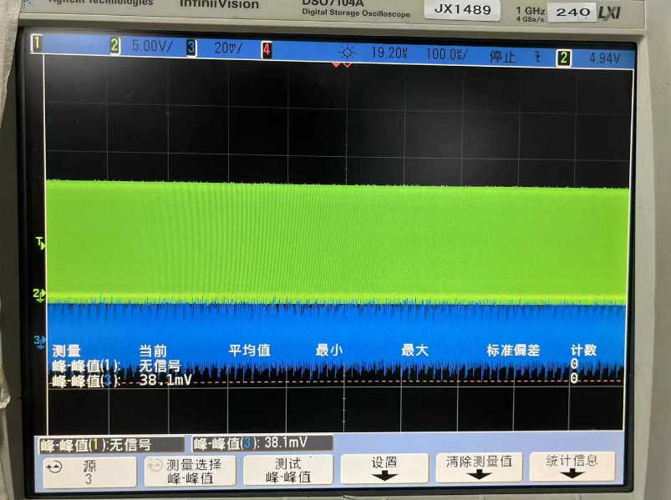
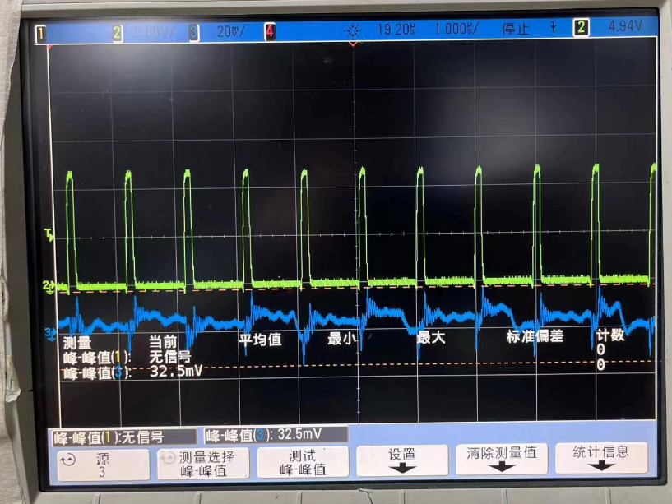
And the SW waveform at 1.04V/7A seems work well.

Slide 6
Customer need / situation :
SW waveform can not disconnect between 0-8A
Max Current for customer use case is 5.4A.
The Boundary value make the SW disconnect is around 1.3A.
(<1.3A SW disconnect, >1.3A SW continuous mode)
Another test:
1. Customer try to switch the SW frequency to 500K and comp parameter as 3.9K +10nf , and 0-8A work all well.

