Slide 1
TPS548D22
OVP Operation
Amnat Yakamna
September 12, 2018

Slide 2
1.0VOUT Setup
VIN=VDD=12V
VOUT=1.0V
FREQUENCY=650Khz
Inductor=0.33µH
Iccmax=25A
OCL=32A
MODE=D-CAP3_DCM
Ramp Generator’s Resistor= (FSW=650Khz=Rx1)

Slide 3
OVP Operation
After OV fault triggers, LS FET turns on to pull down VOUT until negative OC is triggered.
Then LS FET turns off and HS FET turns on for a Ton period. Afterwards, HS FET turns off and LS FET turns on again until negative OC is triggered again.
The negative OC induced switching process repeats again and again in order to regulate the VOUT pull down current. After VOUT is close to being completely discharged, negative OC won’t get triggered anymore and so LS FET stays turned on.
To trigger UV fault after OV fault induced VOUT discharge, FB voltage must drop below UV threshold (68% of the target reference voltage). The UVP comparator output goes high and an internal UVP delay counter begins counting. After 1ms, the device latches OFF both high-side and low-side MOSFETs drivers.

Slide 4
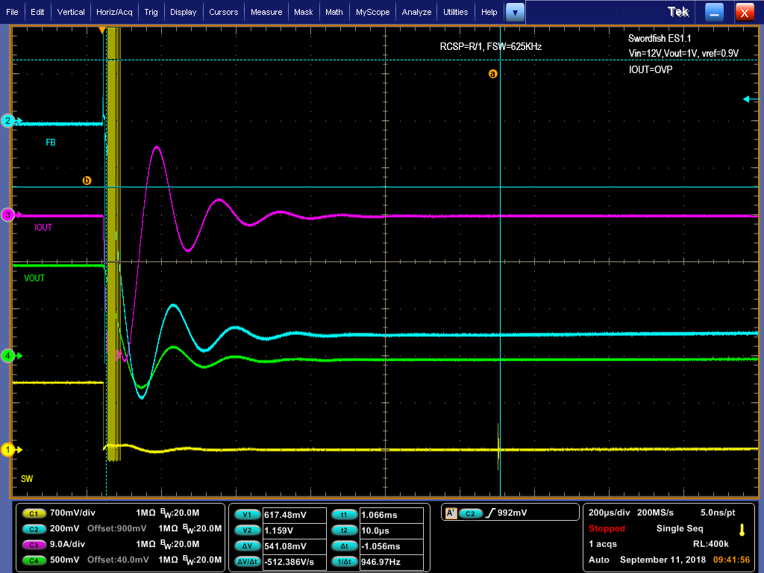
OVP Operation
Shutdown, IOUT=40A
~1ms UVP delay,
LS FET=ON and HS FET=OFF
Device latches off the LS and HS FET.

Slide 5
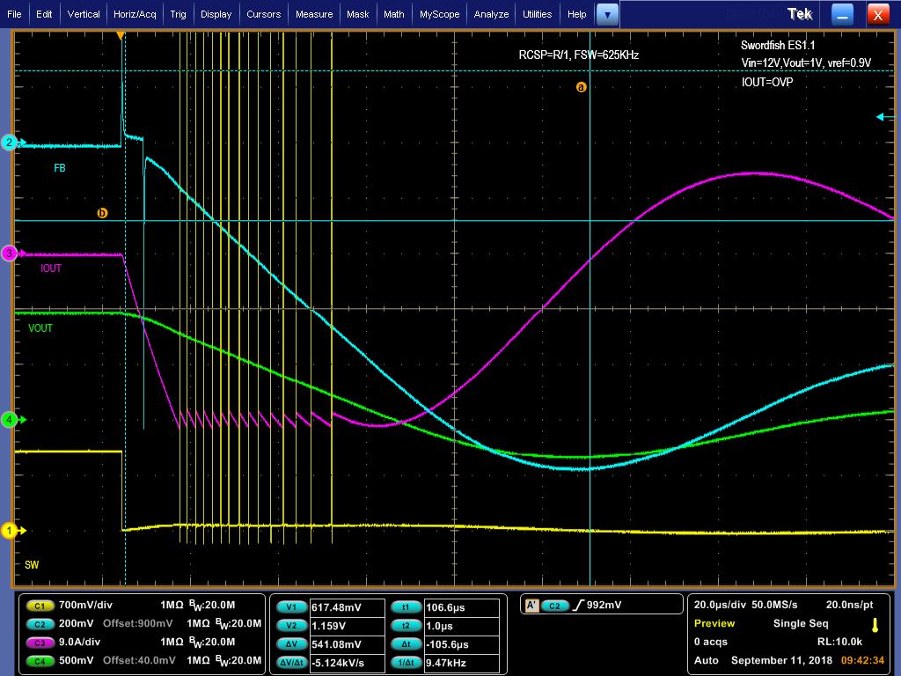
OVP Operation
OV Threshold.
Shutdown, IOUT=40A
UVP Threshold.
LS FET turns on to pull down VOUT until negative OC is triggered.
Inductor current became less negative and more positive. The energy stored in the inductor has to be dissipated through the LC network. The LC network is highly resonant and underdamped so resulting current looks quite oscillatory.

Slide 6
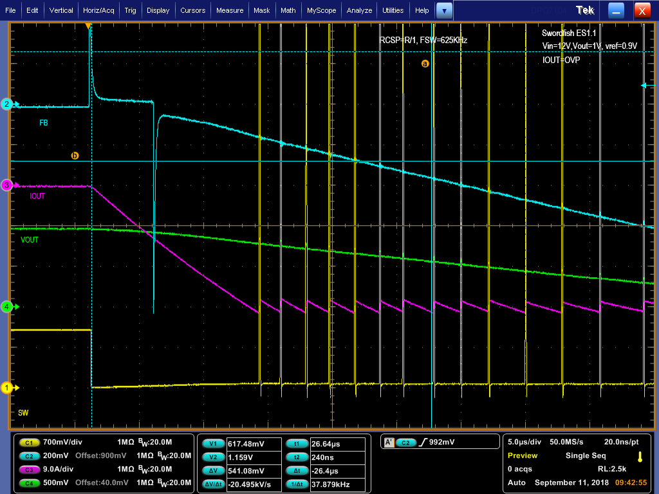
OVP Operation
OV Threshold.
Forced OV condition by the function generator pulsed through a diode for ~5us. The set voltage is at 20% above the reference voltage.

Slide 7
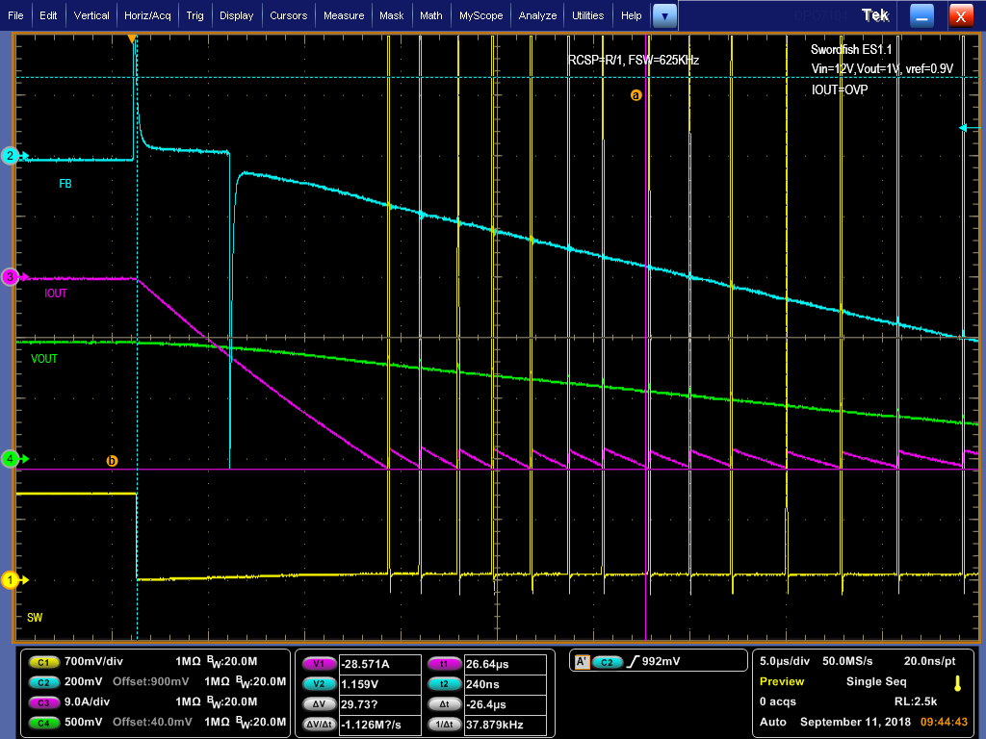
OVP Operation
Switch node Minimum on-time
Negative OC threshold
The different off-time durations controlled by the negative OC threshold and the VOUT decreasing (V=L*di/dt).

