Slide 1
TPS55288 Layout Review
02/01/2024

Slide 2
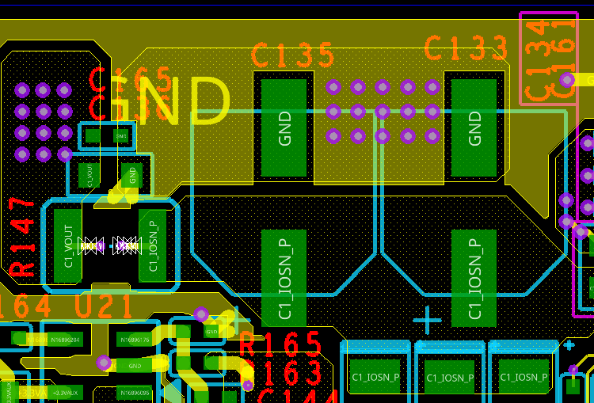
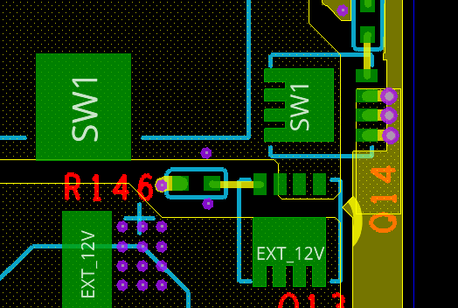
Power component
Add more GND vias here to minimize input loop.
2. Put C135 and C133 outside R147

Slide 3
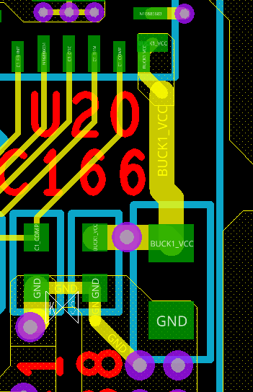
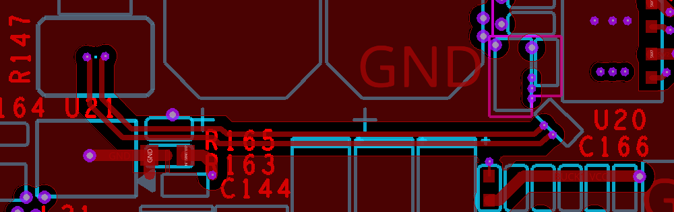
Current sense
Add two 10 ohm resistor in the current sense loop keep kelvin-connection
Connect VCC pin to VCC cap with short and wide trace

