Slide 1
TPS55288 Layout Review
09/03/2024

Slide 2
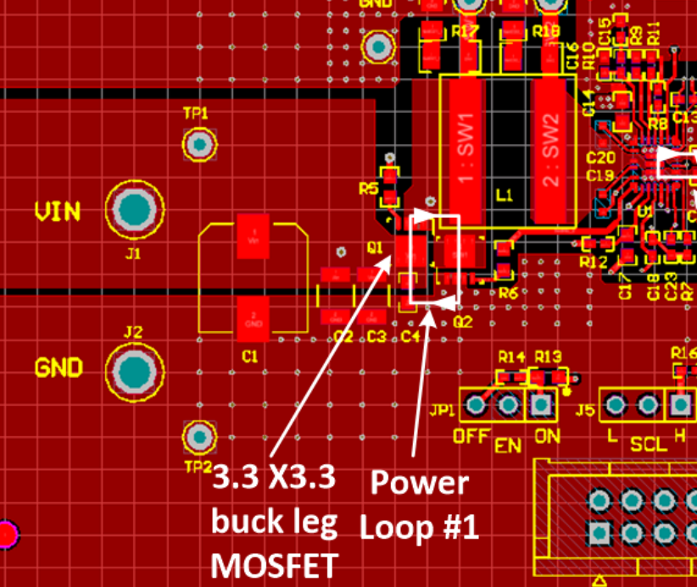
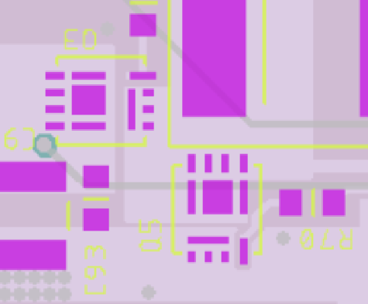
Buck-leg MOSFETs
Put the MOSFETs more compacyt. PCB parasitic inductance could be reduced to minimum, which helps to improve SW1 pin spikes duing switching, as well as EMI performance.

Slide 3
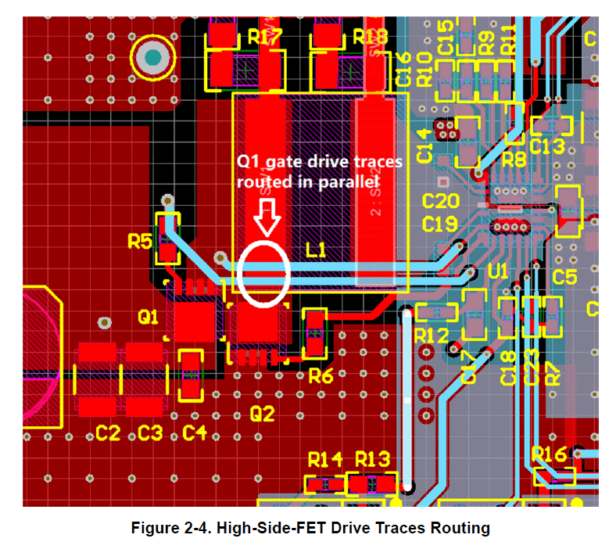
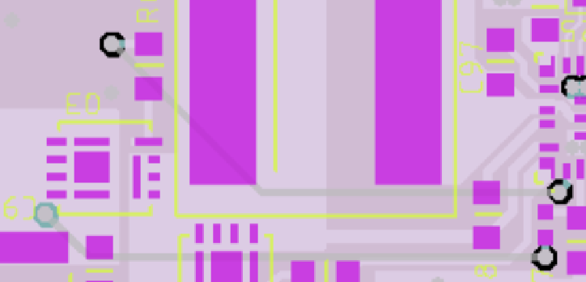
High-Side-FET Drive Traces Routing
To minimize gate-loop area, gate and source traces are routed side by side as differential pairs.

Slide 4
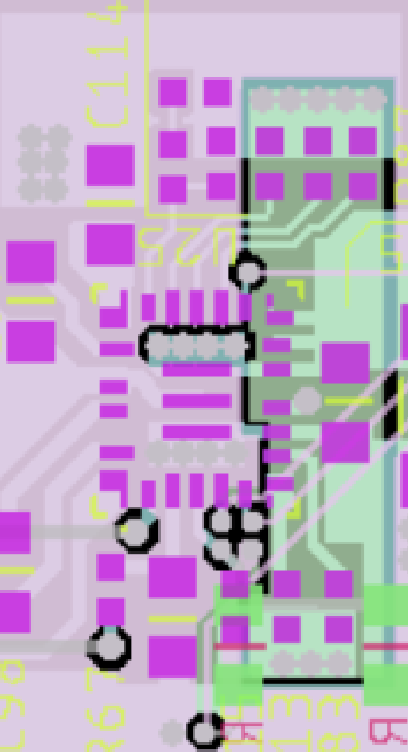
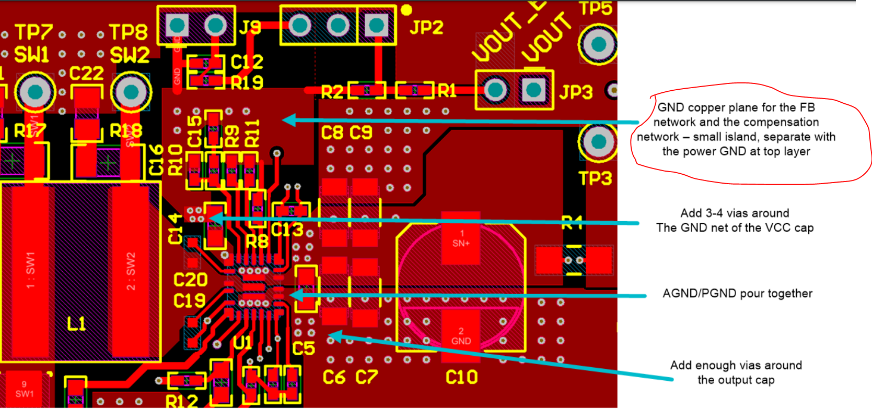
AGND plane
It’s important to isolate the AGND plane and power ground plane. I am not sure but I think you use separate AGND here

Slide 5
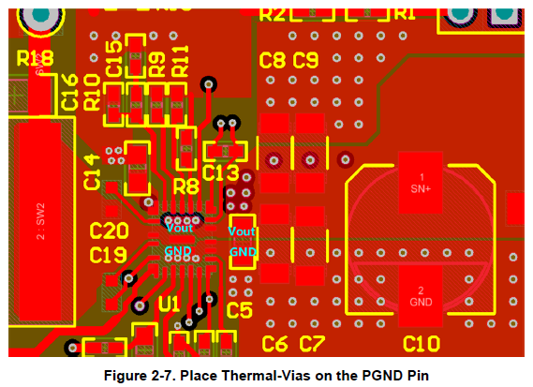
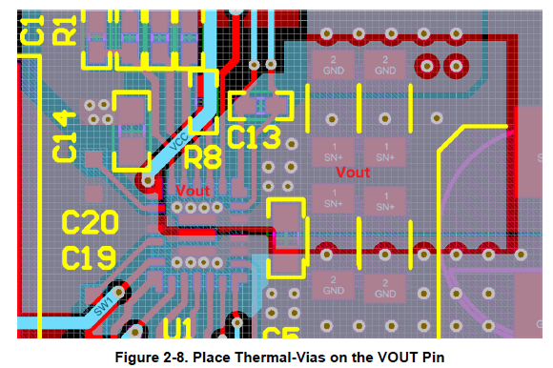
Vias
Put enough vias for thermal.

