Slide 1
TPS55289-Q1 CISPR25 EMI Test Result
@ fsw=400kHz 14Vin

Slide 2
Schematic – EMI Filter

Slide 3
Schematic – TPS55289-Q1

Slide 4
CISPR25 Conduction EMI Test Result

Slide 5
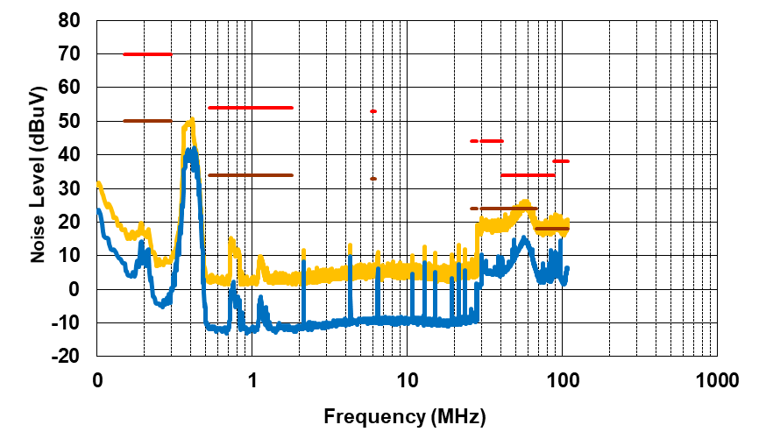
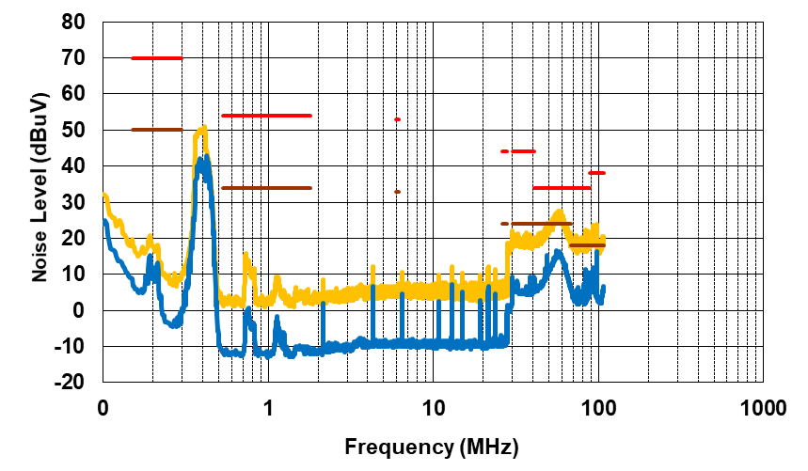
VIN=14V, Vout=5V / Iout=3A
Supply
Return

Slide 6
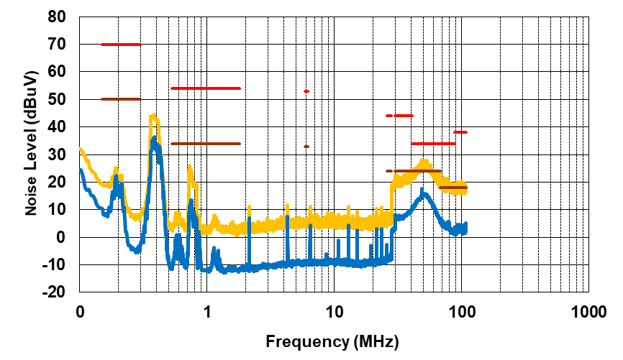
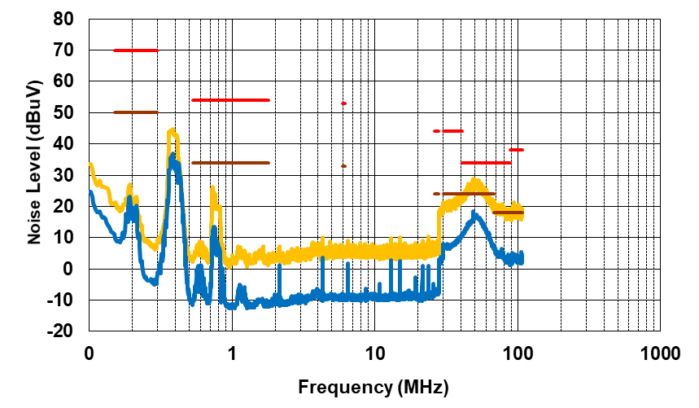
VIN=14V, Vout=9V / Iout=3A
Supply
Return

Slide 7
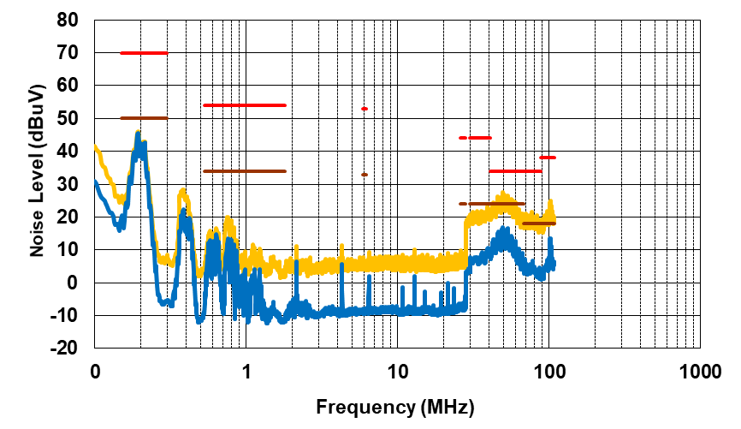

VIN=14V, Vout=15V / Iout=3A
Supply
Return

Slide 8
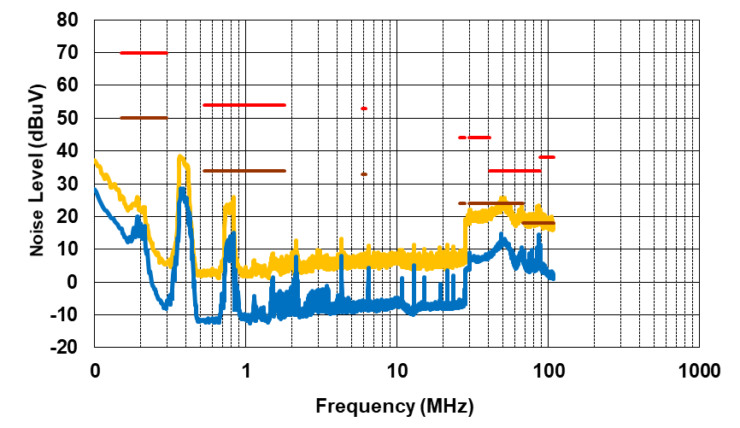
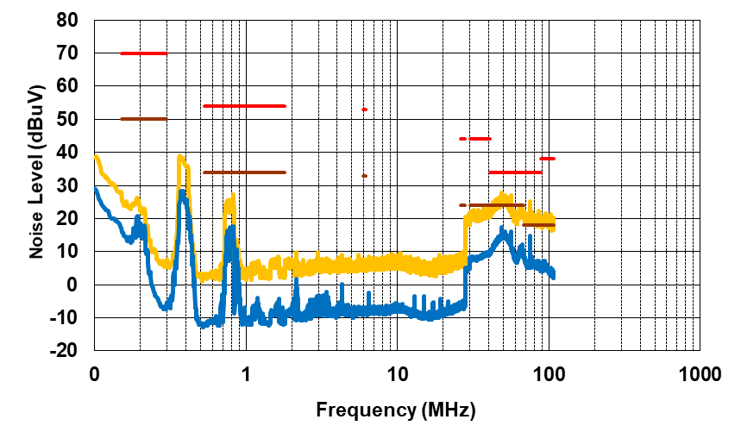
VIN=14V, Vout=20V / Iout=3A
Supply
Return

Slide 9
CISPR25 Radiation EMI Test Result

Slide 10
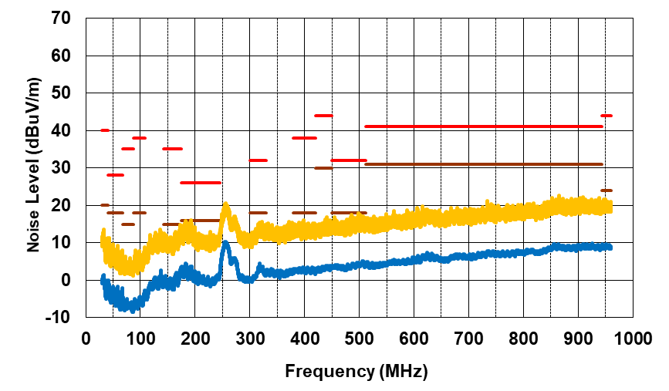
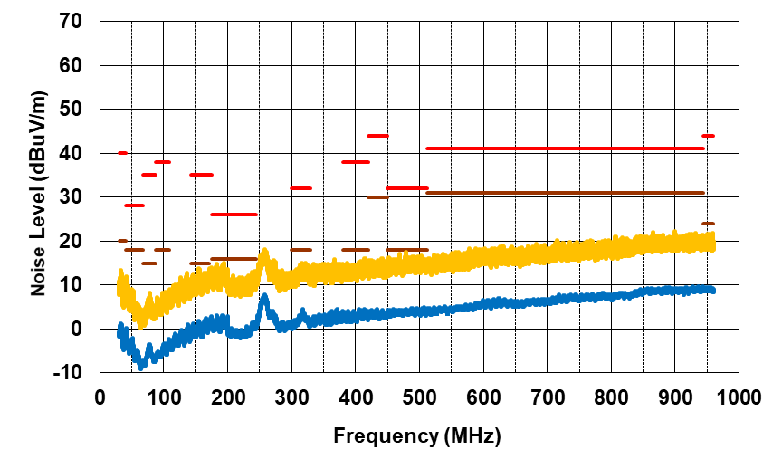
VIN=14V, Vout=5V / Iout=3A
Horizontal
Vertical

Slide 11
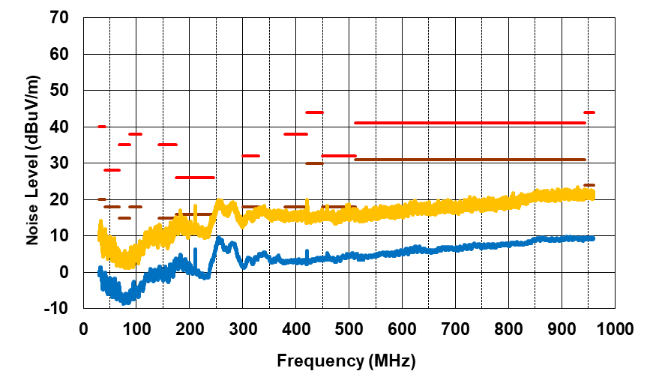
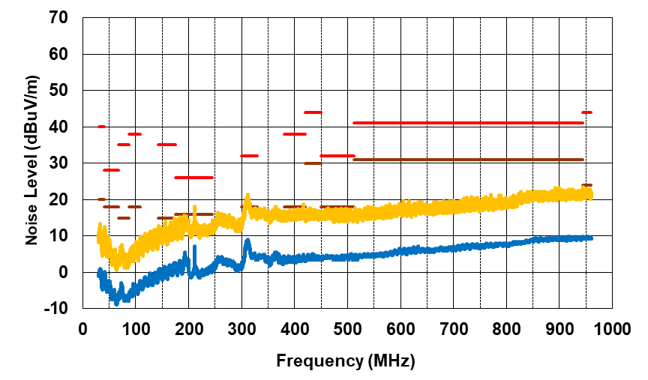
VIN=14V, Vout=9V / Iout=3A
Horizontal
Vertical

Slide 12
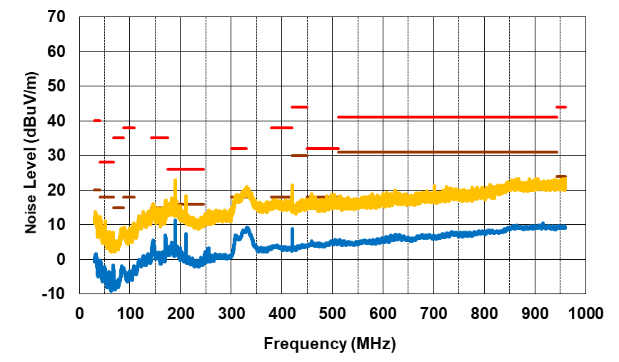
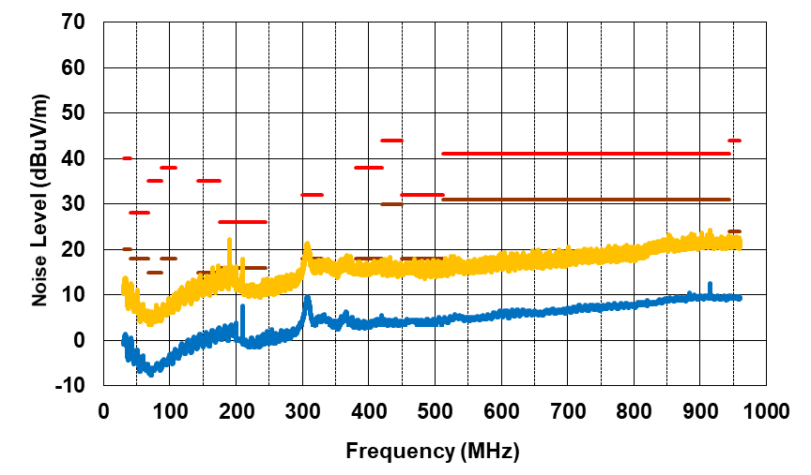
VIN=14V, Vout=15V / Iout=3A
Horizontal
Vertical

Slide 13
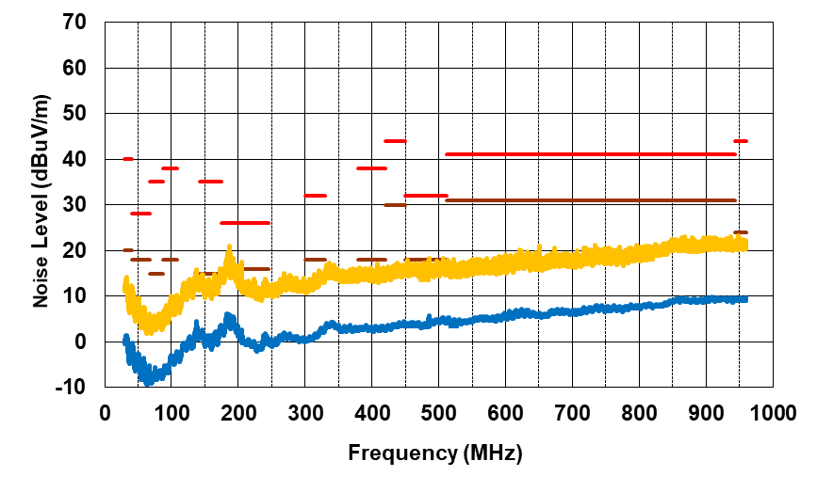
VIN=14V, Vout=20V / Iout=3A
Horizontal
Vertical

