Slide 1
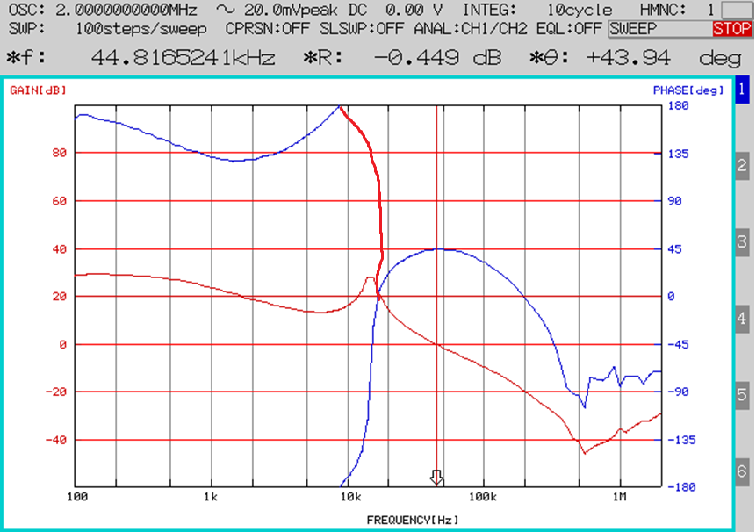
Do you mean phase curve becomes like this?
What should I think about this area?
The gain is over 0dB and phase margin is low and cross zero degree

