Slide 1
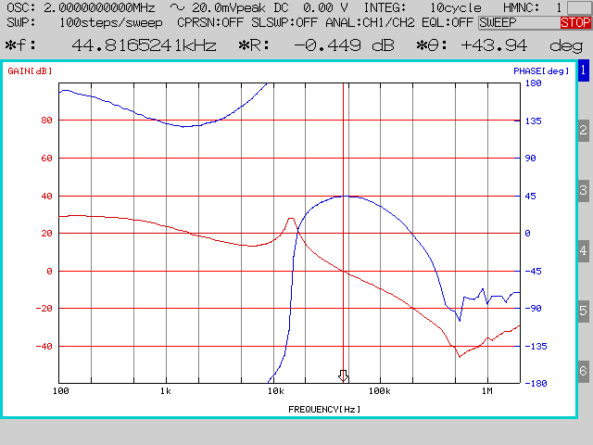
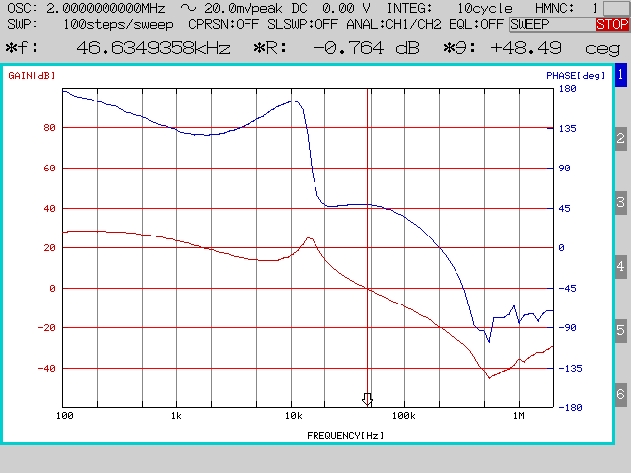
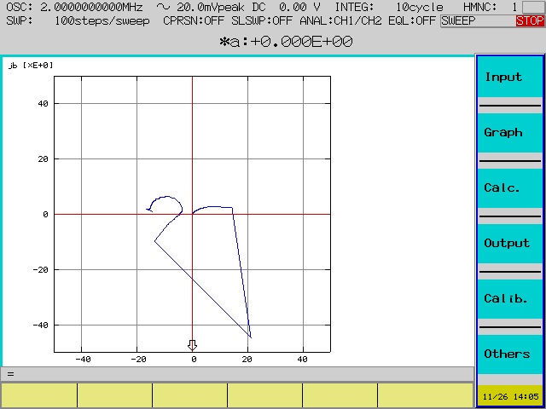
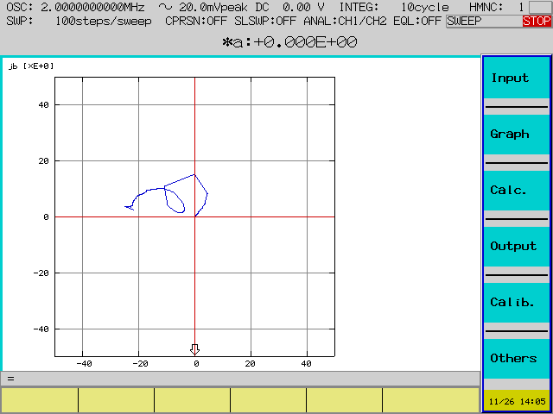
1.5A Load Bode Plot
5A Load Bode Plot
Start Point
1.5A Load Nyquist Plot
5A Load Nyquist Plot

