Slide 1
TPS566235 Sch/layout review
TI
4/24/2023

Slide 2
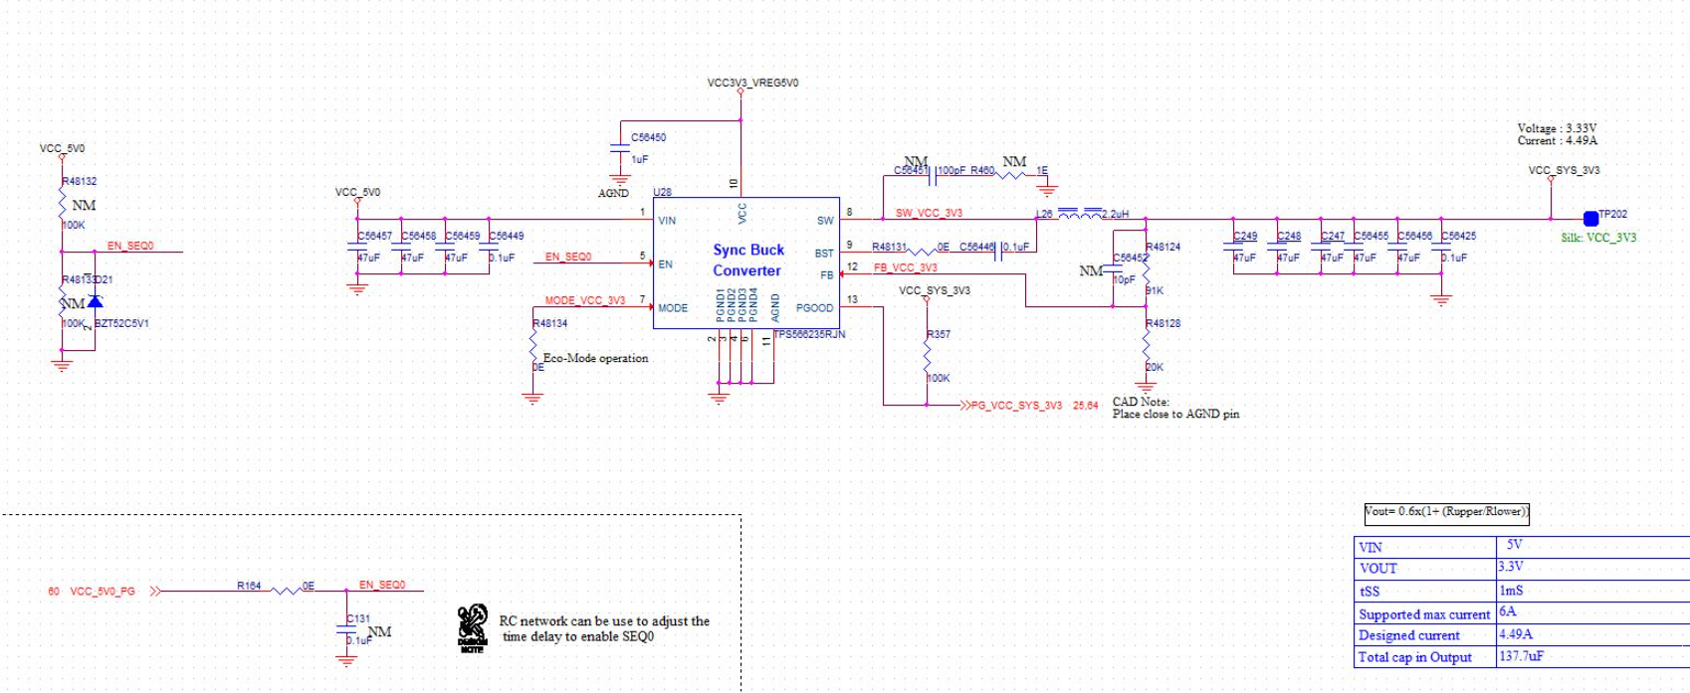
Sch: change inductor from 2.2uH to 1uH to keep similar ripple current for D-CAP3 required.
The datasheet recommend 2.2uH is for 12Vin. Your application is 5Vin.

Slide 3
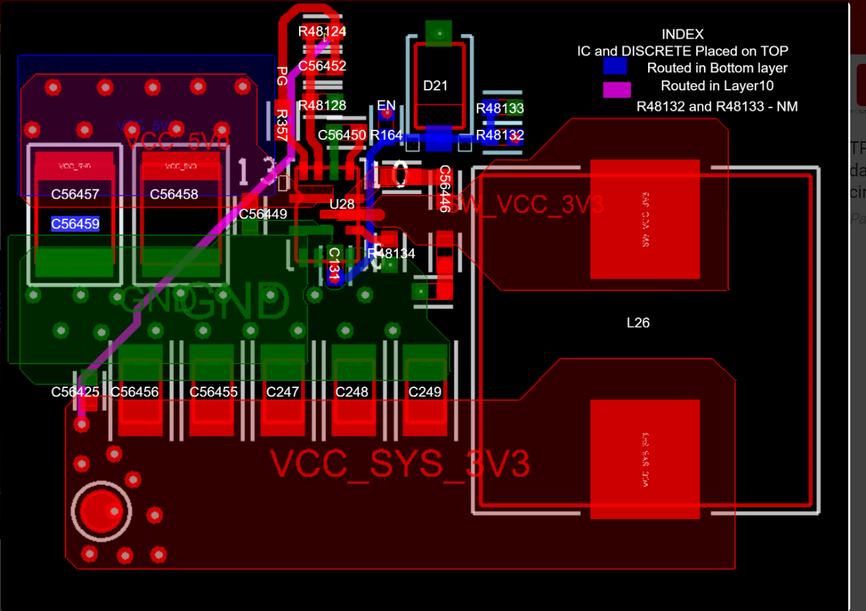
Layout: 1. Cut SW copper on the top which is no need and cause noise
2. Move vias near output caps’ pad
3. Rout FB trace outside input vias which is noisy

