Slide 1
TPS568231 vs MP8770
TI
10/13/23

Slide 2
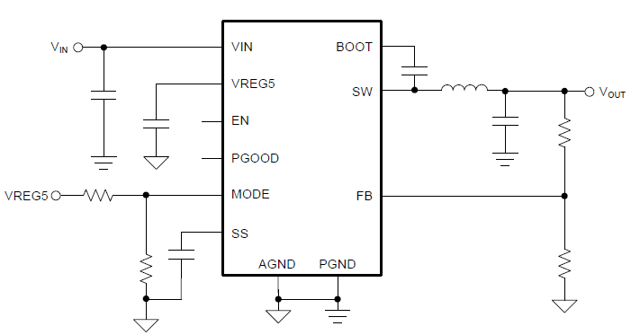
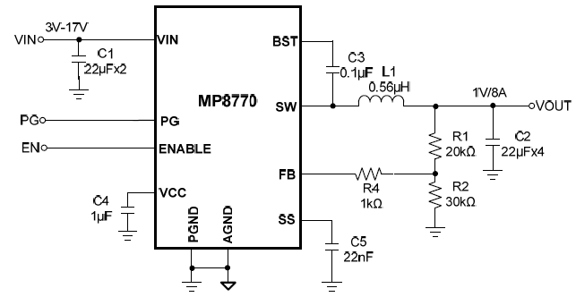
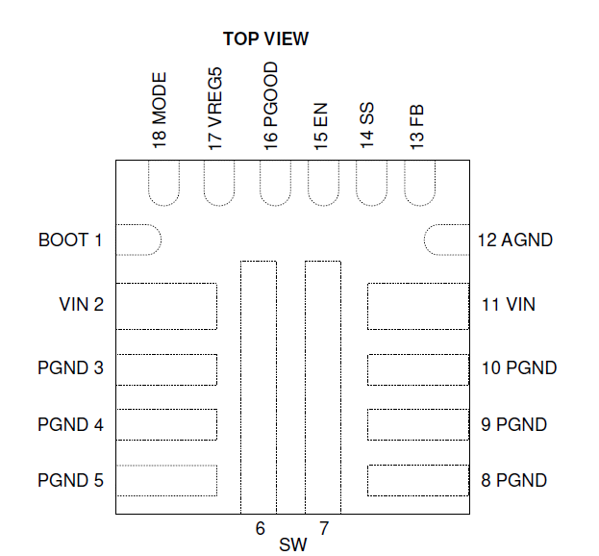
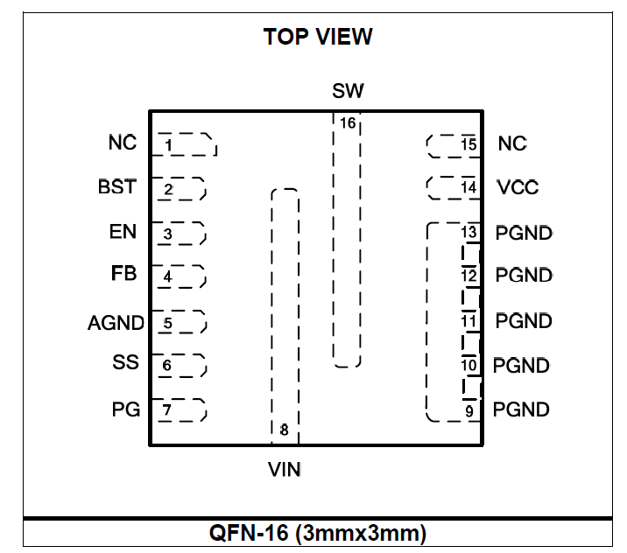
TPS568231
Not p2p compatible
MP8770
TPS568231
MP8770

Slide 3
TPS568231 vs MP8770
Feature | TPS568231 | MP8770
Rated Iout (A) | 8 | 8
Rds_on@4.7V (Ω) | 7.8m/3.2m | N/A
Rds_on@3.3V (Ω) | N/A | 22m/10m
Control Mode | D-CAP3 No ripple injection needed | COT No ripple injection needed
VIN (V) | 3.8 V– 17V with external bias 4.5V to 17V without external bias | 3V-17V without external bias
Vout range | 0.6V-5.5V | 0.6V to Vin* Dmax or 12Vmax
VREF Accuracy | 0.600V, -40C to 125C: ±1% | 0.600V,. -40C to 125C: ±1.5%
Fsw (Hz) | 400k, 800k, 1200k selectable | 700k Fixed
Overcurrent Limit | Two adjustable LS valley, programmable Hiccup | 10A LS valley, Non-programmable Hiccup
Quiescent current | 146uA | 100uA
FCCM/Auto-skip Mode selection | Yes | Automatically adjust between PWM and PFM
OV/UV/OT/UVLO protection | Non-latch | No OVP
Output discharge | Yes | No
Package | 3.5 x 3.5mm, 18-pin (RNN-18)package | 3 x 3mm 16-pin (QFN-16) package
Not p2p compatible

