Slide 1
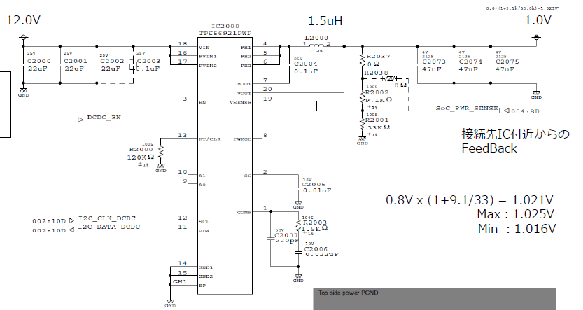
Feedback from cross to CPU
Vin: 12V
Vout: initial 1.0V
control range: 0.9~1.1V
Iout: 0~1.0A

