Slide 1
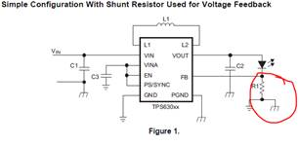
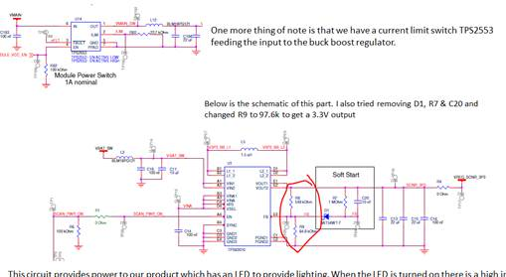
how are they driving this LED. Should be there a current sense to groun?
Your schematic doesn’t have any shown. FB is voltage feedback, not current feedback. Are we missing something?

