Slide 1
TPS61032 Schematic and Layout Review
4/26/2022

Slide 2
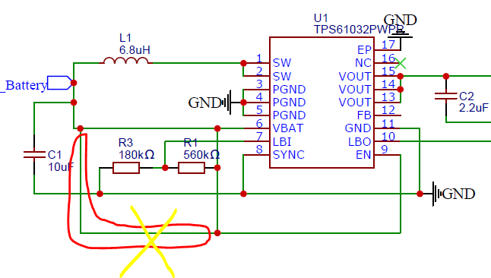
Schematic
1. The line in the red mark is excess, pls delete it.

Slide 3
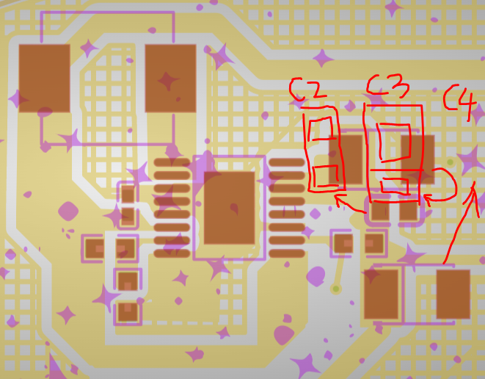
Layout
1. Put the Cout near the Vout pin like below.

Slide 4
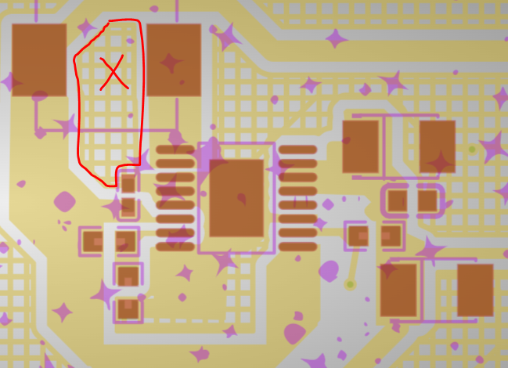
Layout
1. Recommend remove the plane under the inductor.

Slide 5
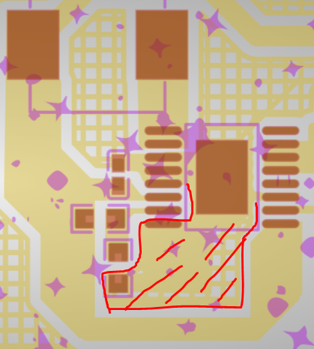
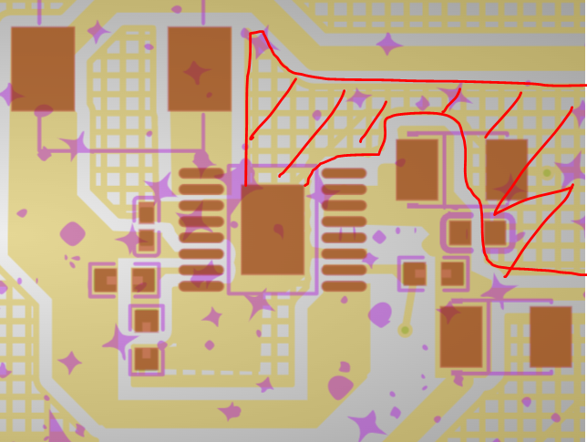
Layout
2. Recommend pour copper plane of GND, but not the crossed copper plane.

