Slide 1
TPS61094 Overview
APP/SR/BCC
Aug. 2025

Slide 2
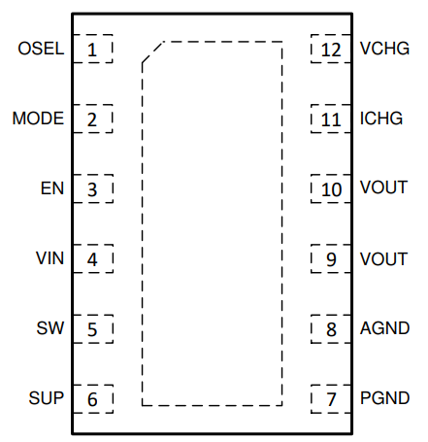
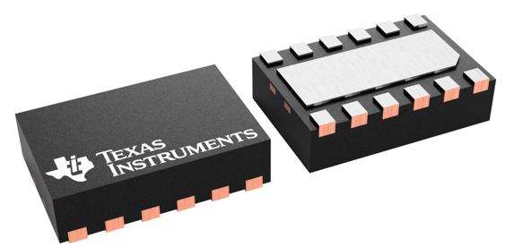
TPS61094 (Photon)
60-nA Iq bi-directional buck/boost converter with 4nA bypass mode
Features
Benefits
Input voltage range: 0.7V – 5.5V, startup 1.8V
Programmable boost output voltage, from 2.7V to 5.4V
Programmable buck output voltage, from 1.7V to 5.4V
Programmable buck output current, from 2.5mA to 600mA
Minimum 1.7A switch valley current limit
High efficiency: up to 96.3% efficiency at VIN = 3V, VOUT = 3.6V, and Iout = 100mA
Pin selectable buck/boost/bypass/true shurdown mode
EN = 1, MODE = 1: Auto buck or boost mode
EN = 1, MODE = 0: Forced buck mode
EN = 0, MODE = 0: Forced bypass mode
EN = 0, MODE = 1: True shutdown mode
Bypass mode with about 2nA Iq (typ)
Boost mode with about 60nA Iq (typ)
Buck mode with about 60nA Iq (typ)
Rdson: 60mΩ(LS),150mΩ (HS), 120mΩ Bypass switch
1 MHz switching frequency
±2% Reference voltage accuracy over -40℃ to +125℃
Output short protection
2mm × 3mm 12-pin WSON package
60nA ultra low Iq: increase light load efficiency to extend battery run time.
Bi-directional buck/boost is suitable for supercap backup power solution.
Bypass switch: decrease power loss and high performance at load transient
Applications
Gas meter, Water meters
Energy Harvest
TPS61094

Slide 3


Super-capacitor Charger and Path Management for Backup Power Solution in E-meter
Traditional power architecture
New power architecture
AC/DC
Buck
Power Mux
4G/2G
AC/DC
Buck
TPS61094
4G/2G
Charger
Boost
Charge / Discharger Control
Save from 3 devices to 1 device with charge/discharge control
Save from 5 power MOSFETs to 3 power MOSFETs by:
Reusing the Boost power FETs as charger.
Reusing the Boost high side FETs as one of power switch.

Slide 4
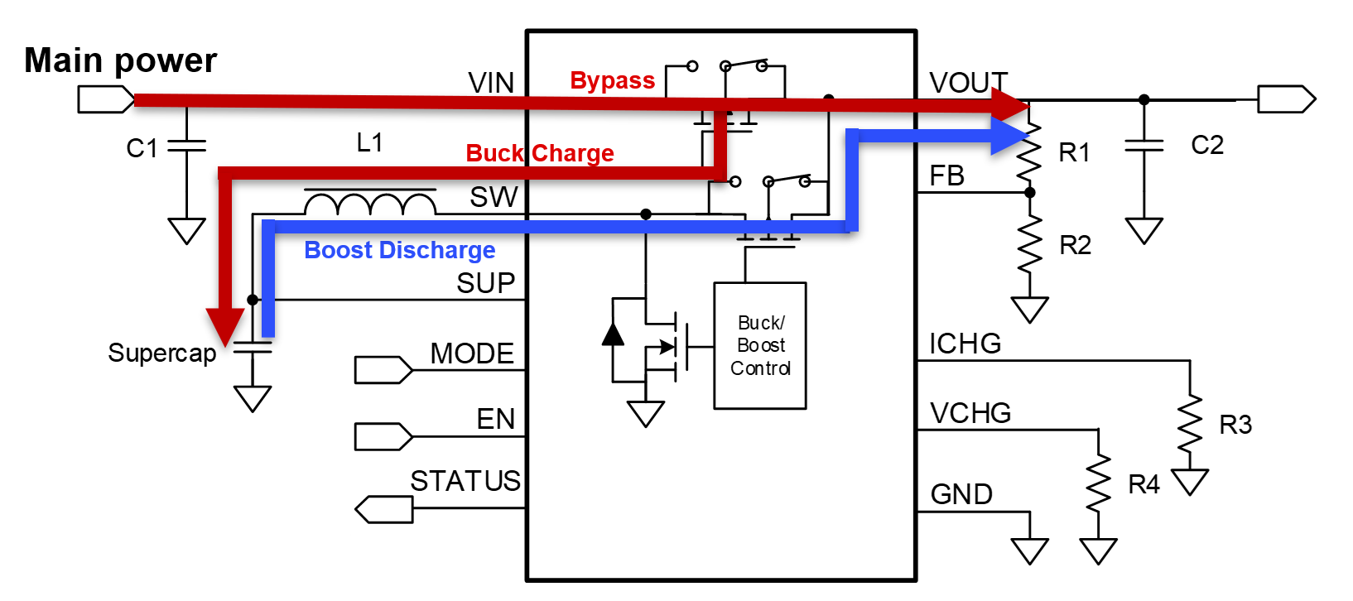
Existing device – TPS61094
Bi-direction LV buck and boost, optimized in Supercap Management

Slide 5
Application Circuit: Pure Boost with Bypass
BYPASS
1
Vin > target Vout
Bypass mode
MODE=1 EN=1
2
BOOST
Vin < target Vout
Boost mode
MODE=1 EN=1

Slide 6
Application Circuit: Boost with Buck Charger
BYPASS
1
BUCK
Set Vout= 3.6V by R1
Vin > target Vout+0.1V
Buck Charger
EDLC
MODE=0 EN=1
Set supercap terminate voltage =2.6V by R3
X
2
Vout=3.6V
BOOST
Set Vout= 3.6V by R1
Vin < target Vout
Boost Converter
EDLC
MODE=1 EN=1
Set supercap terminate voltage =2.6V by R3

Slide 7
Application Example: Bypass Mode and Buck Charge Mode
4V
4V ~ 3.9V
Bypass
1
Buck Charge
0V
When main power is present, and VOUT is not lower than 3.9V, super cap is charged in Buck mode.
ICHG is set at 500mA
VCHG is set at 2.1V
Set super-cap max charging current by R3.
Set super-cap terminate voltage by R4.

Slide 8
Application Example: Bypass Mode (charge disable)
Bypass
4V ~ 3.9V
4V
2
2.1V
When main power is present, and super-cap is charged to VCHG, charge mode is disbaled, only bypass FET is turned on.
Status pin is pulled high.
Status pin is pulled high when charging down.

Slide 9
Application Example: Boost Discharge Mode
3.9V
3
Boost Discharge Mode
VOUT_SET in boost mode is set at 3.9V
When main power is not present, supercap is discharged to power for loads.
Set output voltage in Boost mode by R1， R2

Slide 10
Operation Mode
Mode | EN | MODE | Function
Ture shutdown | 0 | 0 | Ture shutdown mode. Bypass disconnect. VOUT = 0V
Forced bypass mode | 0 | 1 | Force bypass mode. VOUT = VIN
Forced buck charge mode | 1 | 0 | Force buck charge mode. Bypass MOS turns on(VOUT = VIN) while charging the supercap or backup battery
Auto charging or backup | 1 | 1 | When VIN >= VOUT & VOUT >= VOUT_SET + 0.1V, then Charging function enable, turn on Buck, Supercap is charged by buck.
 | 1 | 1 | When VIN >= VOUT & VOUT_SET + 0.1V > VOUT >= VOUT_SET, then Charging function disable, only bypass FET is turned on.
 | 1 | 1 | When VIN < VOUT & VOUT < VOUT_SET, then Backup function enable, turn on Boost, VOUT is powered by Supercap.

