Slide 1
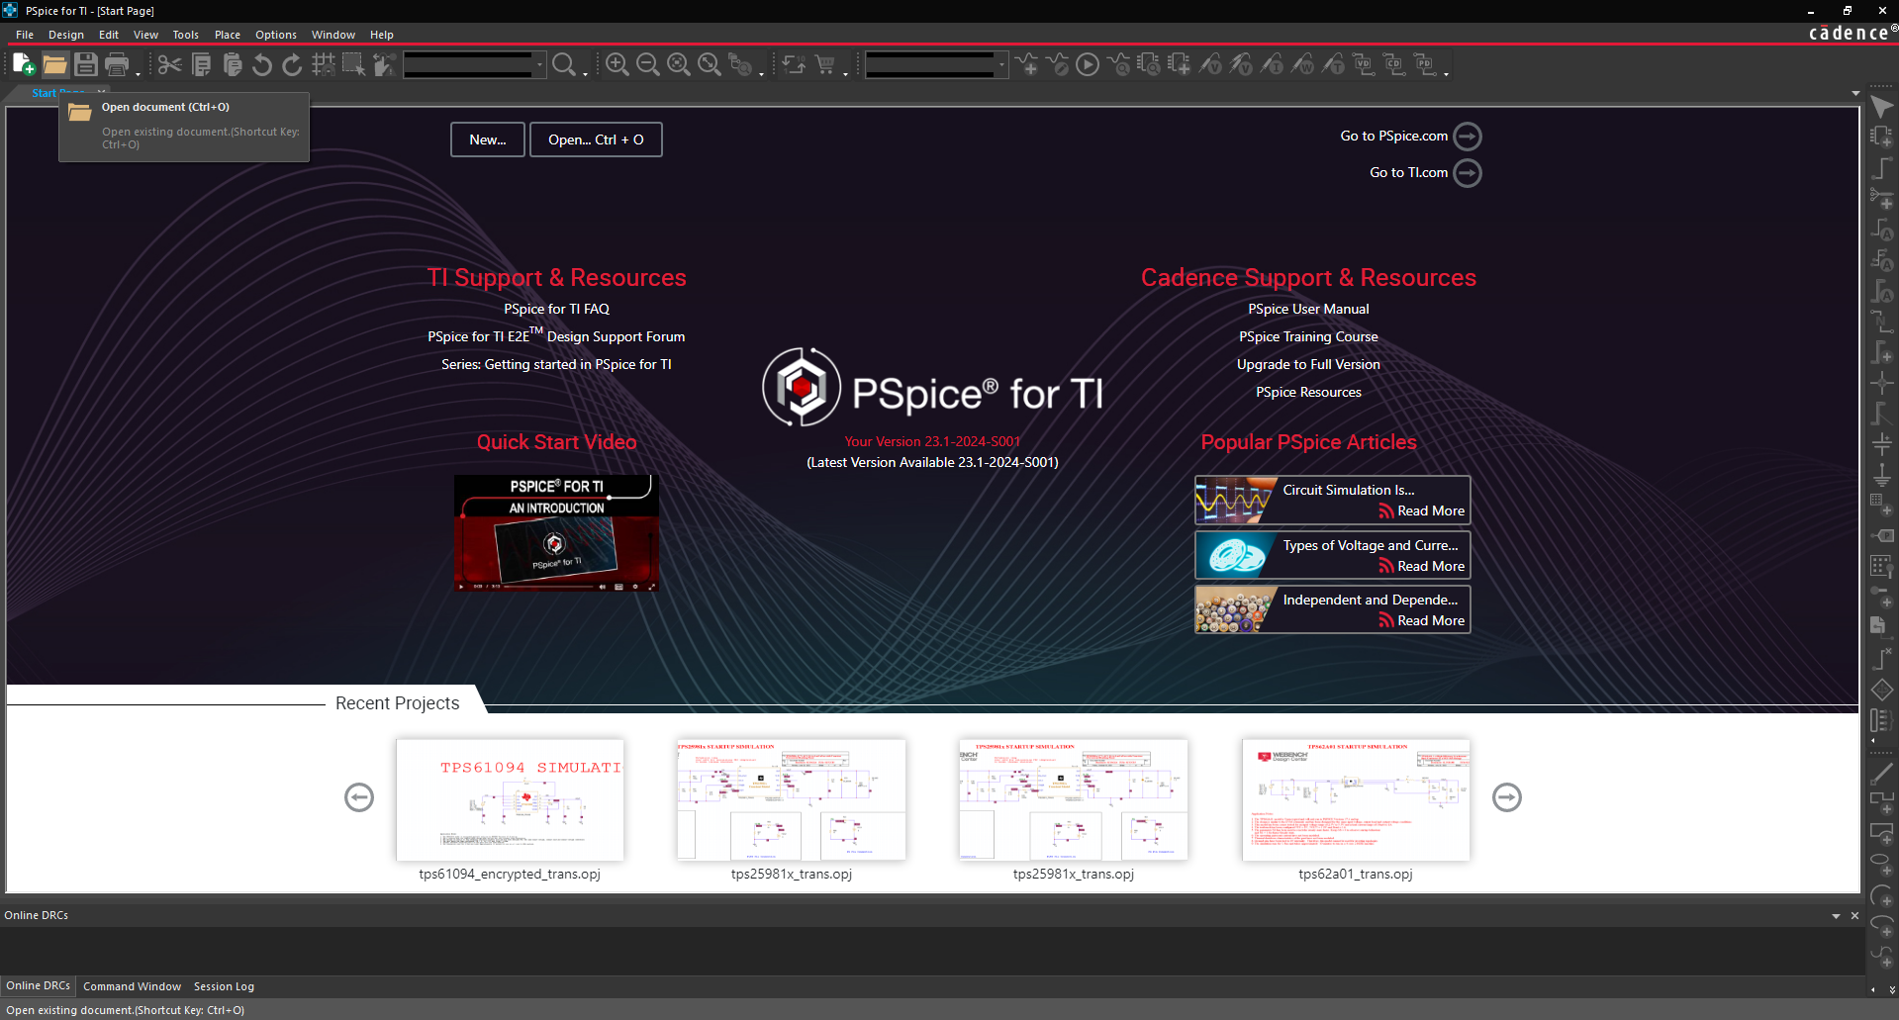
① Launch Pspice for TI and click Open document

Slide 2
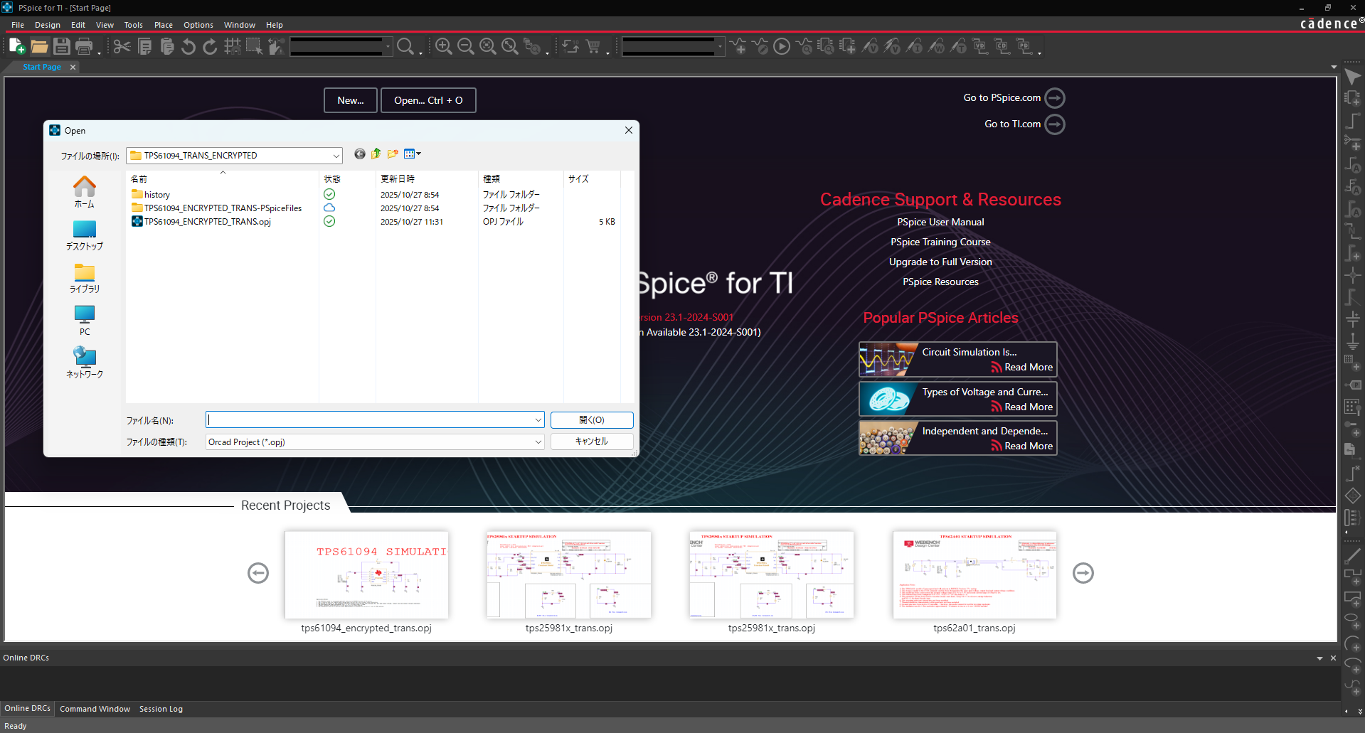
② Select TPS61094_encrypted_Trans.opj in the folder where you unzipped SLVMDO3.ZIP (simulation model of TPS61094)

Slide 3
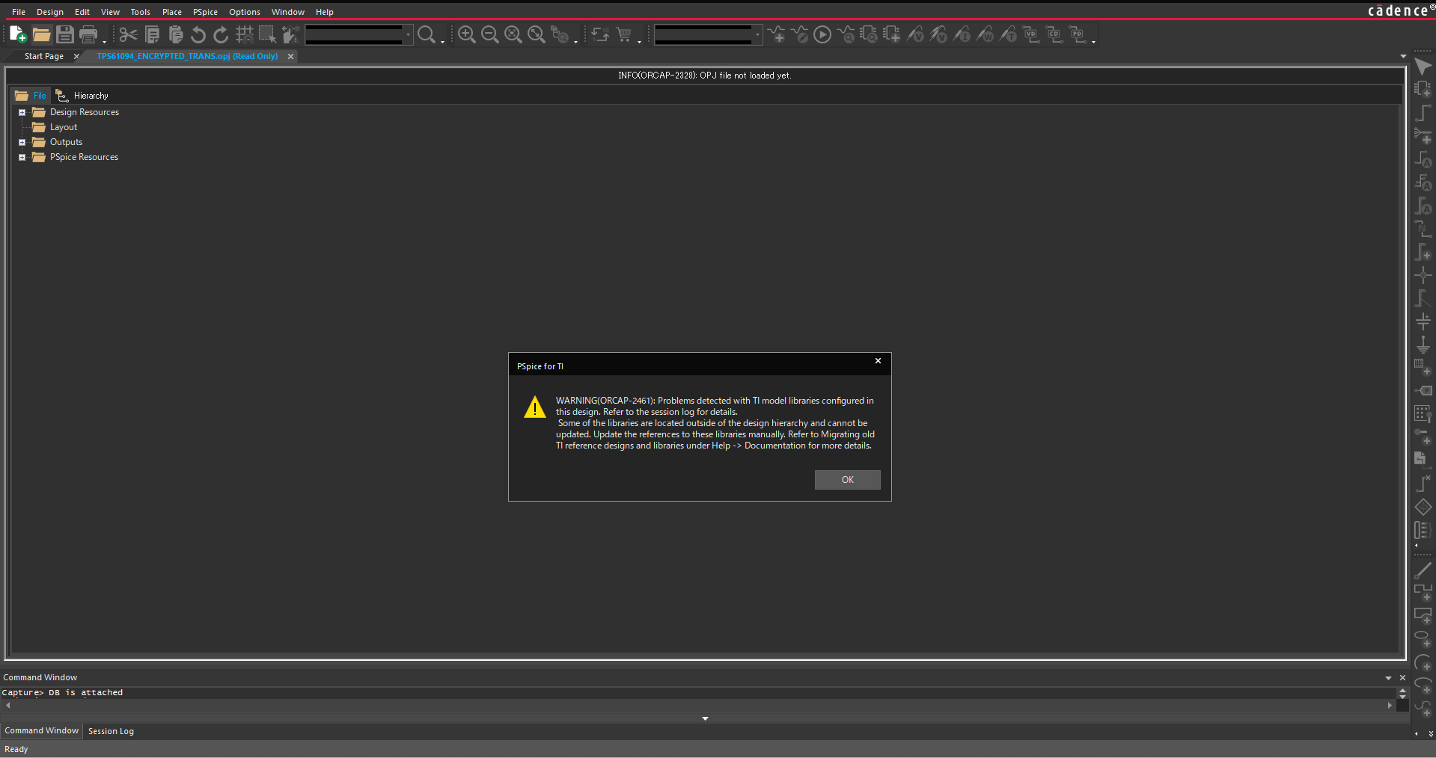
③ after the following error message appears, click OK

Slide 4
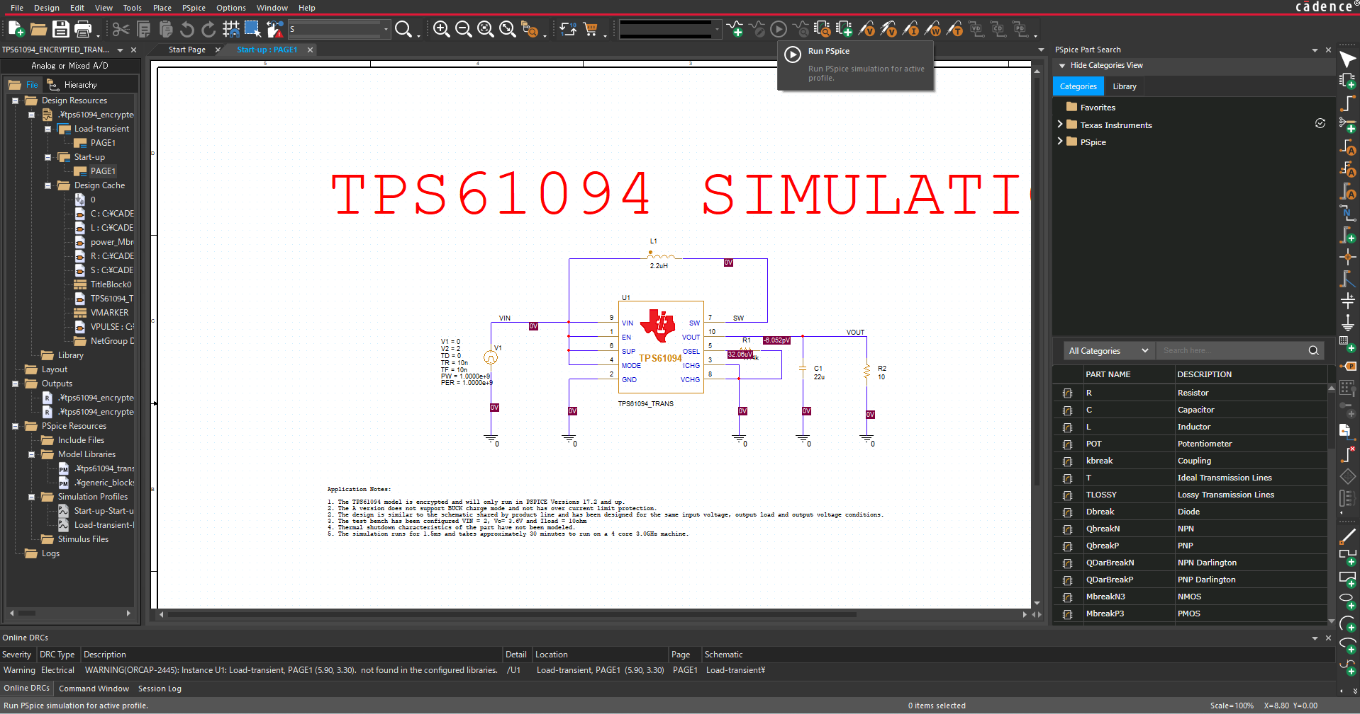
④ Double-click Start-up PAGE1 on the left to open the schematic, and after clicking Run Pspice, an error message#2 on next page is displayed.

Slide 5
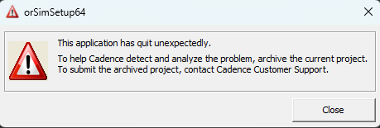
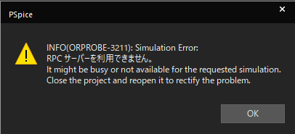
error message#2
After clocking “Close” above, the following error message is displaied.

