Slide 1
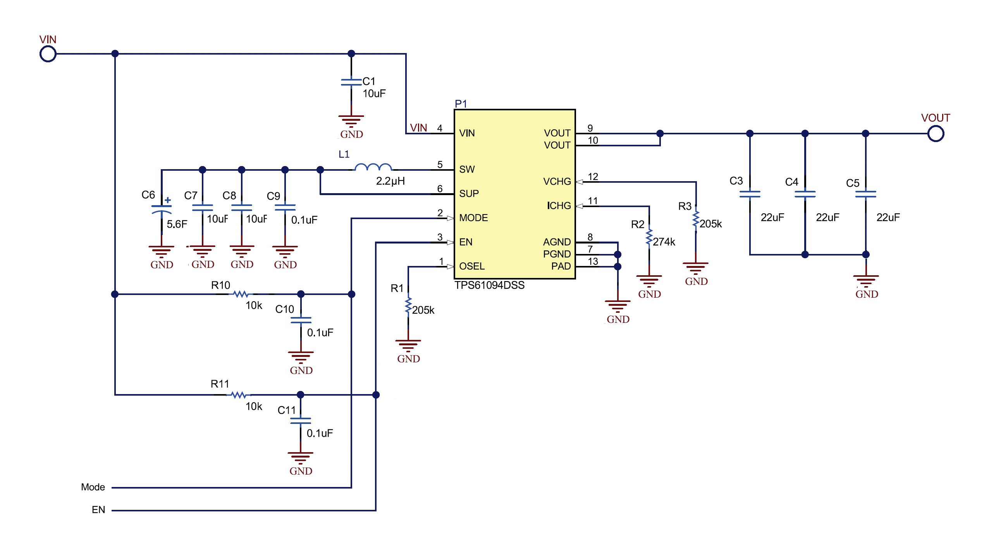
Request for TPS61094 circuit simulation
Circuit Diagram for simulation
VIN=5V
Vout=5V

Slide 2
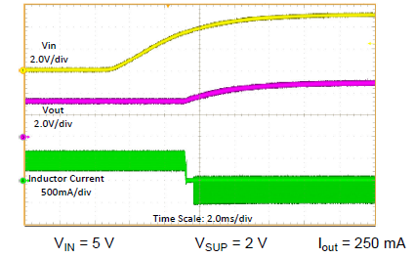
1. Startup (VIN startup)
VIN=5V
Rise time: 3.2ms
VIN
Acquired waveform image
Vout
Iout=0.5A
IL1

Slide 3
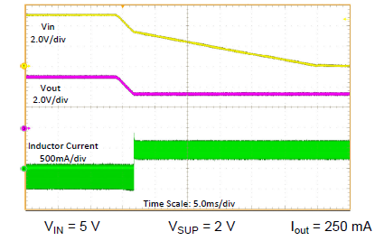
2. Stop (VIN stop)
VIN
Acquired waveform image
VIN=5V
Falling Time: 6ms, 200us
Vout
Iout=0.5A
IL1

Slide 4
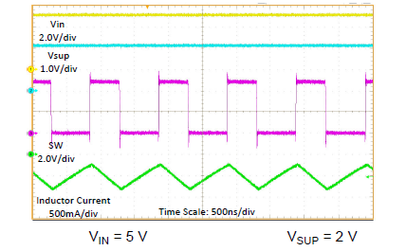
3. Switching operation
VIN
Acquired waveform image
VIN=5V
VSW
Iout=0.5A
IL1
VSUP

Slide 5
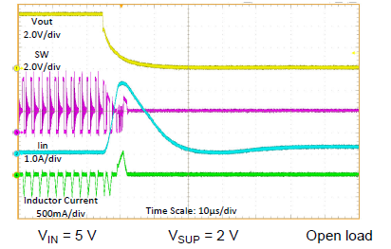
4. Output short Protection (Entry)
Acquired waveform image
VIN=5V
Iin
Vout
Iout=0A
-> short circuit
VSW
IL1

Slide 6
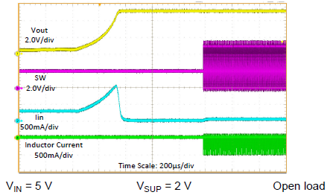
5. Protection Operation (Output short Protection: Recover)
Acquired waveform image
VIN=5V
Iin
Vout
Iout = short -> 0A
VSW
IL1

Slide 7
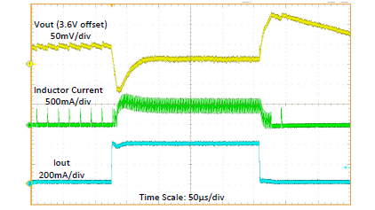
6. Sudden change in load
VIN=5V
Acquired waveform image
Vout
Iout=0 ← -> 0.5A
Time: 10us
Iout
IL1

Slide 8
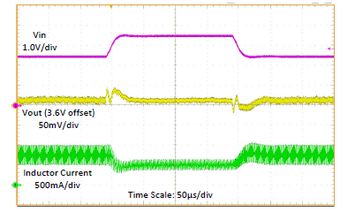
7. Sudden input change
VIN = 5V +/- 0.5V
Abrupt Time: 40us
Acquired waveform image
VIN
Vout
Iout=0.5A
IL1

