Slide 1
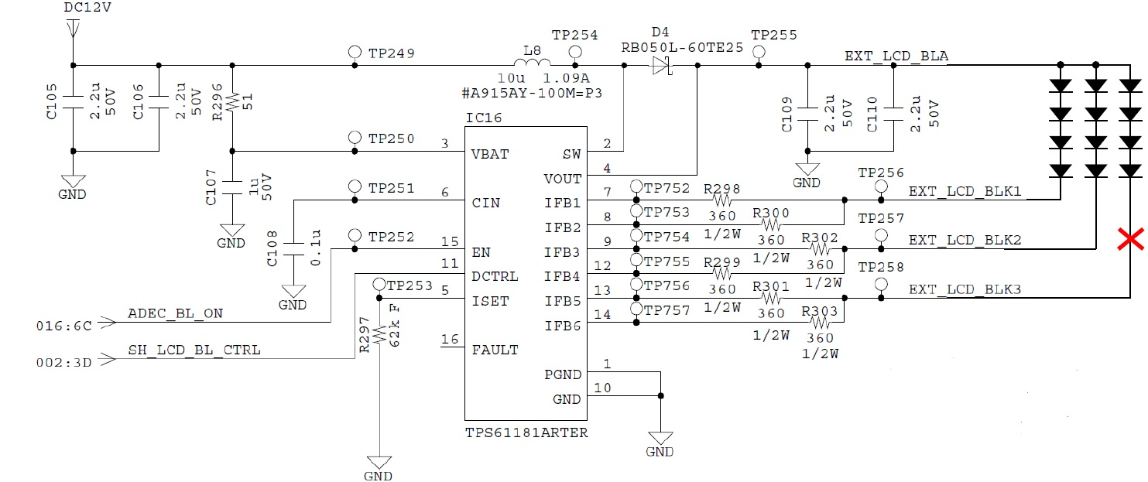
TPS61181ARTER open test (schematic)
Intended open to functional check

Slide 2
TPS61181ARTER open test (waveform)
EN = H
CH1 : TP258 voltage
CH2 : TP258 current
(actually 0 amps)
CH3 : TP257 voltage
CH4 : TP257 current

Slide 3
Inquiry
1. In the datasheet p.11, we can see as bellow.
Does it mean that when an open string is exists, however, the rest strings are still on, isn’t it ?
2. If 1. is yes, the waveform in previous slide looks different from the description in the datasheet.
Could you guess the reason why ?

