Slide 1
TPS62056 Schematic/Layout Review
TI
2/28/2023

Slide 2
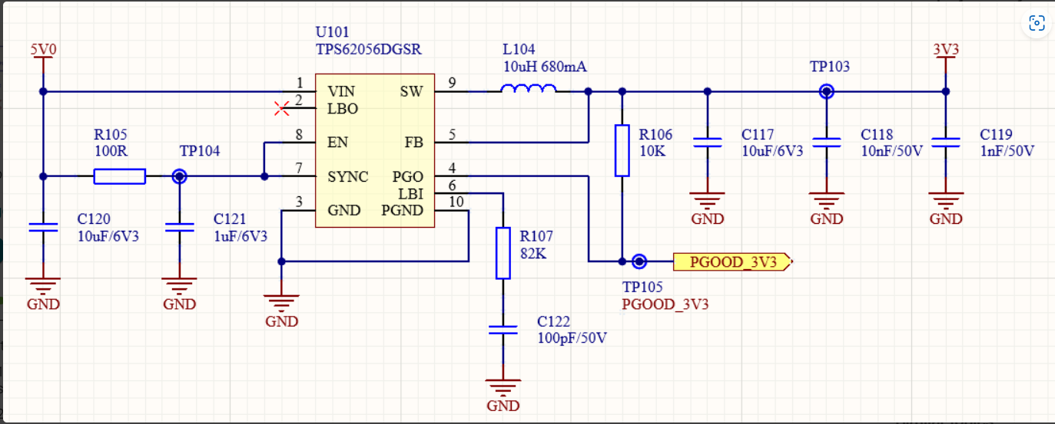
Schematic: Non-pop C121, R107 and C122

Slide 3
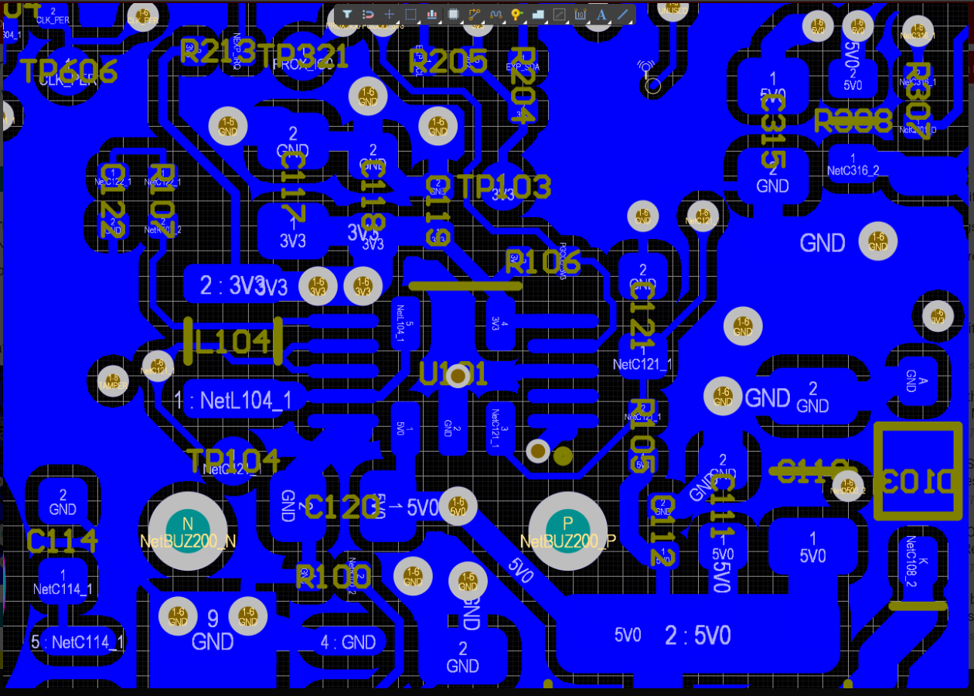
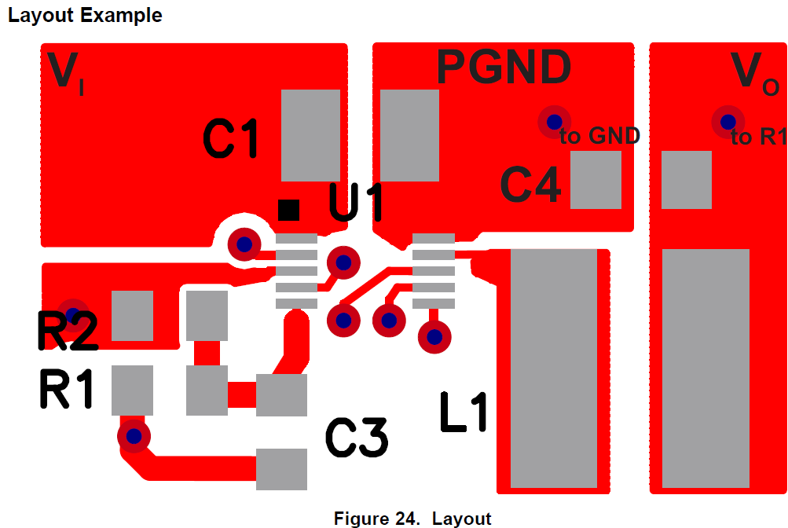
PCB layout top layer: Very poor and didn’t follow our layout example in the datasheet as right side
Input cap C120 must be placed between Pin1 and Pin 10 directly. Long trace with vias to pin1 will cause abnormal.
Output cap C117/C118/C119 GND must be connected to Pin GND directly. Too long GND connection may cause issue. Refer to example.
Delete the connection from SW to the middle of device and other X area (don’t know why have those connections)

Slide 4
PCB layout top layer: Very poor and didn’t follow our layout example in the datasheet as right side
Cut the trace as below. Why does this trace connect to that pad? This trace is too close to Vin pin. Vin pin is very noisy.
This connection may make SYNC coupling some noises. Disconnect it and try.

