Slide 1
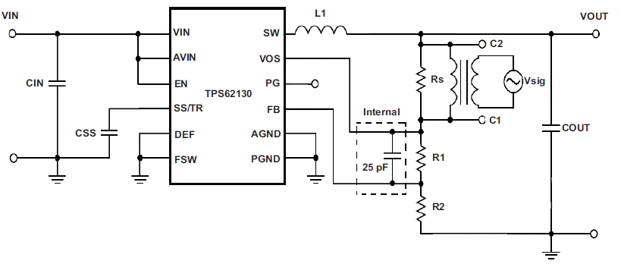
Loop gain measurement of DCS Control Device
1
2
3

Slide 2
1.TPS62080A 1.1Vout @ 5VIN
#1 Layer
#1 + #3 Layers overlap
SW
PG
VIN
VOS
FB
GND
MODE
EN

Slide 3
1.TPS62080A 1.1Vout @ 5VIN
#1 + #3 Layers overlap
VOS
My comment is
*PG line should avoid SW area due to switching noise.
Is VOS line OK?

Slide 4
2.TPS62080A 3.3Vout @ 5VIN
#1 Layer
#1 + #3 Layers overlap
PG
SW
VIN
VOS
FB
EN
GND
MODE

Slide 5
2.TPS62080A 3.3Vout @ 5VIN
#1 + #3 Layers overlap
Need check this line
Due to cross SW pattern
My comment is
*PG line should avoid SW area due to switching noise.
Is there any comment?

Slide 6
3.TPS62080A 1.8Vout @ 5VIN
#1 Layer
#1 + #3 Layers overlap
PG
SW
VIN
VOS
FB
EN
GND
MODE

Slide 7
3.TPS62080A 1.8Vout @ 5VIN
#1 + #3 Layers overlap
My comment is
*Nothing especially

Slide 8
4.TPS62080A 1.15Vout @ 5VIN
#1 Layer
#1 + #3 Layers overlap
PG
SW
VIN
VOS
FB
EN
GND
MODE

Slide 9
4.TPS62080A 1.15Vout @ 5VIN
#1 + #3 Layers overlap
My comment is
*PG line should avoid SW area due to switching noise.
Is there any comment?

