Slide 1
TPS62160 Inverting application issue from E2E
TI
8/17/2021

Slide 2
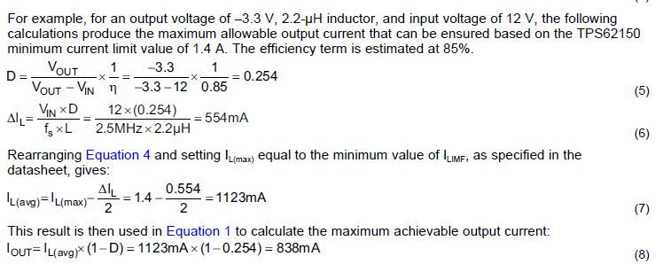
TPS62160 Inverting Max achievable output current
Based on the equation 5-8 in application note SLVA469C
3.3Vin | -5.5Vout
Fsw | 2.25MHz
L | 2.2uH
Ilmax for Buck | 1.45A highside 1.2A low side
Eff | 0.85
D | 0.735
Delta I | 490mA
Il(ave) | 955mA
Ioutmax | 253mA
Soft start | 25mV/us

Slide 3
TPS62160 Inverting soft start inrush current
Soft start slew rate is 25mV/us from TPS62160 datasheet page 11 (section 8.4.1)
Output ceramic caps: 4x22uF+1x47uF=135uF
Based on i=Cdu/dt= 135uFx25mV/us=3.375A roughly
So during soft start: 3.375A inrush current triggers the OCP and causes output could not reach -5.5V
Customer addED 85mA load, the output voltage gets even lower -1V
Suggestion: Reduce output cap to 1x22uF to see if it can improve.

Slide 4
Important Notice and Disclaimer
TI PROVIDES TECHNICAL AND RELIABILITY DATA (INCLUDING DATASHEETS), DESIGN RESOURCES (INCLUDING REFERENCE DESIGNS), APPLICATION OR OTHER DESIGN ADVICE, WEB TOOLS, SAFETY INFORMATION, AND OTHER RESOURCES “AS IS” AND WITH ALL FAULTS, AND DISCLAIMS ALL WARRANTIES, EXPRESS AND IMPLIED, INCLUDING WITHOUT LIMITATION ANY IMPLIED WARRANTIES OF MERCHANTABILITY, FITNESS FOR A PARTICULAR PURPOSE OR NON-INFRINGEMENT OF THIRD PARTY INTELLECTUAL PROPERTY RIGHTS.
These resources are intended for skilled developers designing with TI products. You are solely responsible for (1) selecting the appropriate TI products for your application, (2) designing, validating and testing your application, and (3) ensuring your application meets applicable standards, and any other safety, security, or other requirements.
These resources are subject to change without notice. TI grants you permission to use these resources only for development of an application that uses the TI products described in the resource. Other reproduction and display of these resources is prohibited. No license is granted to any other TI intellectual property right or to any third party intellectual property right. TI disclaims responsibility for, and you will fully indemnify TI and its representatives against, any claims, damages, costs, losses, and liabilities arising out of your use of these resources.
TI’s products are provided subject to TI’s Terms of Sale or other applicable terms available either on ti.com or provided in conjunction with such TI products. TI’s provision of these resources does not expand or otherwise alter TI’s applicable warranties or warranty disclaimers for TI products.

