Slide 1
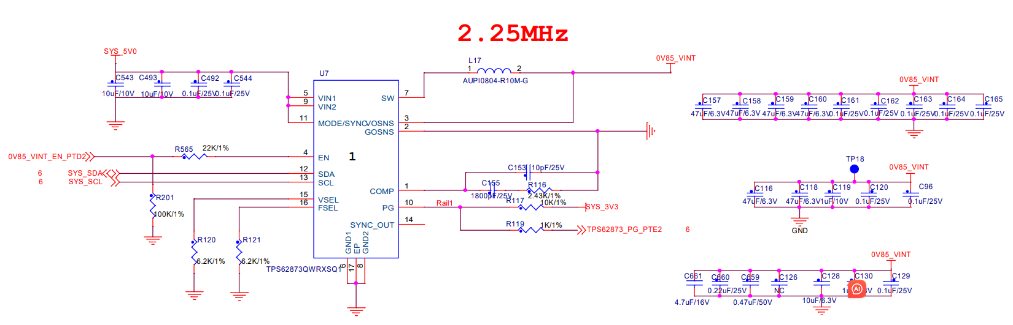
TPS62873-Q1

Slide 2
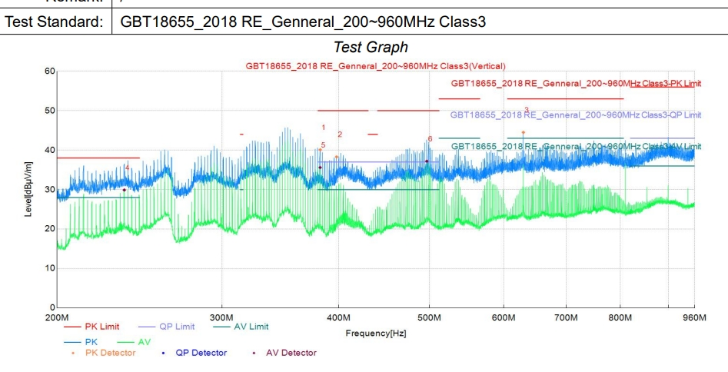

Slide 3
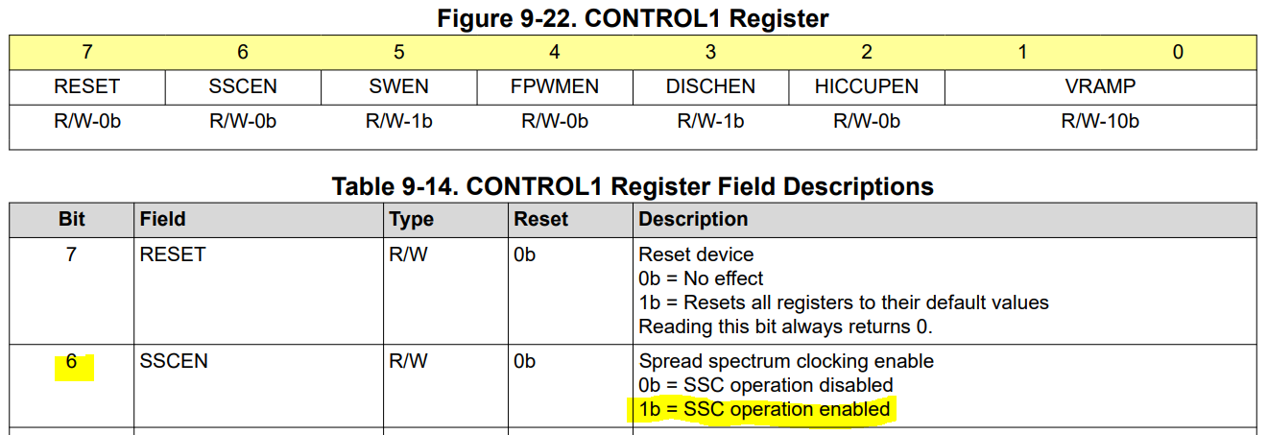
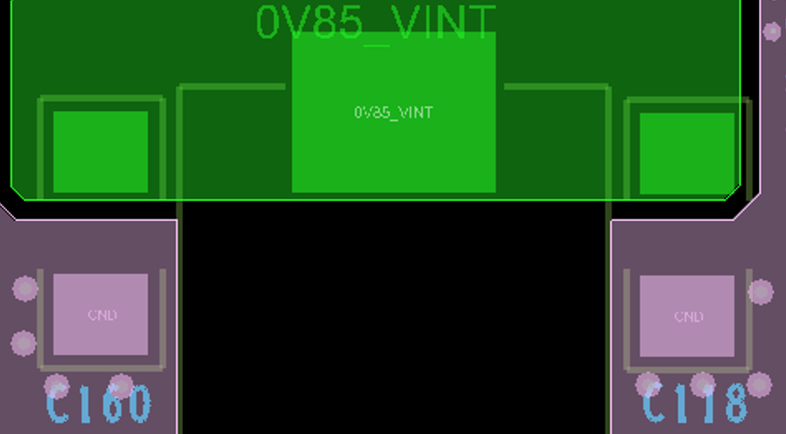
Comments
Enable Spread Spectrum Clocking
  Change Control1 Register, bit [6] to 1b
Change C492 & C544 to 0.47uF
Place 0.47uF close to C160 and C118
0.47uF
0.47uF

