Slide 1
TPS62903 Layout Review
Nancy
11/15/2021

Slide 2
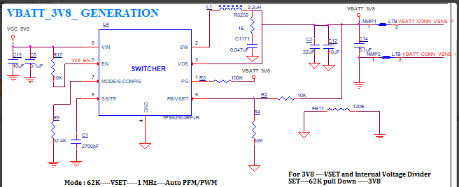
New schematic:
Move snubber to the lest side of inductor. It should be on SW, not Vout.
Remove FB17, we don’t recommend separate AGND and PGND. The GND of input and output must be shortest loop connected together. Please make sure adding FB17 is working properly before changing the layout.
Increase C13 from 10uF to 22uF, Change C5 from 0.1uF to 22uF. 10V or 16V voltage rating

Slide 3
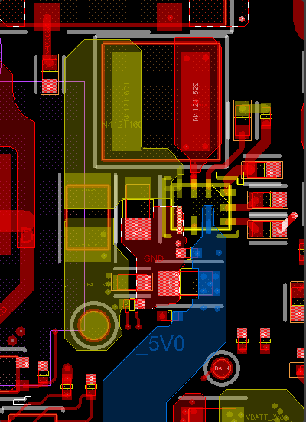
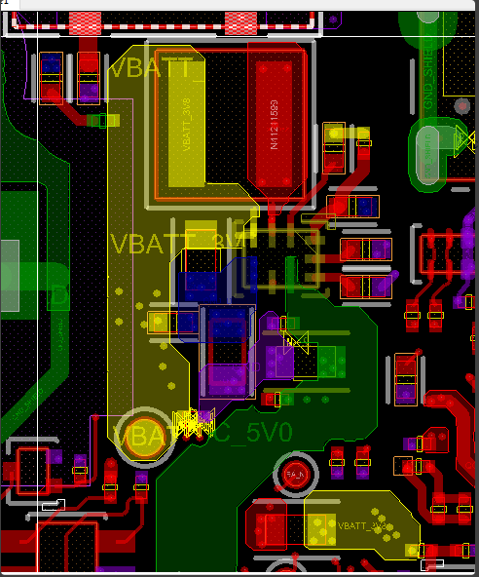
Update one:
Remove FB17. The GND of input and output must be shortest loop connected together.
Recommend go back to left side placement
Follow datasheet layout example
First sent image:
The placement looks good.
Please remove 5 vias on the copper of switching node. This may cause issue.
Why add those vias?
C13/C5 must close to Vin pin

