Slide 1
TPS63805 verus TPs63806

Slide 2
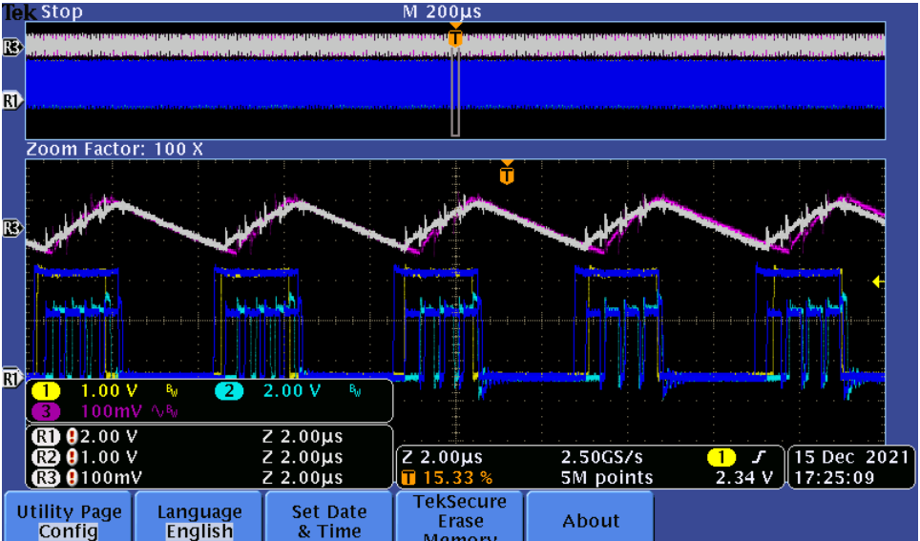
Bench test Vin=2.5V Iout=300mA Vout=3.3V
Almost no difference between them, ripple and switching node.
Notes:
When studying a converter schematic prior to PCB layout, it’s often convenient to highlight the high current traces, the high dv/dt circuit nodes, and the noise-sensitive nets as shown in this slide. This example shows a voltage-mode controlled regulator intended for noise-sensitive communications applications that uses TI’s LM5145 100V synchronous buck controller.
Various noise reduction features integrated in the LM5145 include external clock synchronization, internal oscillator. Pulse skipping at light loads is inhibited during synchronization or when the SYNCIN pin is pulled low to reduce noise and RF interference. For added reliability, the LM5145 is rated for negative SW and gate drive transients of -5V up to 20ns duration.

Slide 3
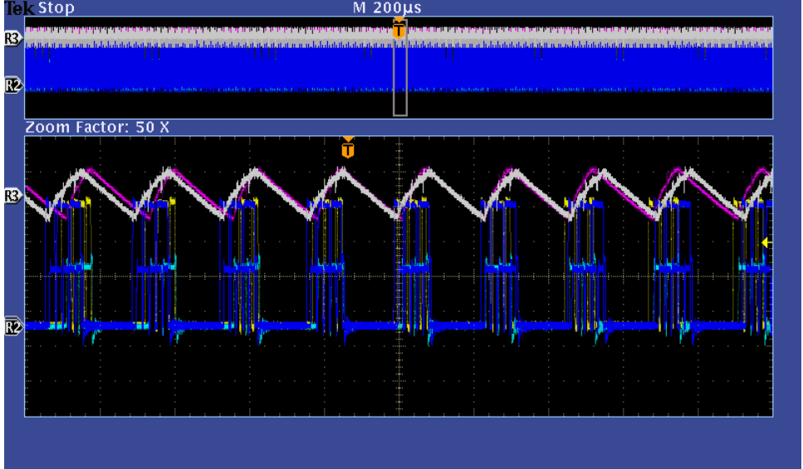
Bench test Vin=3.3V Iout=300mA Vout=3.3V
Almost no difference between them, ripple and switching node.
Notes:
When studying a converter schematic prior to PCB layout, it’s often convenient to highlight the high current traces, the high dv/dt circuit nodes, and the noise-sensitive nets as shown in this slide. This example shows a voltage-mode controlled regulator intended for noise-sensitive communications applications that uses TI’s LM5145 100V synchronous buck controller.
Various noise reduction features integrated in the LM5145 include external clock synchronization, internal oscillator. Pulse skipping at light loads is inhibited during synchronization or when the SYNCIN pin is pulled low to reduce noise and RF interference. For added reliability, the LM5145 is rated for negative SW and gate drive transients of -5V up to 20ns duration.

Slide 4
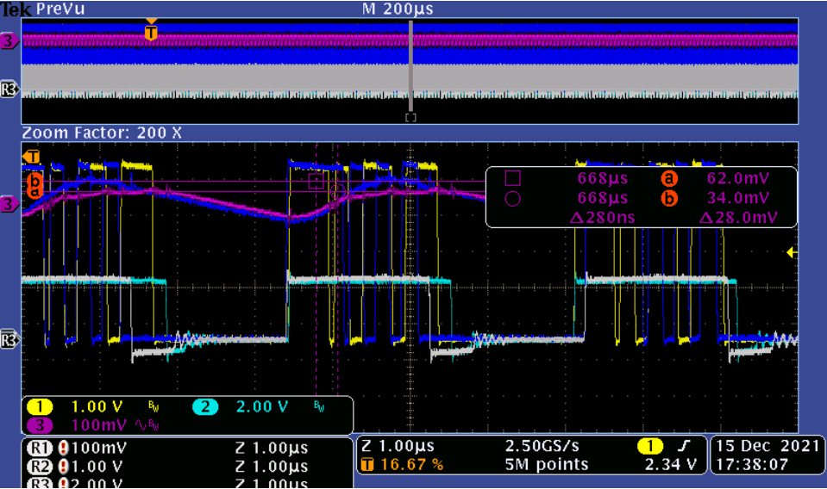
Bench test Vin=4.5V Iout=300mA Vout=3.3V
Ripple performance is little better(28mV) than TPS63806.
Notes:
When studying a converter schematic prior to PCB layout, it’s often convenient to highlight the high current traces, the high dv/dt circuit nodes, and the noise-sensitive nets as shown in this slide. This example shows a voltage-mode controlled regulator intended for noise-sensitive communications applications that uses TI’s LM5145 100V synchronous buck controller.
Various noise reduction features integrated in the LM5145 include external clock synchronization, internal oscillator. Pulse skipping at light loads is inhibited during synchronization or when the SYNCIN pin is pulled low to reduce noise and RF interference. For added reliability, the LM5145 is rated for negative SW and gate drive transients of -5V up to 20ns duration.

Slide 5
 | Switching frequency | Rise time | Fall time
TPS63805 | 360-530ns | 30.7ns | 28ns
TPS63806 | 261-740ns | 30.9ns | 28.8ns

