Slide 1
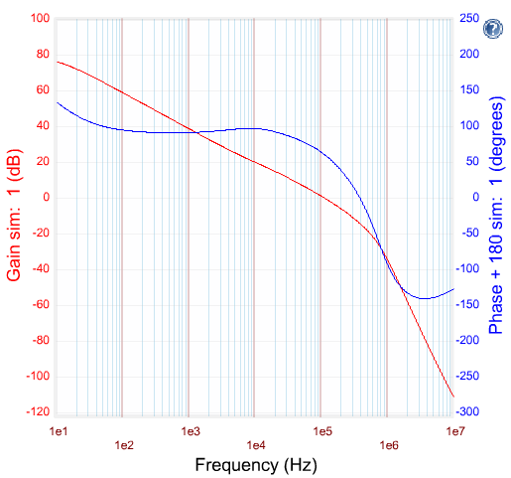

DCDC-1 data using 1.5uH

Slide 2

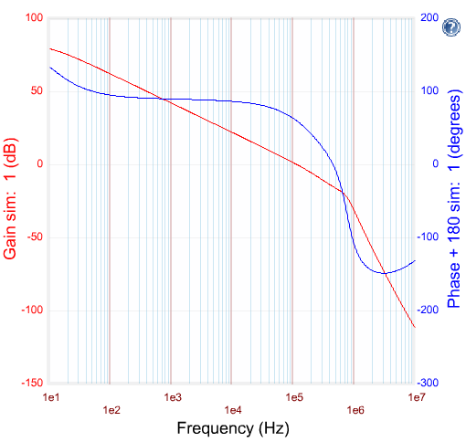
DCDC-2 data using 1.5uH

Slide 3
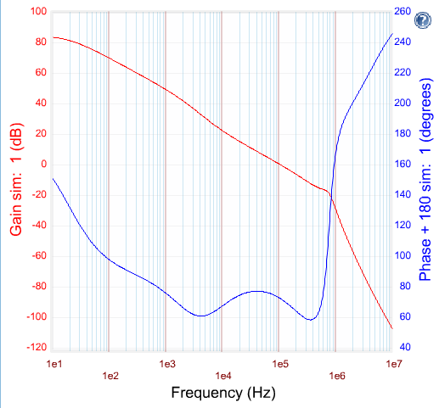


DCDC-3 data using 1.5uH

