Slide 1
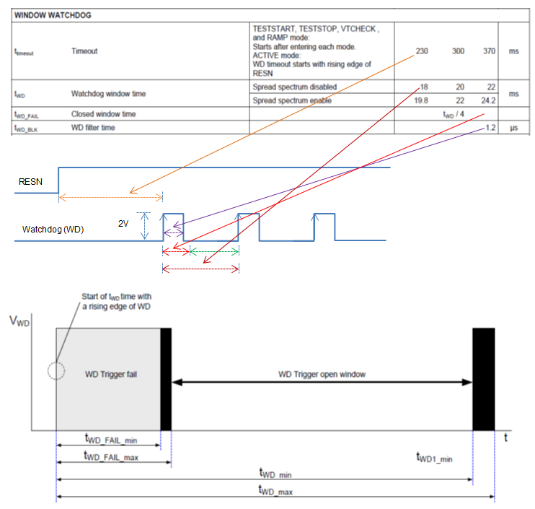
Watchdog
TPS65311-Q1 watchdog
Apply WD first pulse within 230mS after RESN goes high
Keep WD period to less than 18ms and more than 5.5ms
Keep the WD pulse width to more than 1.2us
WD signal should have VOL<0.3V and VOH>2.0V
For example, WD signal with 3.3V IO level and 15ms period with 5ms on time, will work provided this is applied within 230ms after RESN goes high.
When spread spectrum is enabled, watchdog timing requirements will change slightly

Slide 2
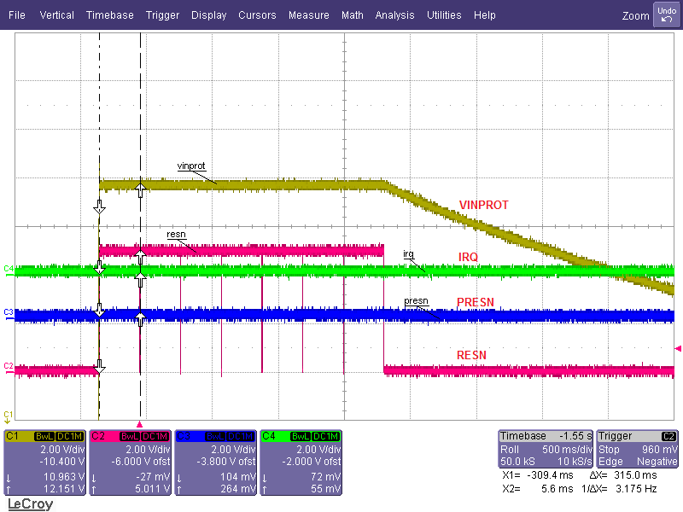
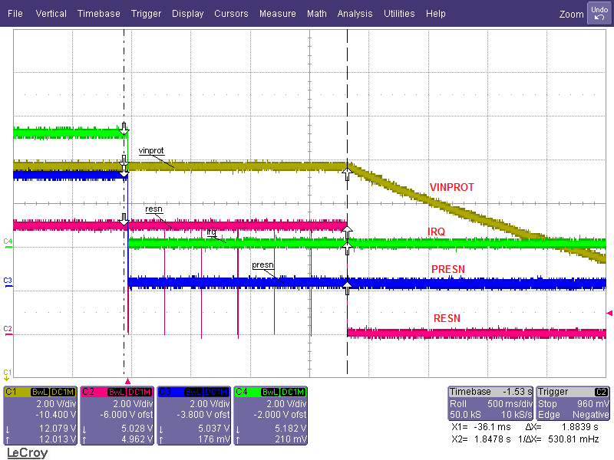
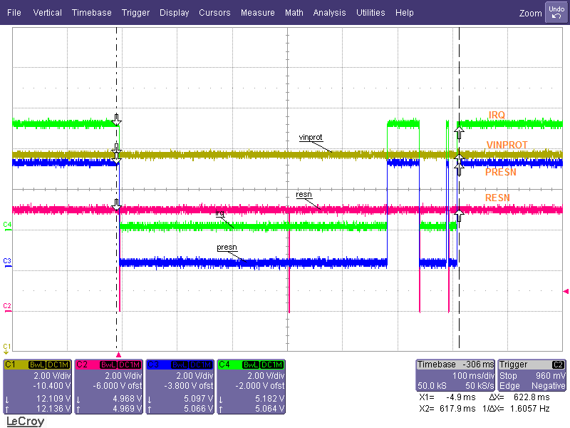
Status Pins: IRQ, RESN,PRESN. Watchdog pin dependency
Power up without WD signal Active to LPM0 after removing WD signal with EC=7 In Active after removing WD signal and reapplied before EC=7
During power up / or in active mode if WD is not applied, device goes in to LPM0 mode after EC=7. If WD is applied back before EC <7, device stays in Active Mode

Slide 3
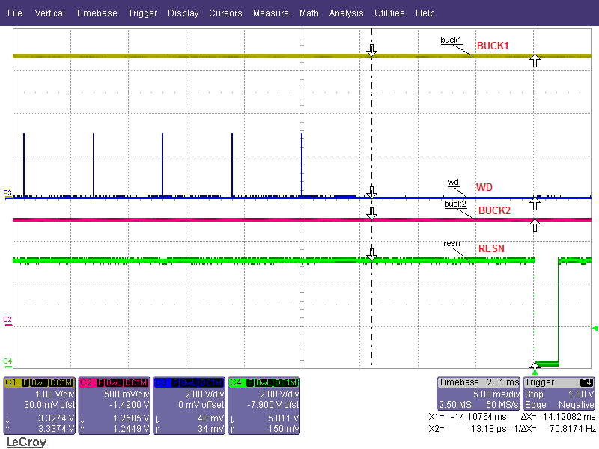
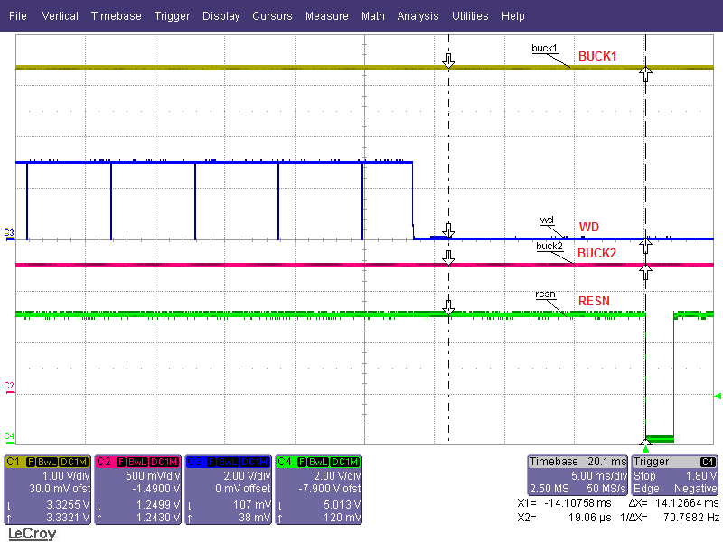
Status Pins: RESN. Watchdog pin dependency
Delay from missing WD pulse to RESN low. Here WD period ~ 6ms, very small pulse width
Delay from missing WD pulse to RESN low. Here WD period ~ 6ms, very large pulse width
WD window time is 20ms-typ and hence device waited until it lapsed 20ms (~14ms+6ms). Approximate WD fail detection to RESN low is less than 1ms.
Also RESN Hold time (RESN Low duration) ~ 2ms

