Slide 1
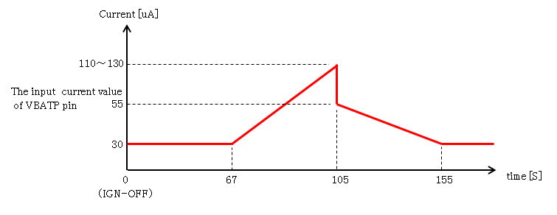

Slide 2
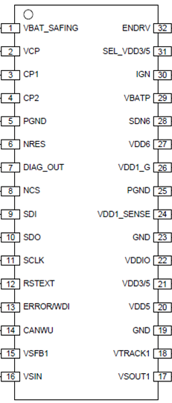
VBAT
A
MCU
CUT
13.5V
VBAT
MCU
VDD6
GND
VDD6
OPEN
GND
GND
GND
CUT
GND
GND

Slide 3
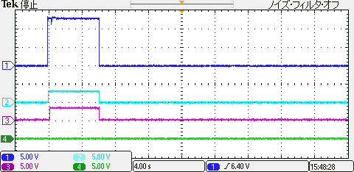
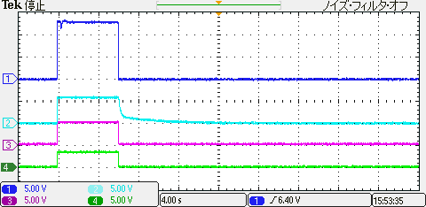
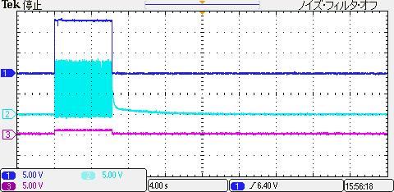
IGN
IGN
NRES
VDD6
ENDRV
VDD5
CANWU
VDD3
IGN
SDN6
VDD1_G

