Slide 1
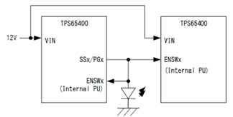
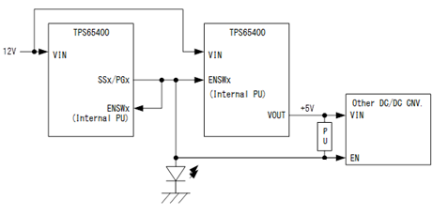
Q1. When they want to turn on the LED via SSx/PGx-pin, does the configuration as below work? Are there any ideas to turn on the LED via SSx/PGx-pin?
Q2. SSx/PGx-pin of TPS65400 is connected to other devices EN-pin(e.g. TPS53317, TPS74601). The below configuration is OK? And as well as Q1, are there any ways to turn on the LED?

