Slide 1
TPS65400EVM Interface with GUI
-With PI-Commander-PMU Software

Slide 2
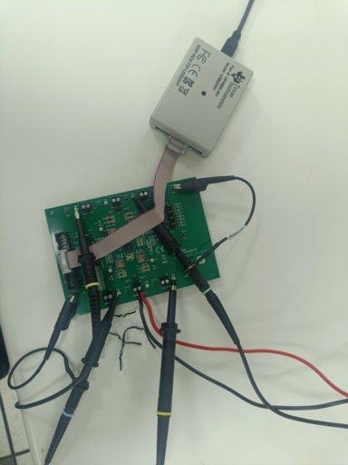
SETUP
Install PI-Commander-PMU Software from SLVC603 GUI for evaluation module (EVM) | TI.com
Make sure connections are accurate

Slide 3
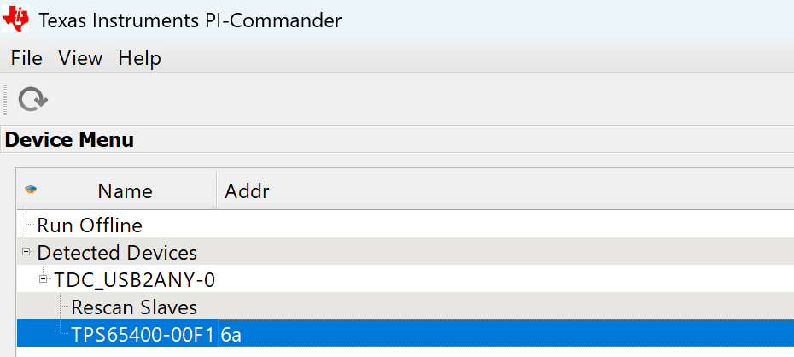
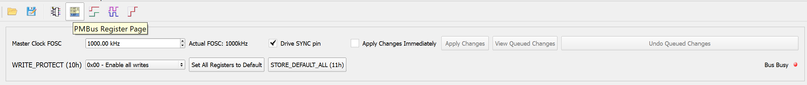
Software settings
After Installing the software and connecting the setup you will see a dialog box
Select TPS65400-00F1 6a
Then click on PMBus Register Page
Choose sync clock frequency and sync clock to EVM by clicking on the dialog box Drive SYNC pin
Click set all registers to default and write all changes to EEPROM

Slide 4
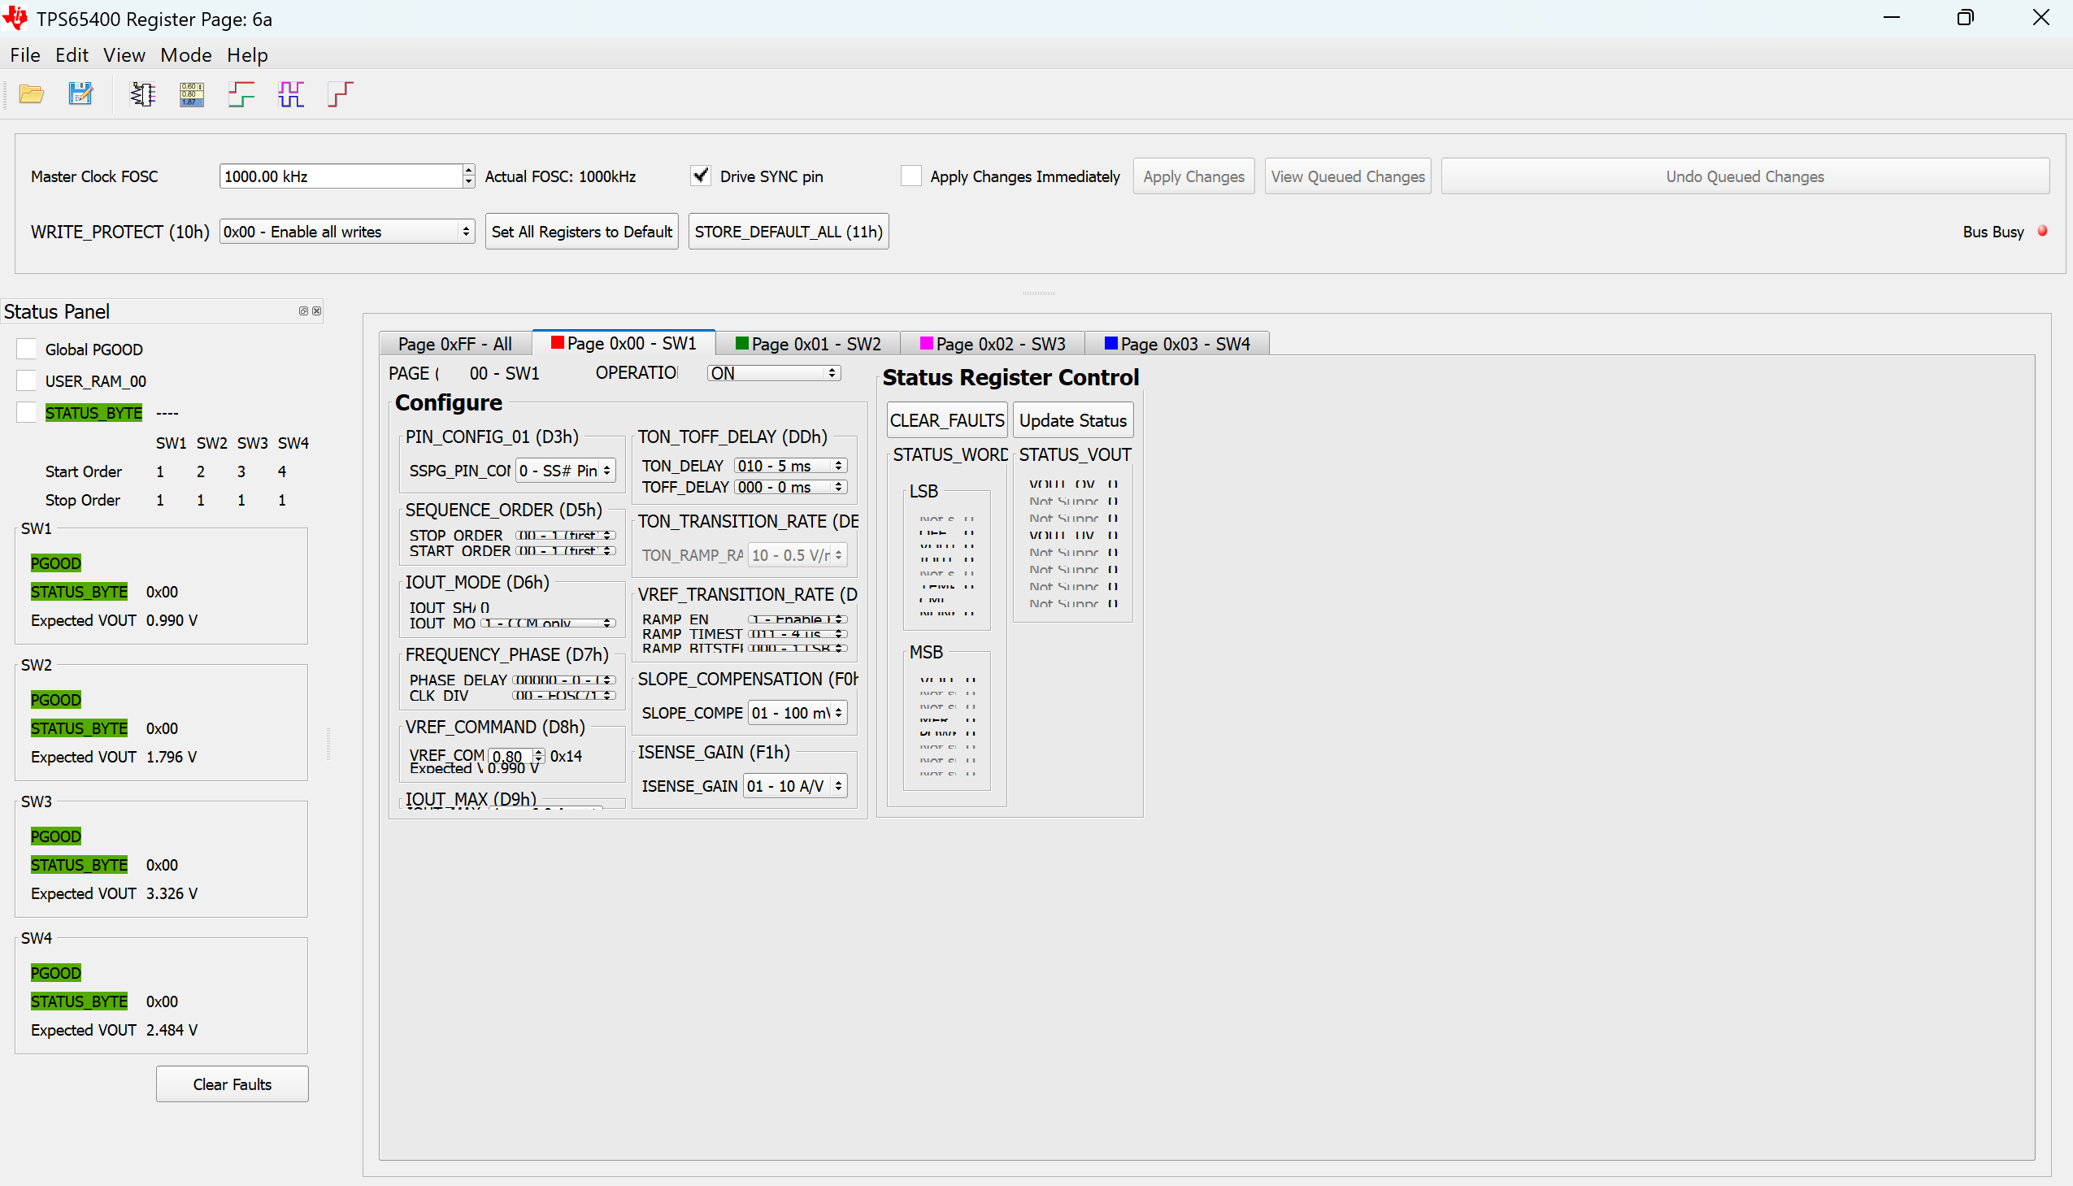
Register page settings

Slide 5
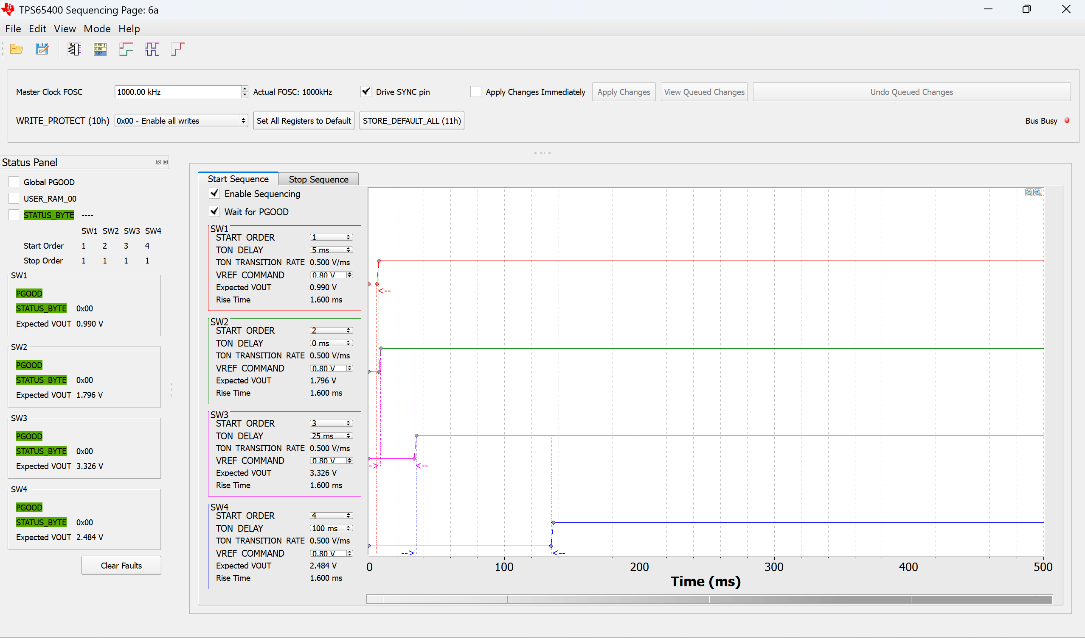
Sequencing page settings
Set the delays and voltages as shown and then click apply changes

Slide 6
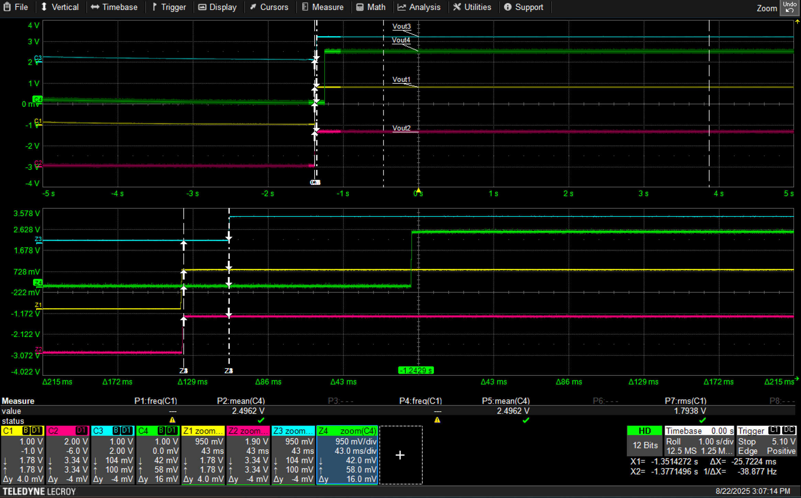
Output voltage waveforms
We can see that delay between Vout2 and Vout1 is 0ms and delay between Vout3 and Vout1 is 25ms

Slide 7
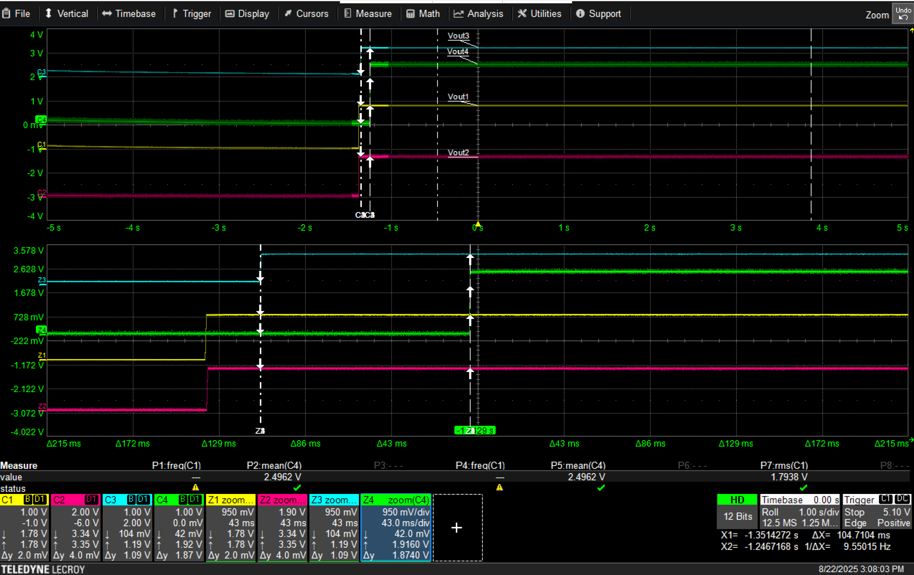
Output voltage waveforms
We can see that delay between Vout3 and Vout4 is 100ms

