Slide 1
TPS6590377ZWSR Not Output Power Issue
18/07/2022

Slide 2
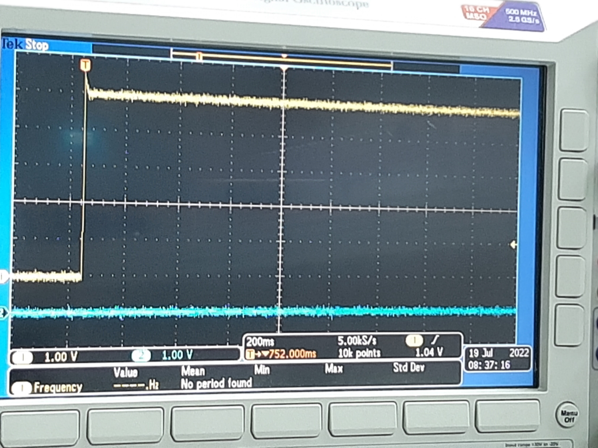
POWERGOOD

Slide 3
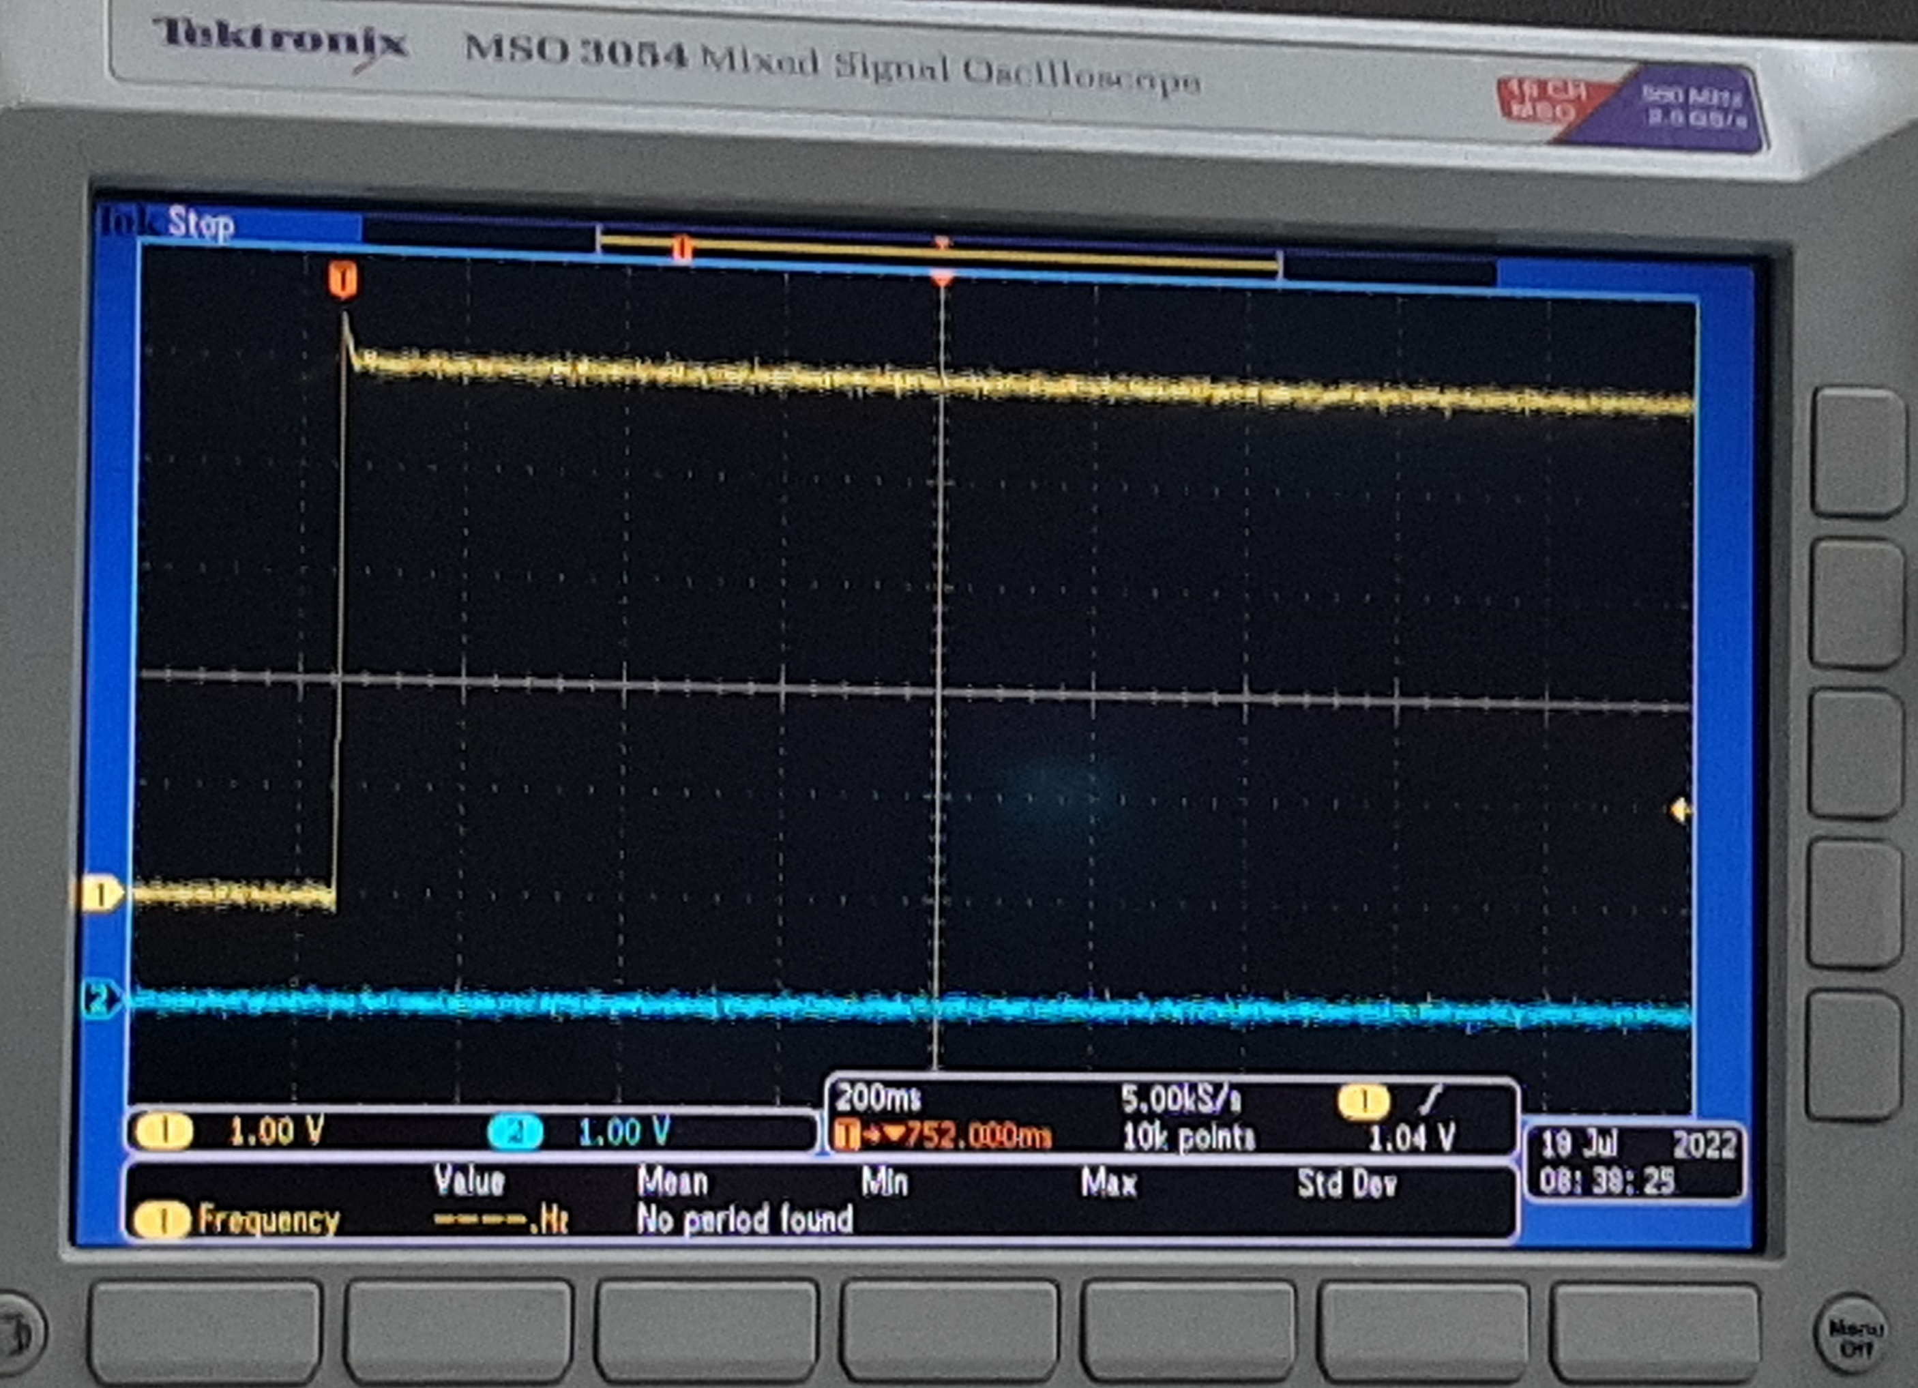
REGEN1

Slide 4
RESET_IN

Slide 5
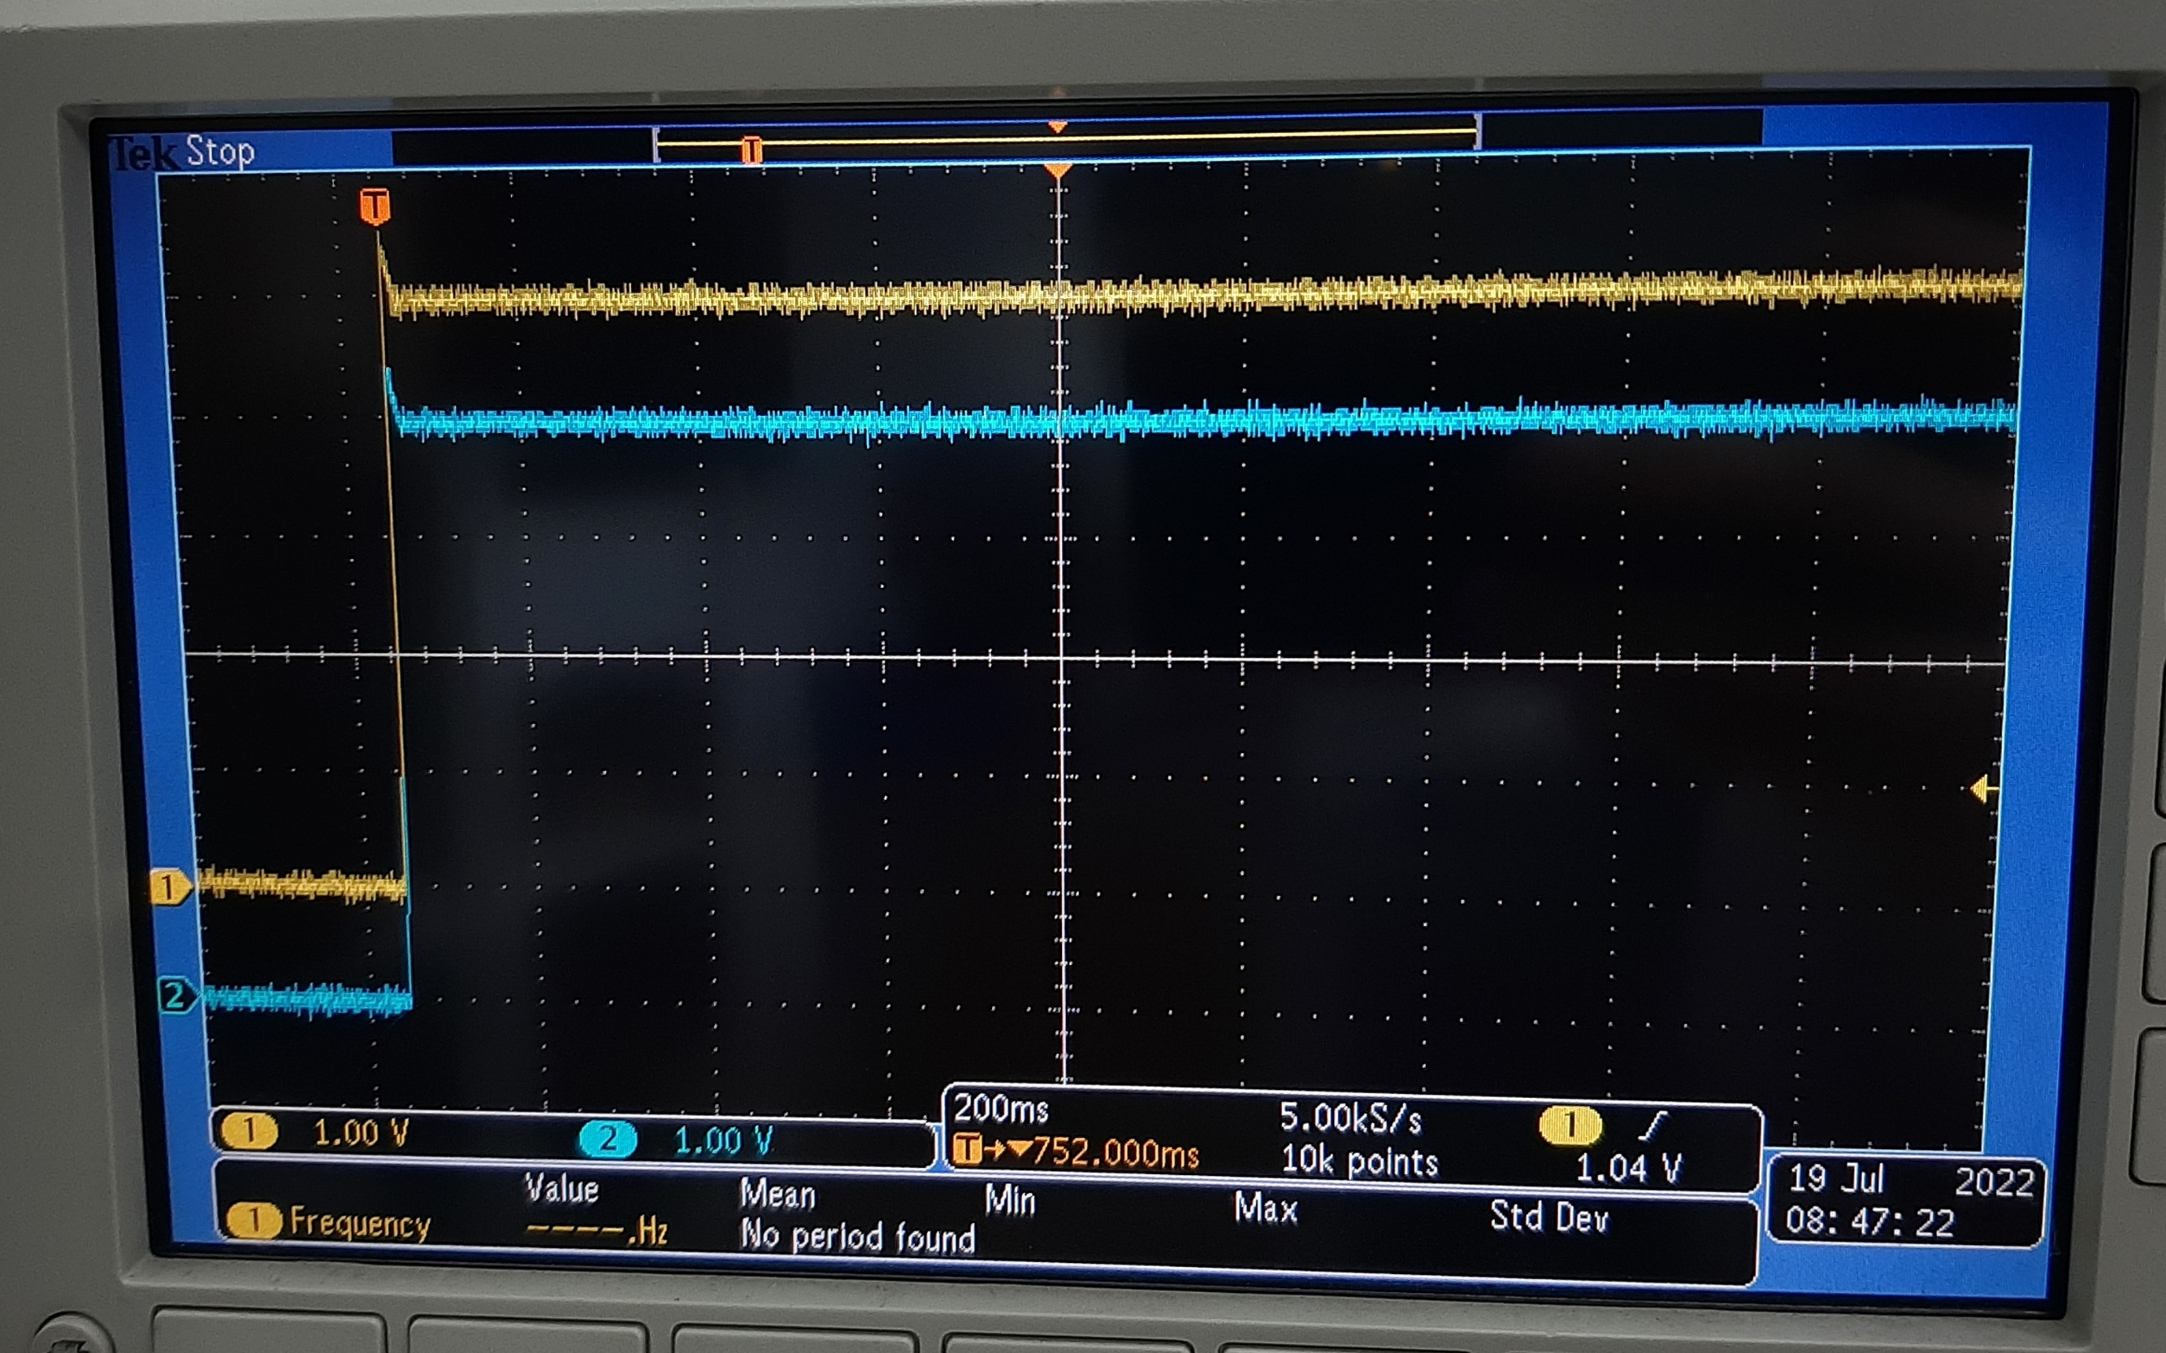
RPWRON

Slide 6
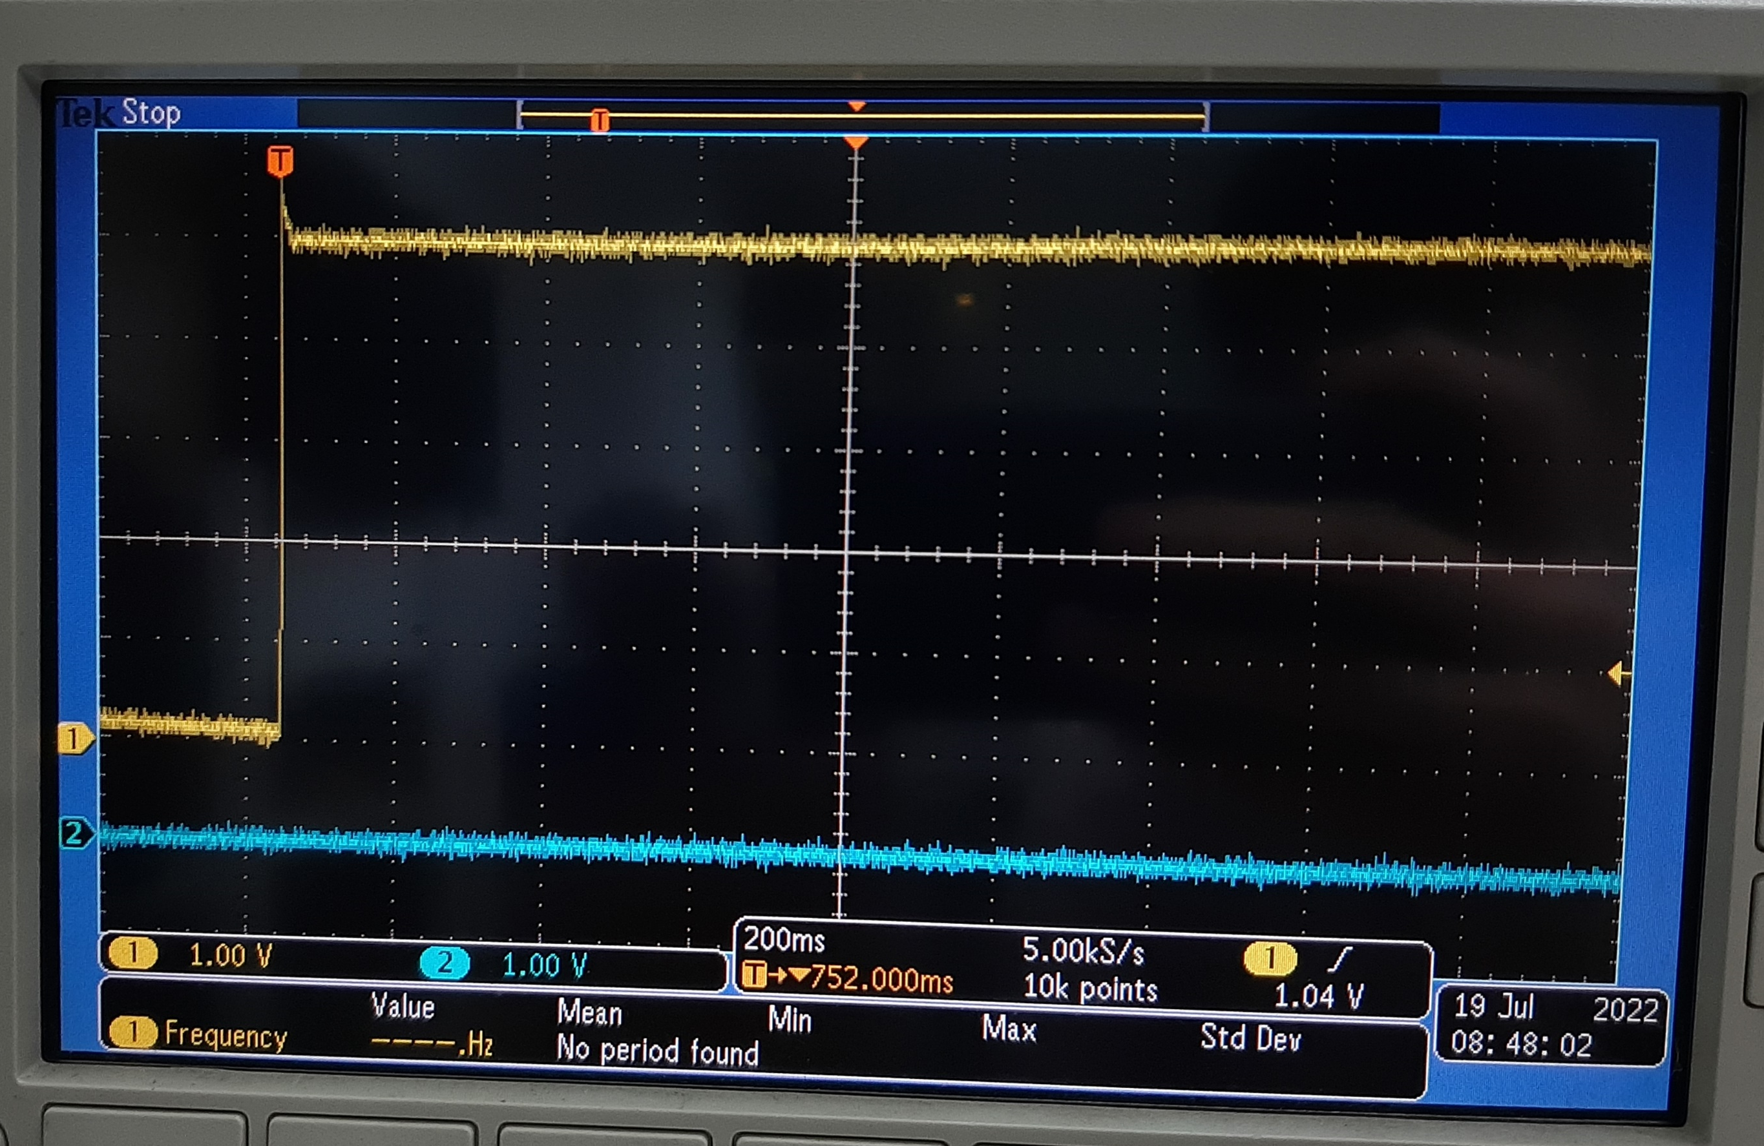
ENABLE1

Slide 7
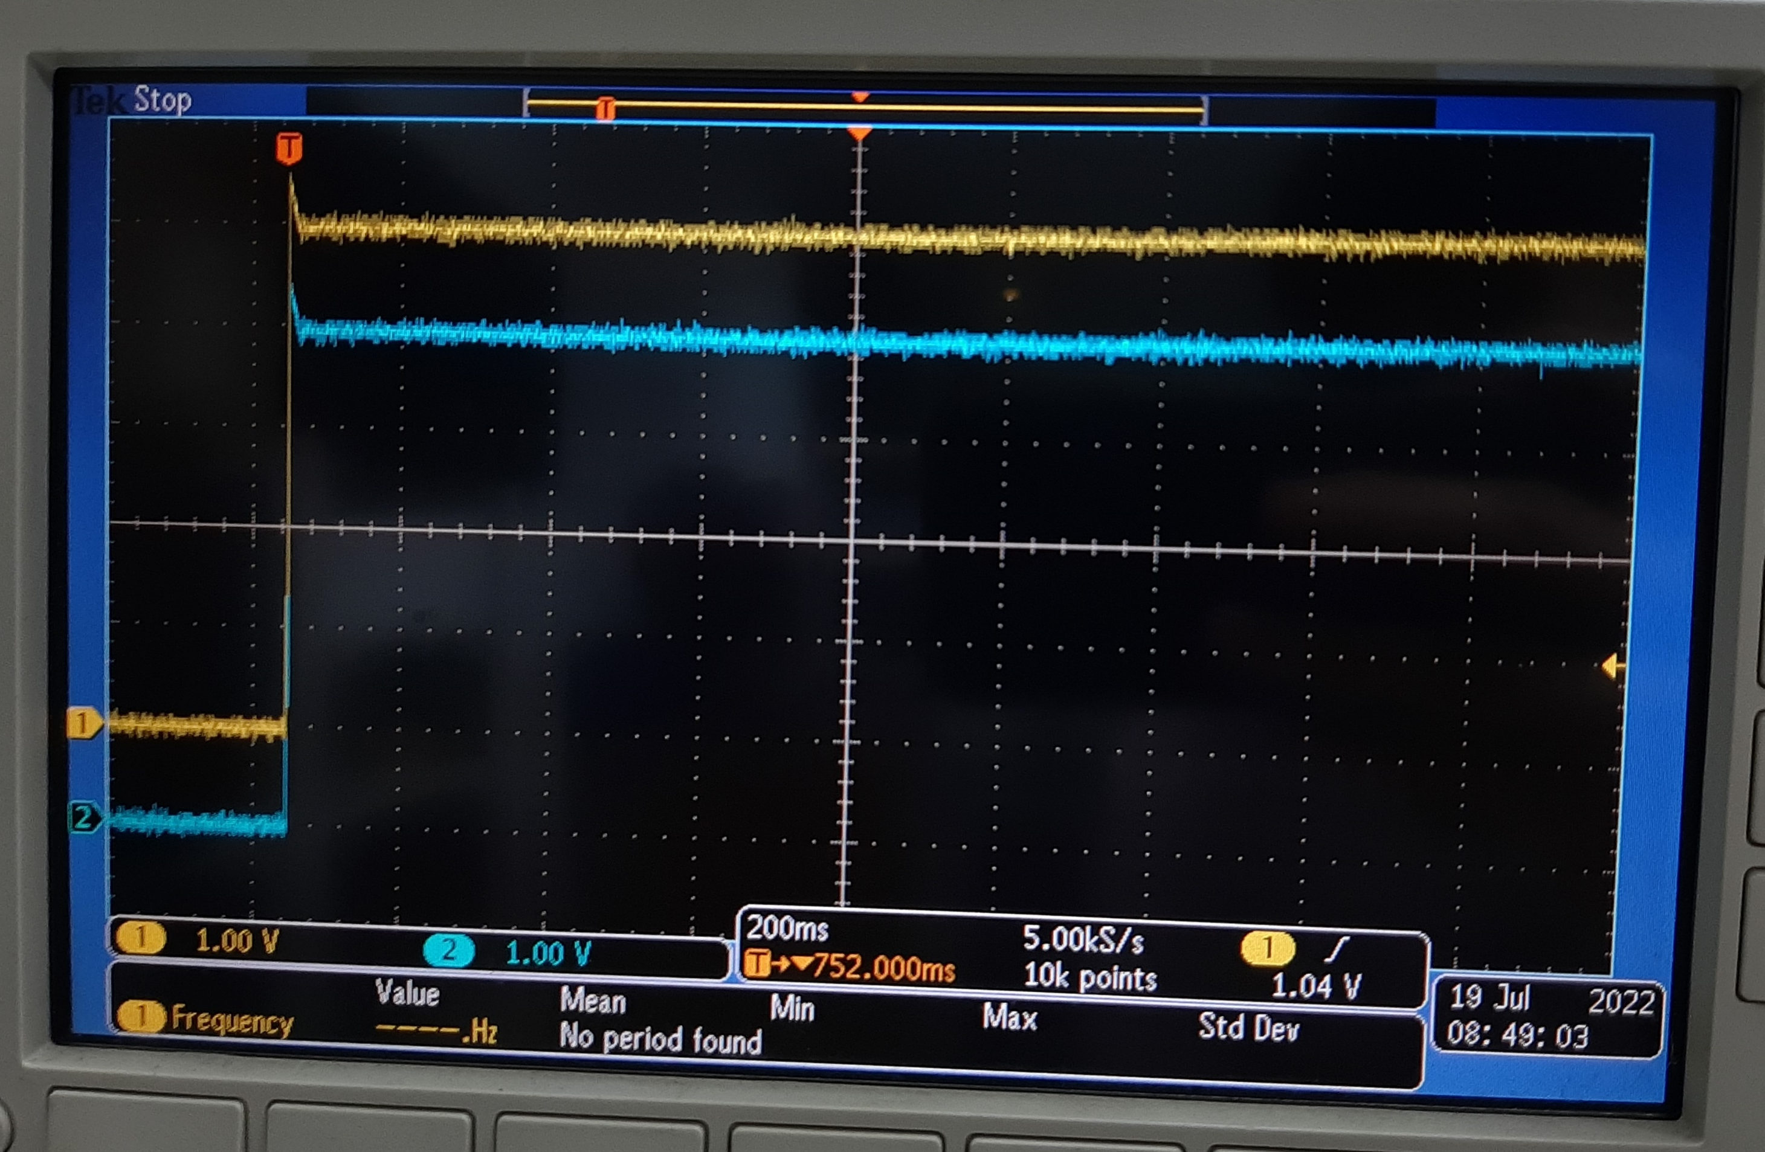
PWRON

Slide 8
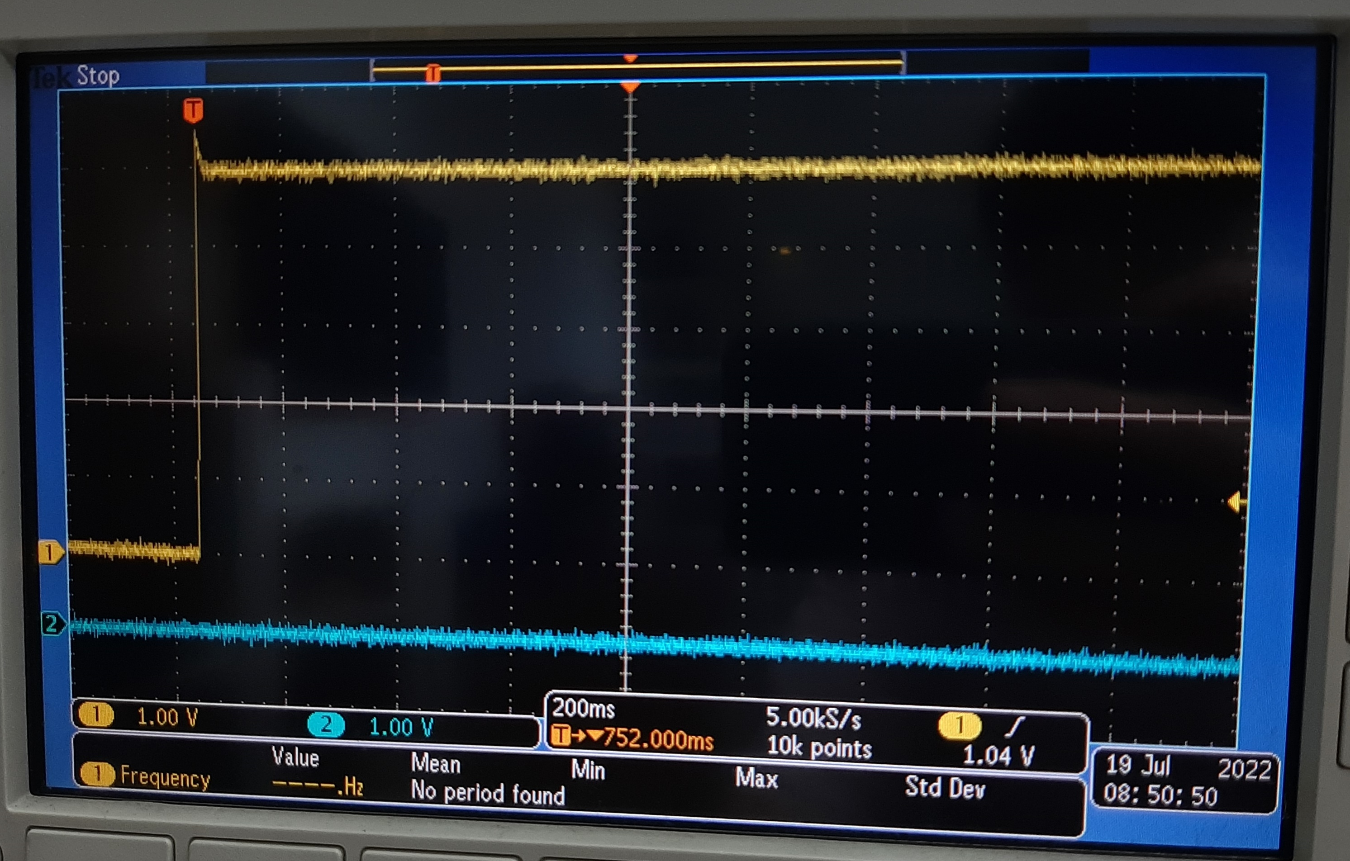
BOOT0

Slide 9
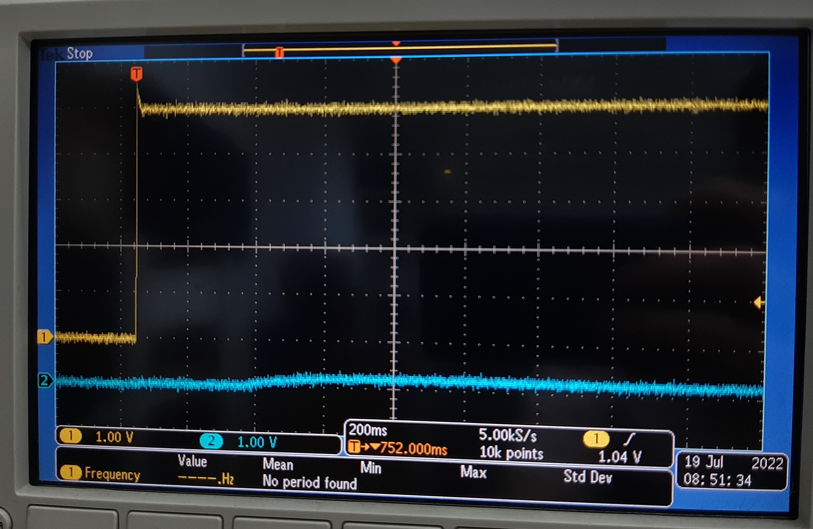
BOOT1

Slide 10
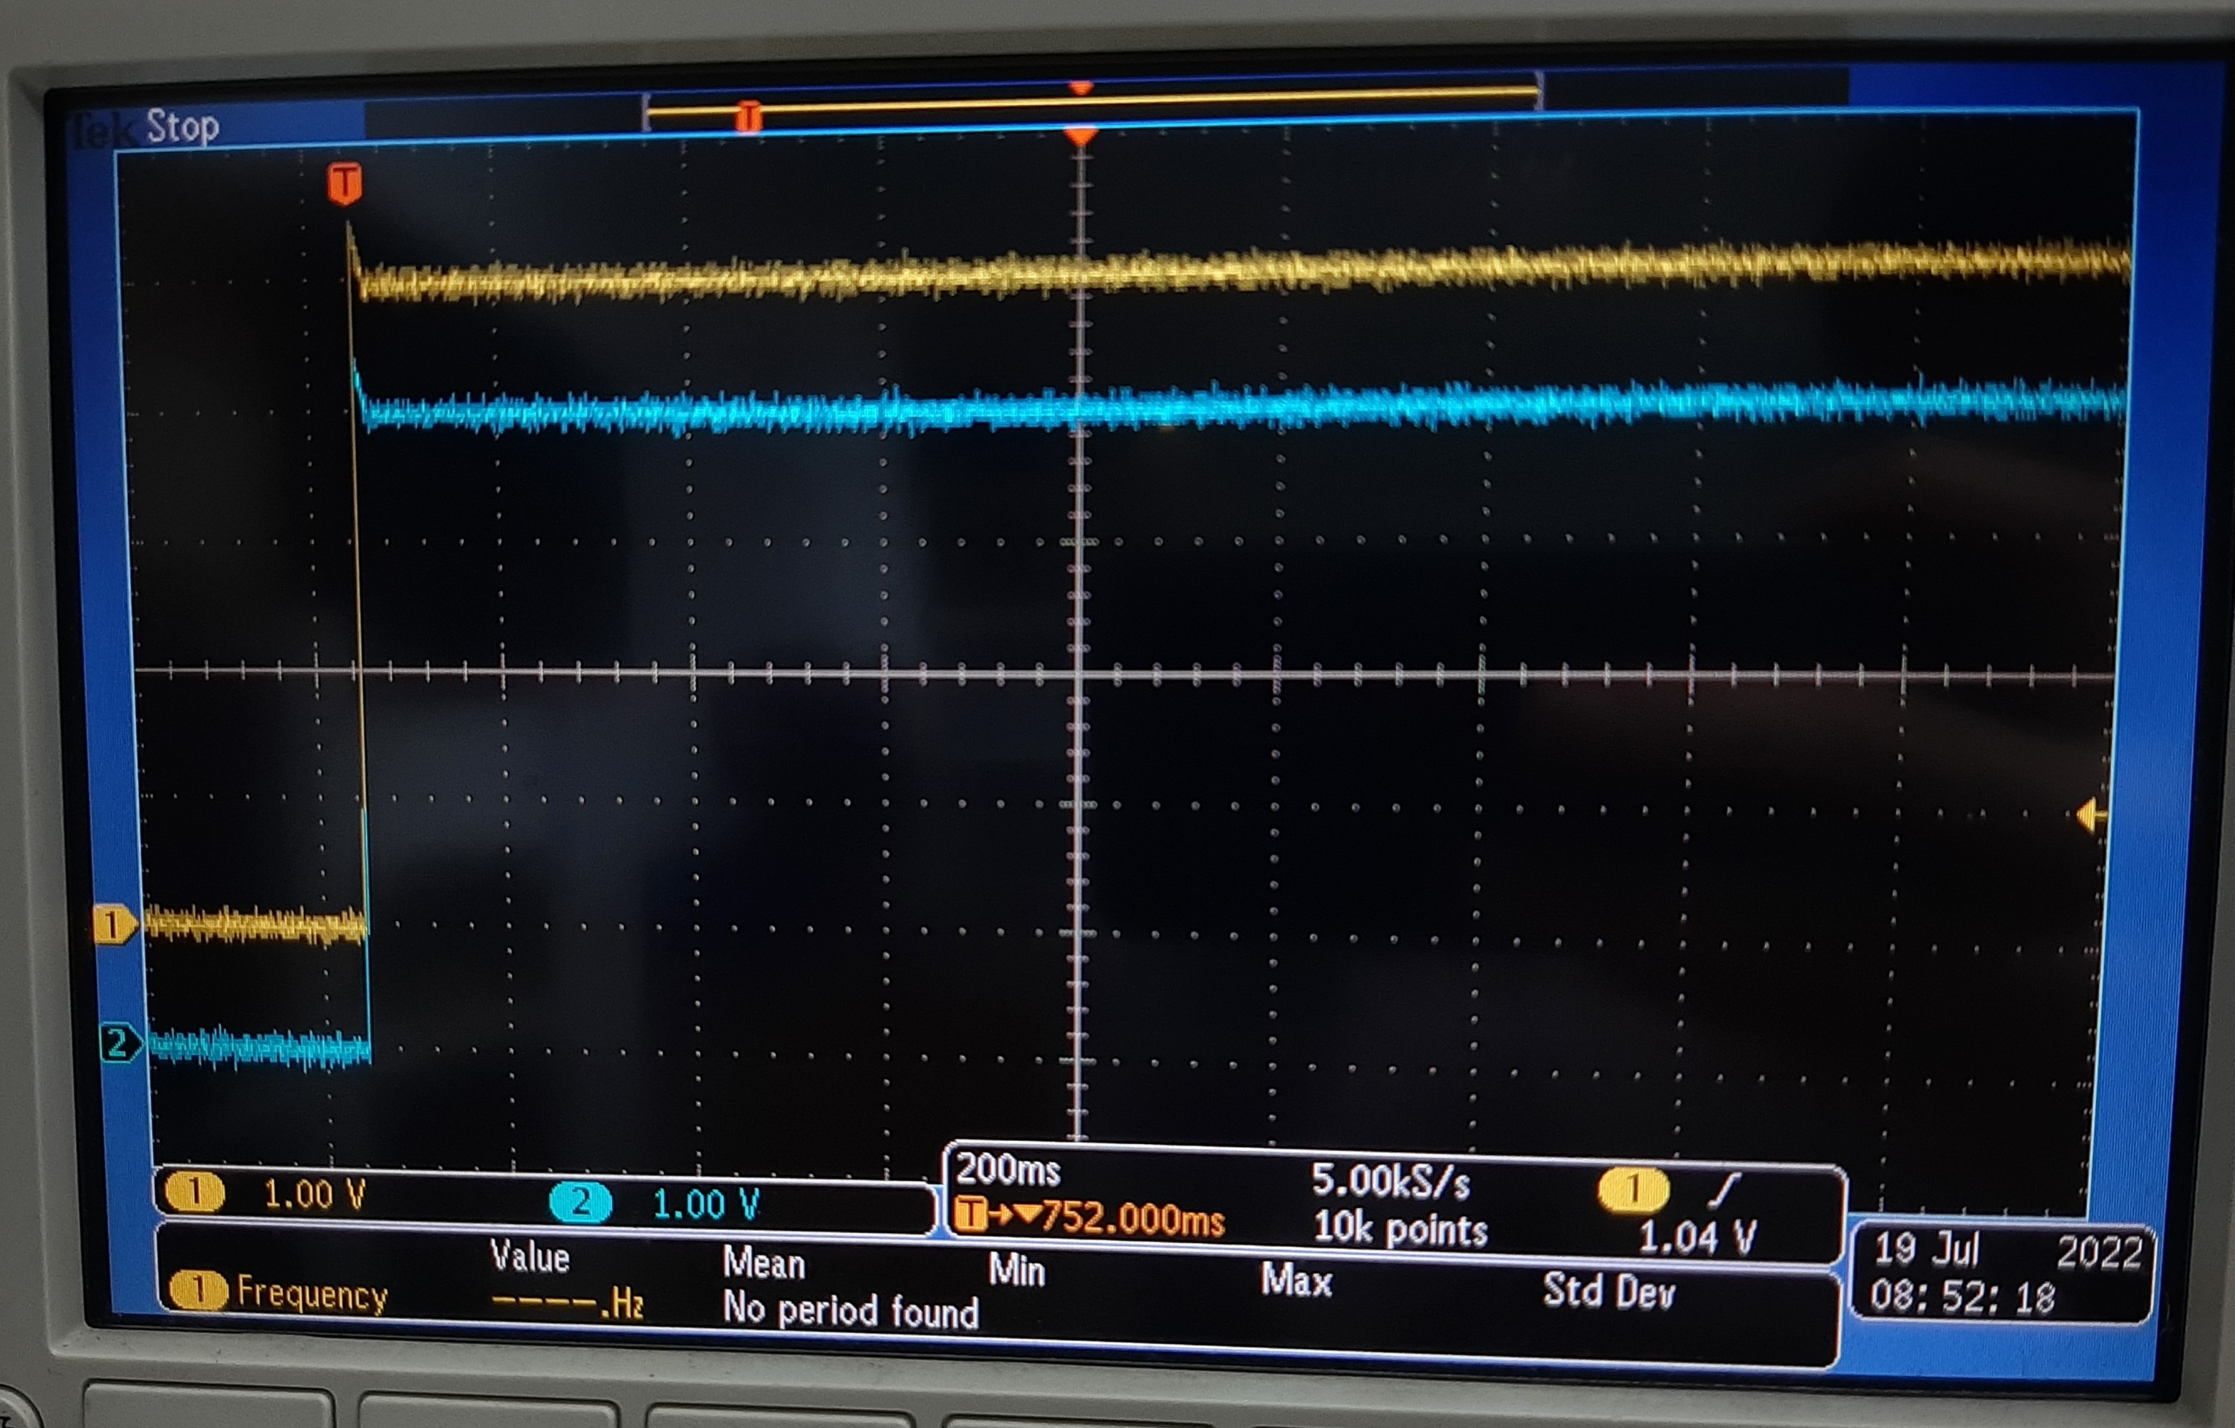
VCC SENSE

Slide 11
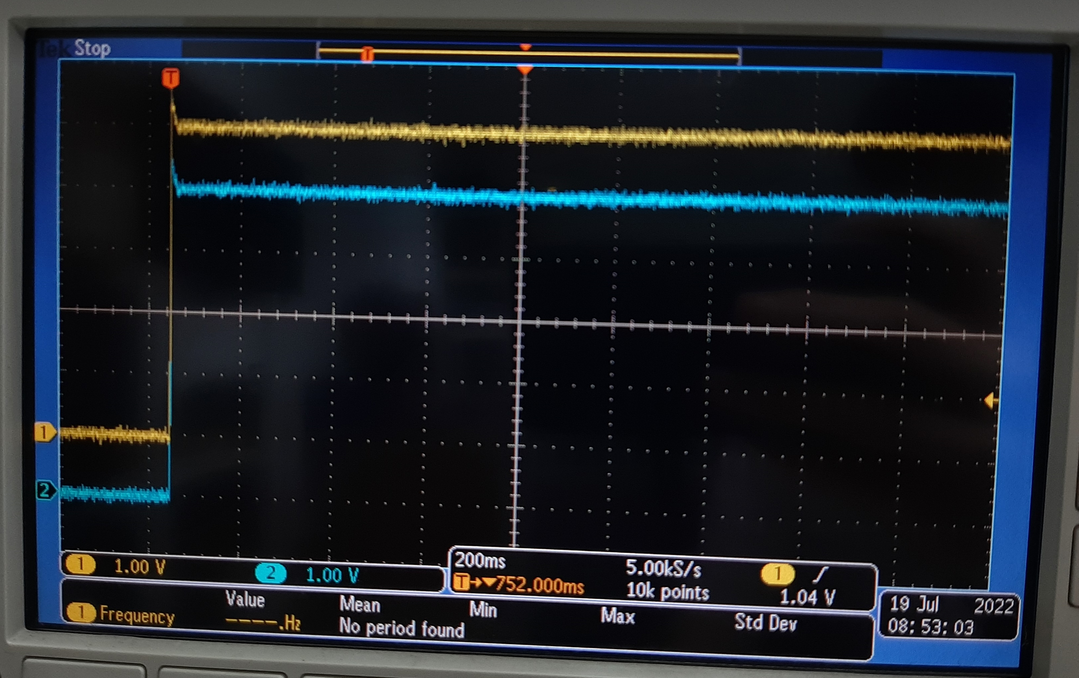
VCC SENSE2

Slide 12
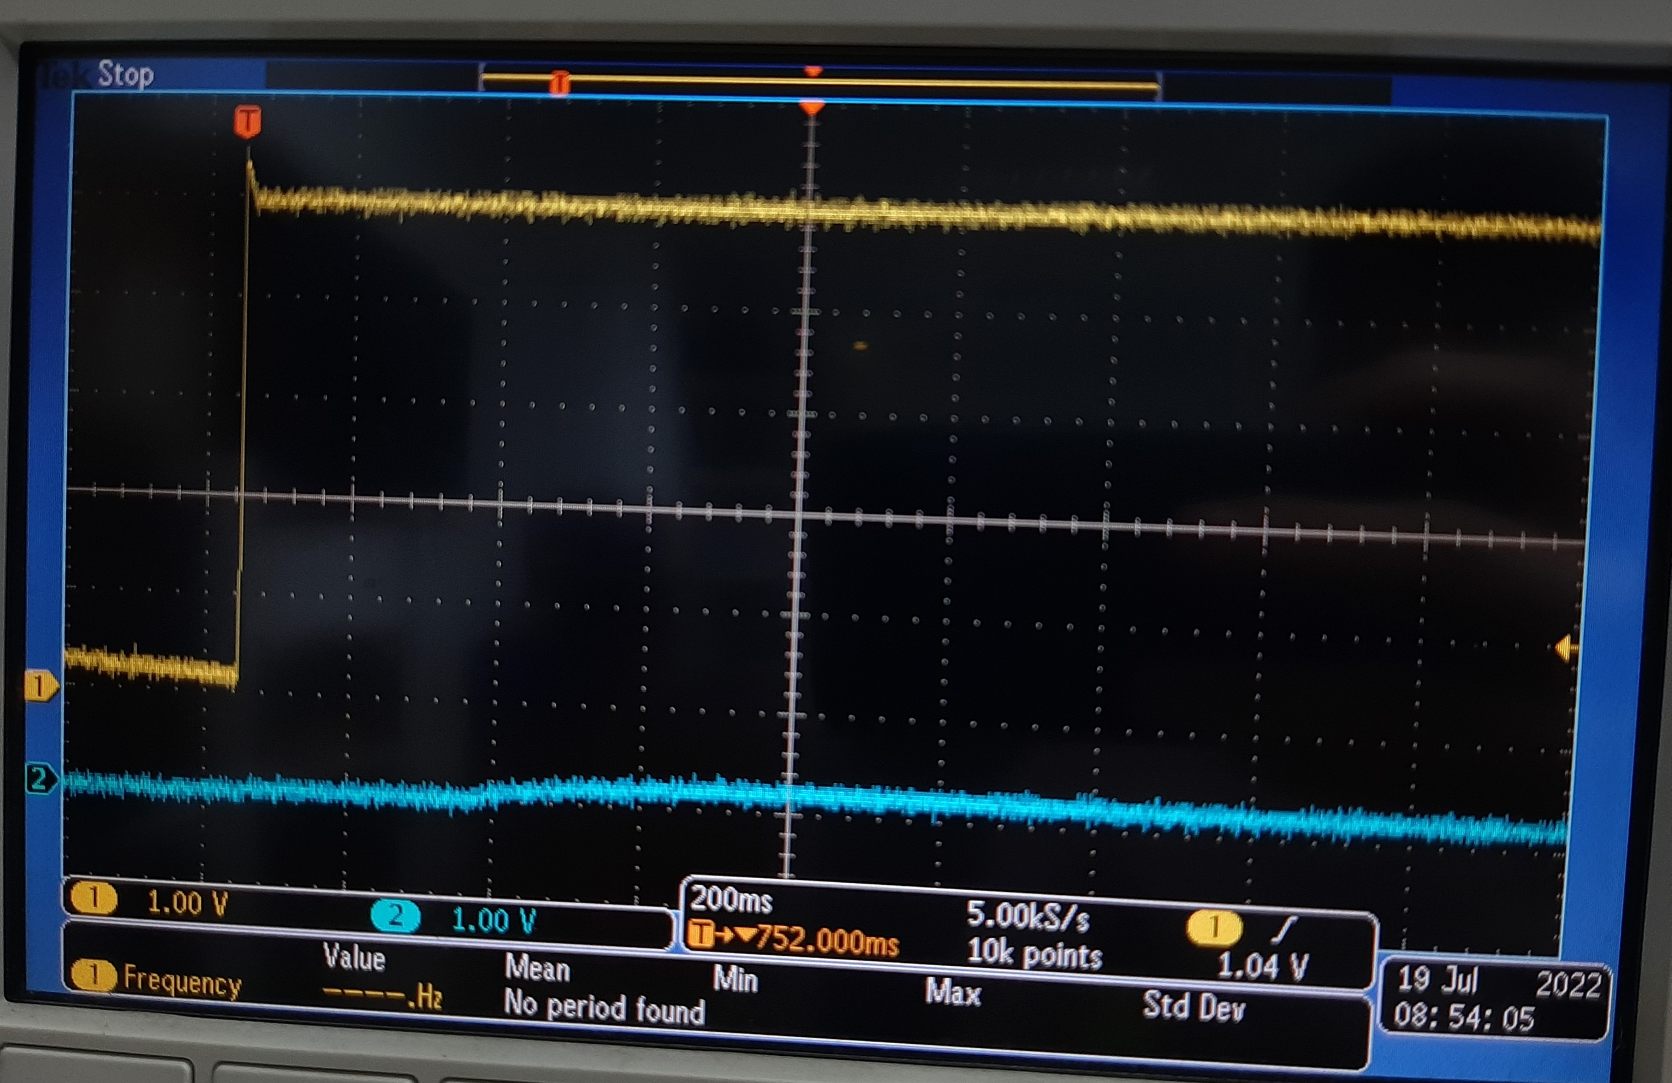
LDOVRTC_OUT

