Slide 1
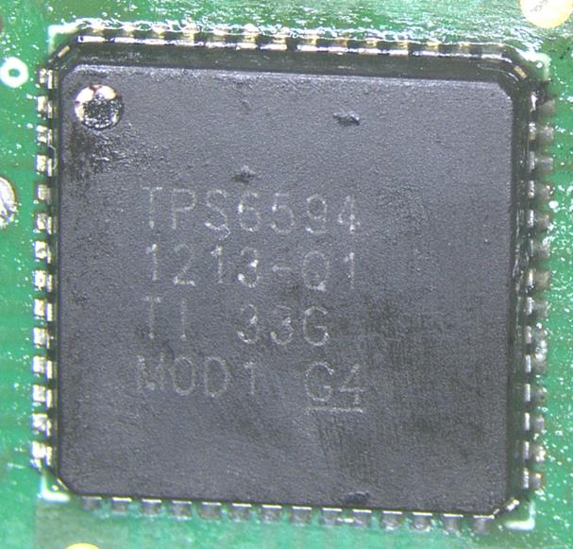
1. Air temp 80C, Tj 110C~120C, TPS65941213Q1 SPMI abnormal after power up result lose communication with LP8764. 100% reproducible at high temp.
2. One pcs TPS65941213Q1 among 15Ku report this issue.
3. No any voltage output. Register report SPMI abnormal. There are only 8 SPMI clock after power up then no signal. Scope capture is at next page
4. ABA swap experiments, problem goes with this pcs TPS65941213Q1
Problem Description

Slide 2
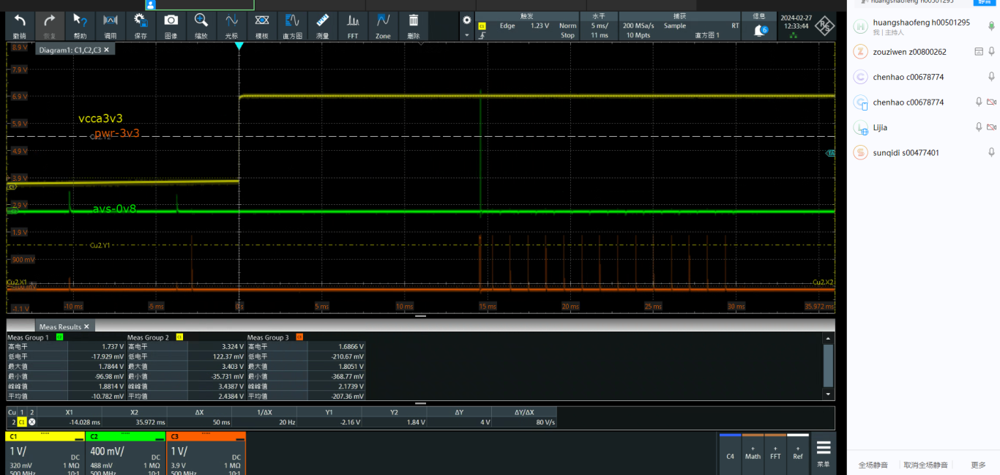
SPMI_CLK: this is one group 8 clock zoom out
SPMI_DATA

