Slide 1
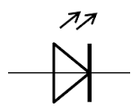
The Customer is considering two different sets of boards as below.
TPS68470 Board A
Board with LED
This Board is designed for connecting with “Board with LED”
TPS68470 Board B
Board without LED
This Board is designed for connecting with “Board without LED”

Slide 2
Replace two boards as below.
TPS68470 Board A
Board without LED
This Board is designed for connecting with “Board with LED”
TPS68470 Board B
Board with LED
This Board is designed for connecting with “Board without LED”

