Slide 1
TPS82150 Soft start Pspice simulation
TI/BSR/MV/LC
8/22/2021

Slide 3
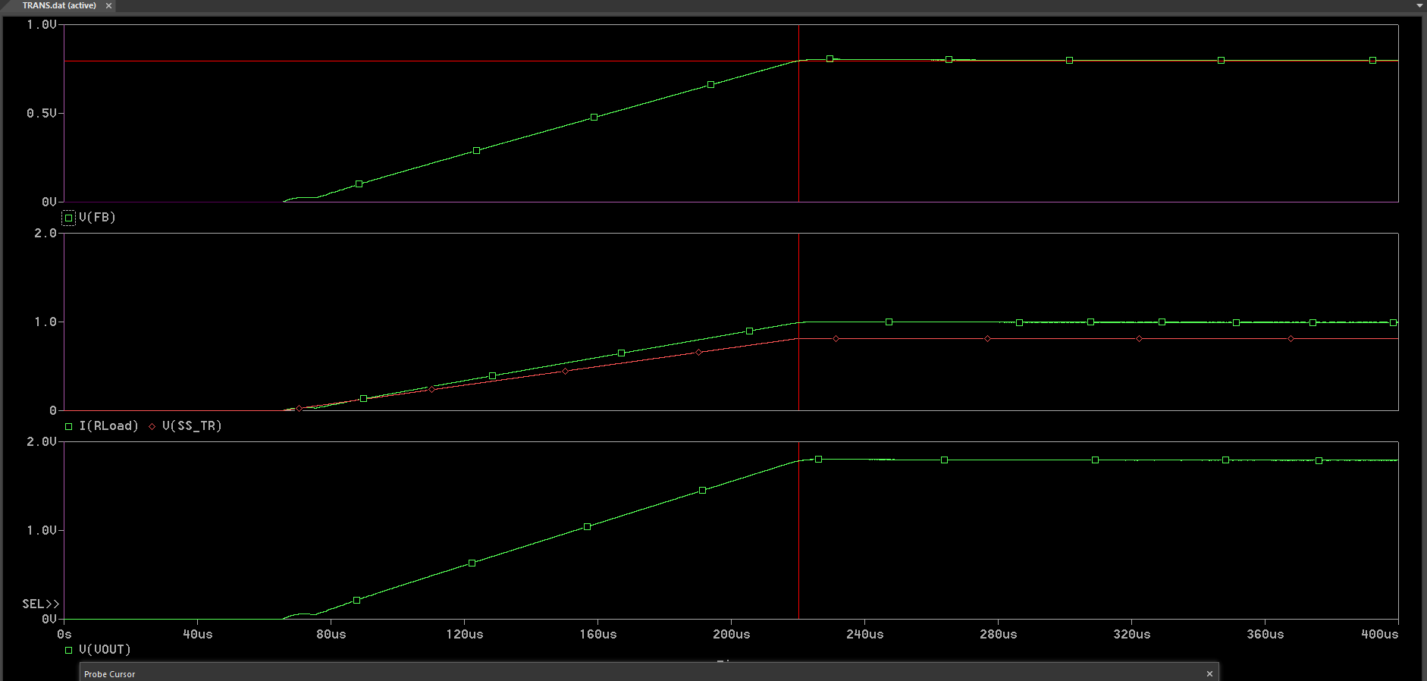
12Vin, 1.8V/1A, 470pF soft start time is around 220us which matches the equation. But 1.8Vout rise time is around 225us
Soft start voltage only ramps up to 0.8V, after that Vout is not controlled by soft start time. So for 1.8Vout, 1.8V rise time is around 225us

Slide 4
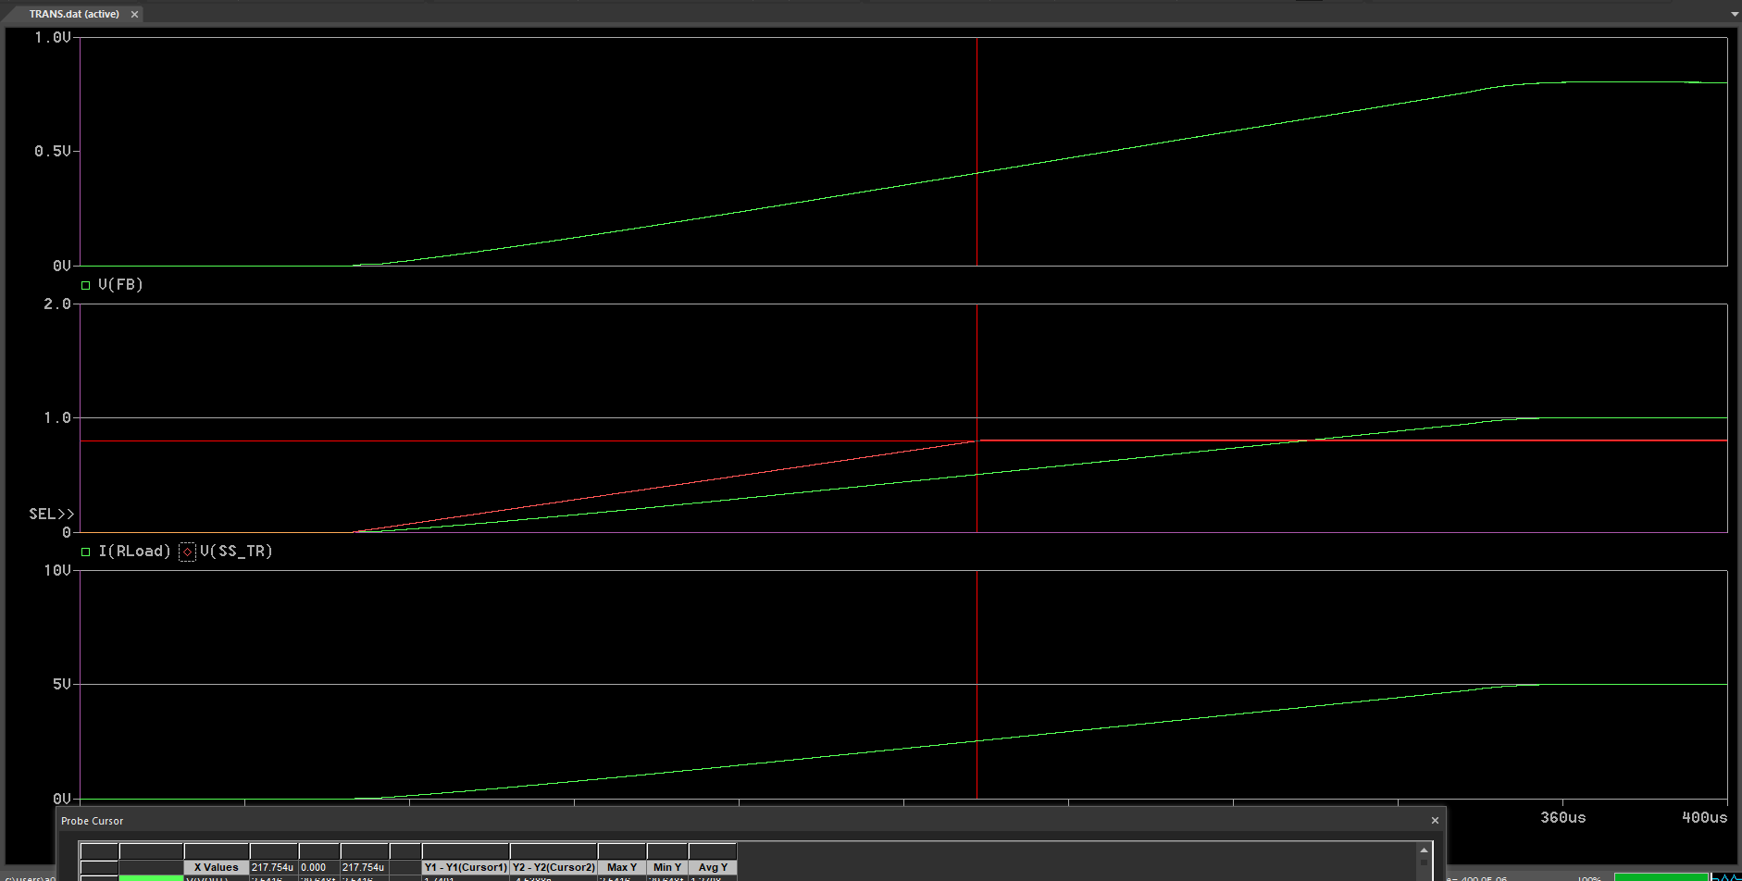
12Vin, 5V/1A, 470pF soft start time is around 218us which matches the equation. But 5Vout rise time is around 360us
Soft start voltage only ramps up to 0.8V, after that Vout is not controlled by soft start time. So for 5Vout, 5V rise time is around 360us

