Slide 1
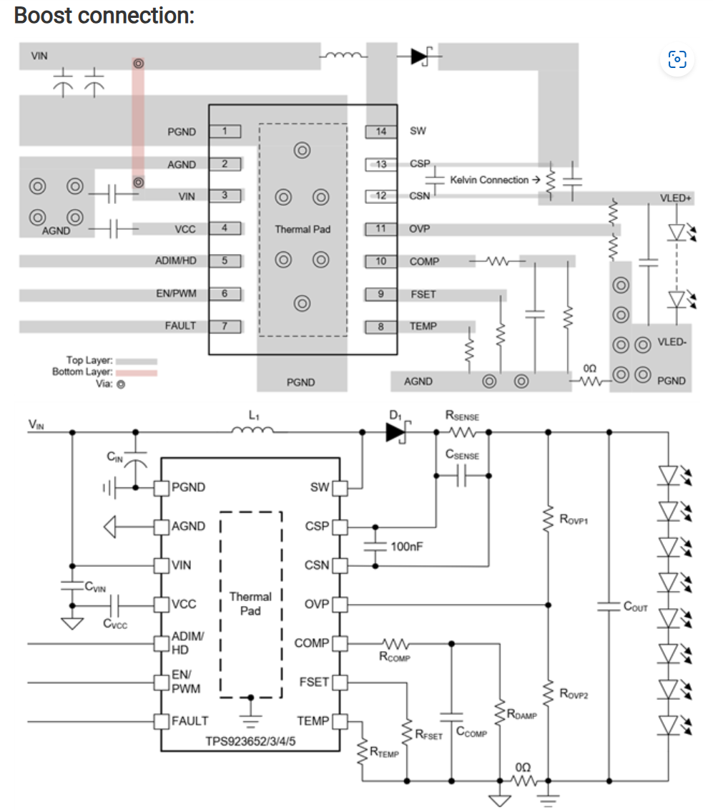
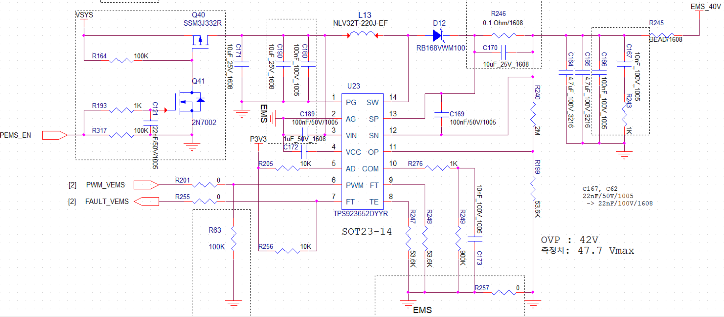
□ TPS923652 PCB DG
Issue : The switching noise generated in the currently designed PCB is affecting other logic, so I would like to modify it with Ti's guide in the next step PCB version.
Requests: May I have your recommended values ​​for
- R_COMP, C_COMP, C_DAMP
- R_SENS, C_SENS.2.
3. Our design spec
- Vin: 12~16.8V.
- Vout: 40V.
- The output current is under 100mA excluding the output capacitor charging current,
and there is no need for current limit.
L13
D12
C171
C180
C189
C169
R246
C170
C172
C165
C164
C166
R276
C173
R249
12V~ 16.8V
R247
R248
R257

