Slide 1
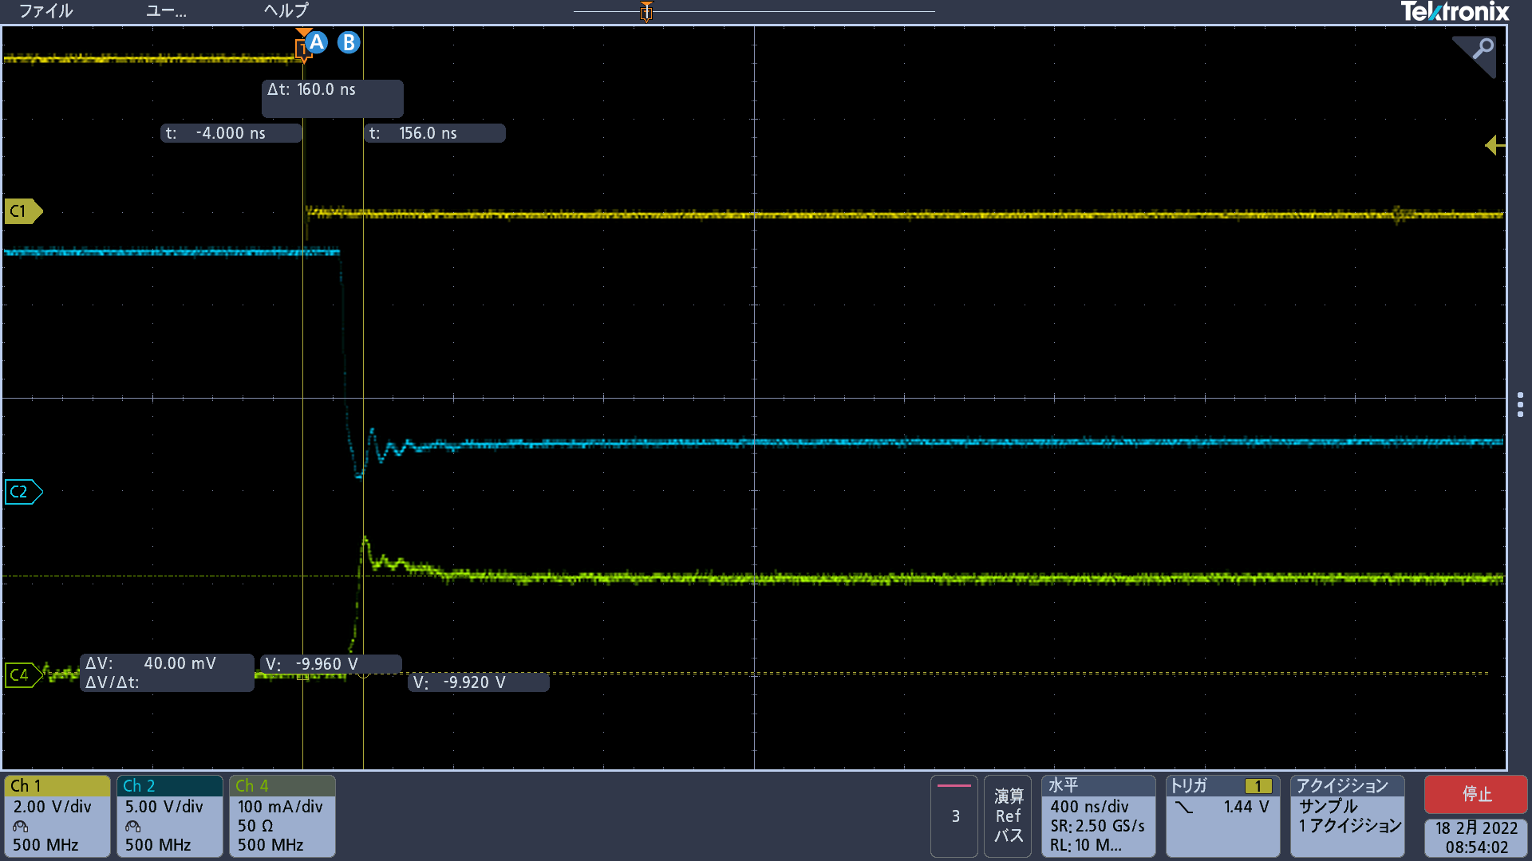
Direct PWM Mode_0xFFF → 0xAAA_Vout/Iout
400ns div

Slide 2
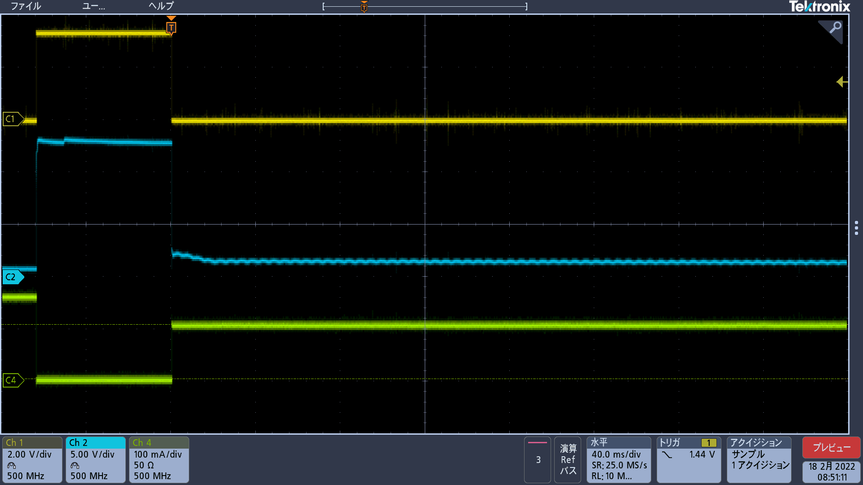
Direct PWM Mode 0xFFF → 0xAAA_Vout/Iout
40ms div

Slide 3
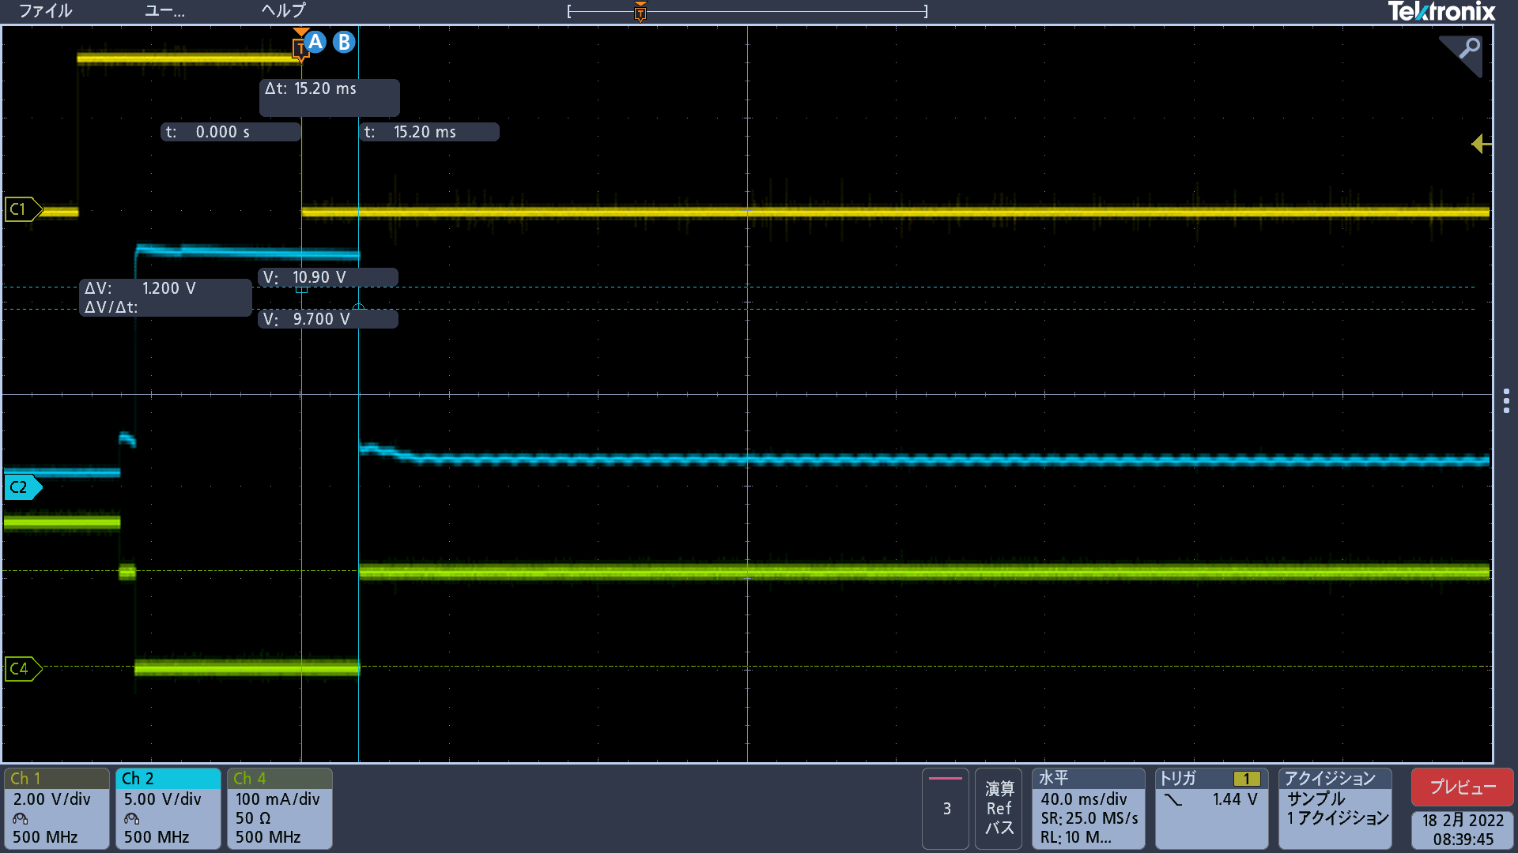
Phase-Shift PWM Mode_0xFFF → 0xAAA_Vout/Iout

