Slide 1
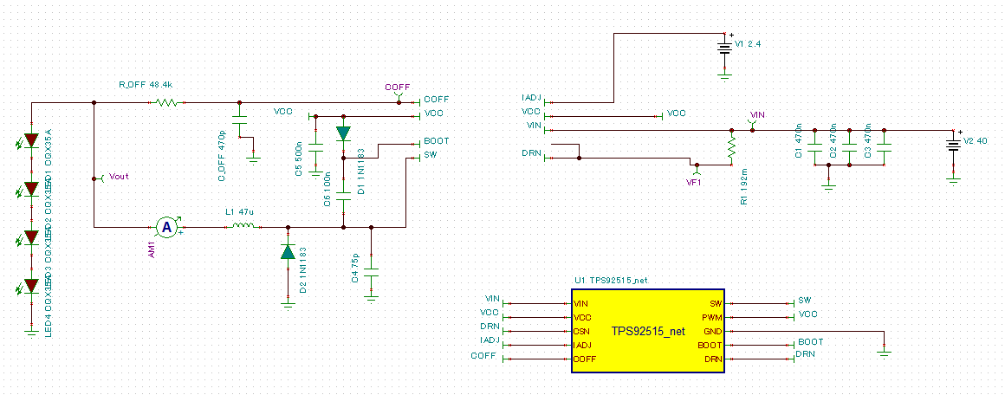
No Roff2 connection

Slide 2
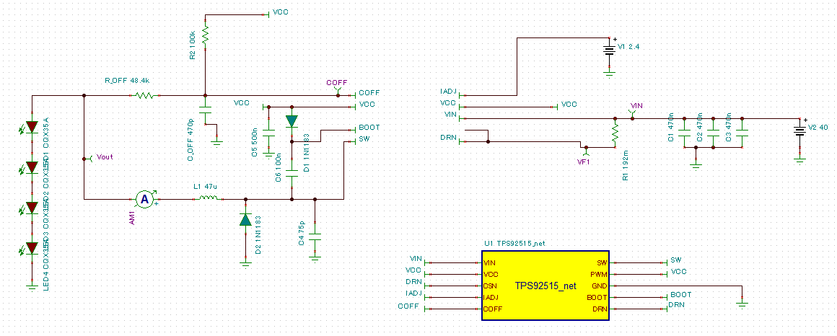
Roff2 connection without Diode

Slide 3
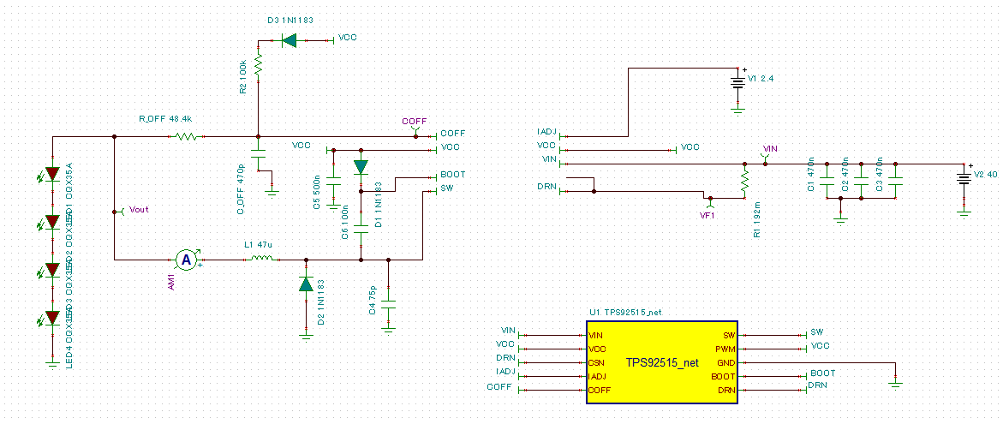
Roff2 connection with Diode

Slide 4
Frequency Summary
 | Coff Charge(us) | Non Chargey(us) | T(us) | Fsw(Hz)
No Roff 2 | 2.6 | 0.9 | 3.5 | 285,714
Roff2 without Diode | 2.07 | 0.73 | 2.8 | 357,143
Roff2 with Diode | 2.1 | 0.74 | 2.84 | 352,113

