Slide 1
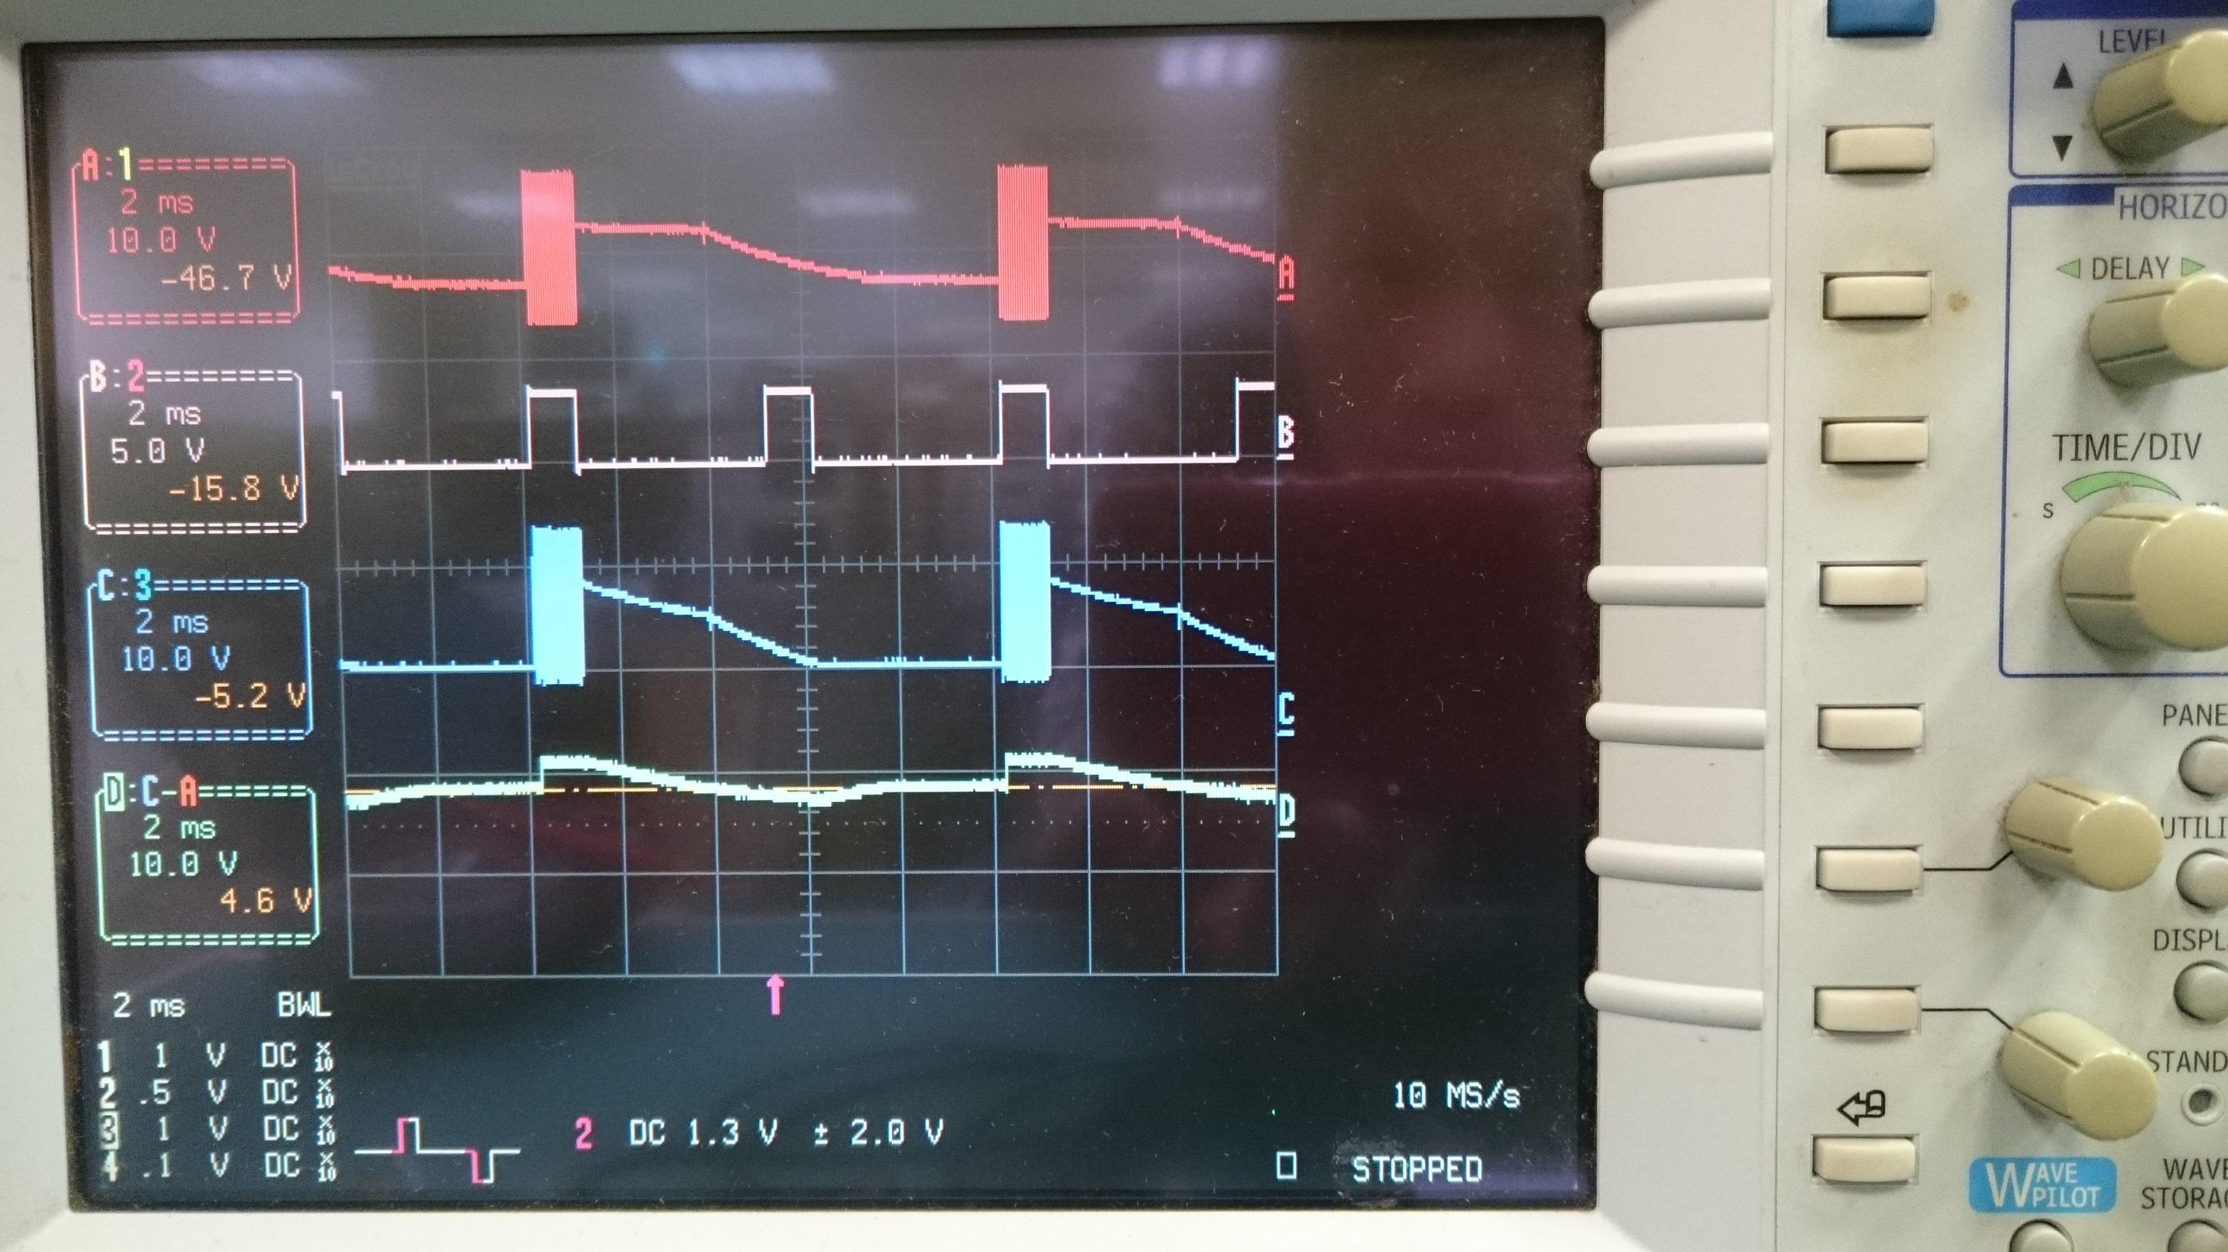
TPS92518
Measure by EVM 12Vin to 3S1P LED
CH1:Vsw1
CH2:PWM1 200Hz
CH3:Vboot1
CH4:Vboot1-Vsw

Slide 2
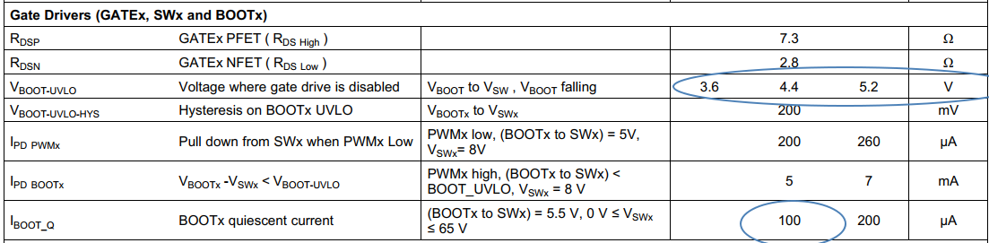
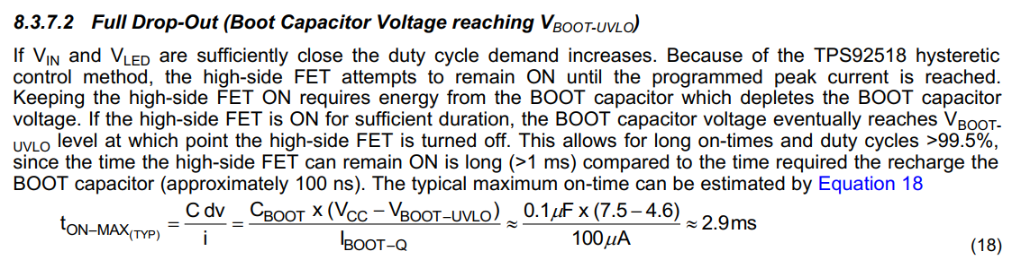
TPS92518
Base on Equation 18 and Vboot-UVLO spec(3.6V~5.2V)
Vin 12V , Cboot 0.1uF => Ton_max(typ) is 7.4ms

Slide 3
TPS92518
Q1. Is any side-effect to change Cboot value for keeping 200Hz PWM ?
Q2. What condition of TPS92518 could do PWM dimming ratio up to
10,000 : 1 ?
Q3. If Vin is 9~16V , PWM frequency is 200Hz , ILED is 2.5A / ch (2S1P)
May each output support higher LED current ex: 2.5A or higher ?
By changing higher current rating of external MOSFET , Inductor and
Diode ??

