Slide 1
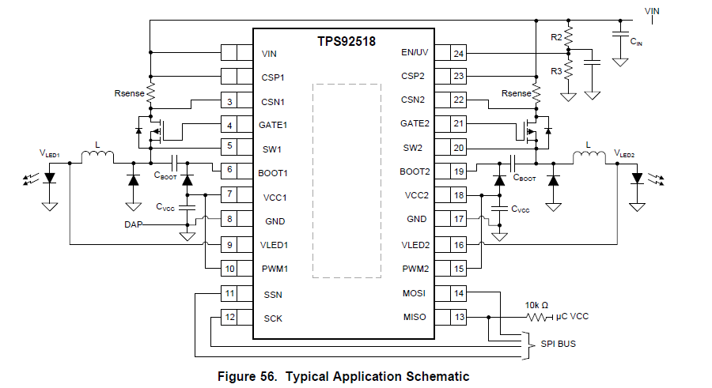
Shunt FET control
signal
Nch FET
PWM1
PWMx and shunt FET control
Is same frequency but inverting.
PWM1
This frequency depends
on LEDx_MAXOFF_DAC
Shunt FET
control
signal
Inductor
Current
0V

