Slide 1
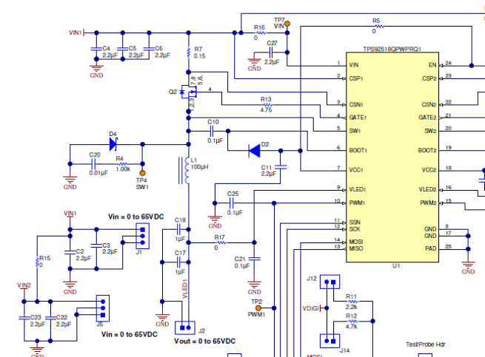
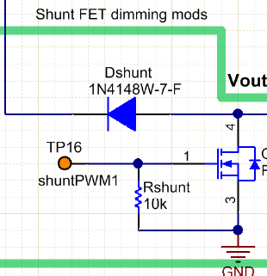

Iout
PWMx control
From MCU
Shuntx control
From MCU
GPIO
ILED
Ishunt

Slide 2
20us at duty=1% dimming (PWM dimming)
PWMx=500Hz
From MCU
synchronize
18us ON(2us off) at duty=0.1% dimming
10us on (10us off) at duty=0.5% dimming
Turn off at duty >1%
Shuntx frequency
=1MHz
From MCU

