Slide 1
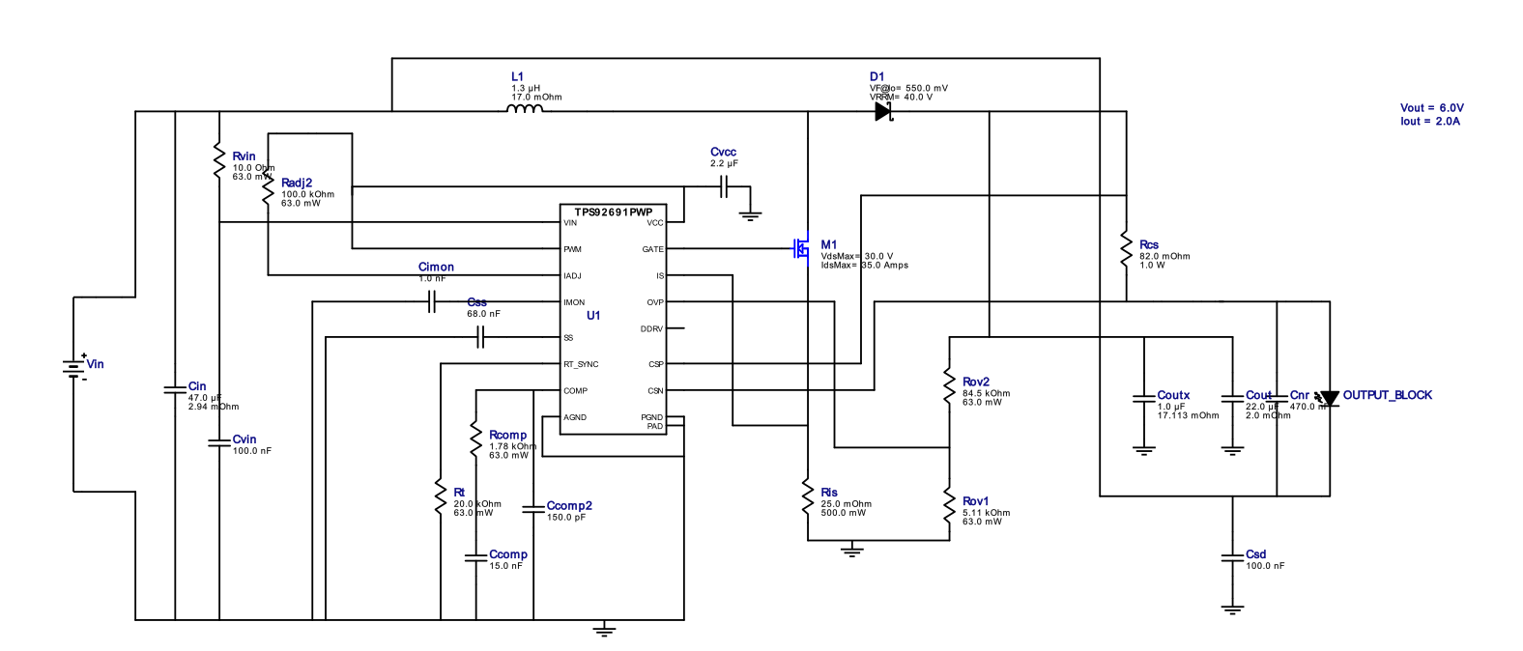
External VIN bias 5~8V
Battery Voltage
3.6V to 6.8V
6.4V/2A
(LED 2S,2P)

Slide 2
External VIN bias 5~8V
Battery Voltage
3.6V to 6.8V
3.2/4A
(LED 1S,4P)

