Slide 1

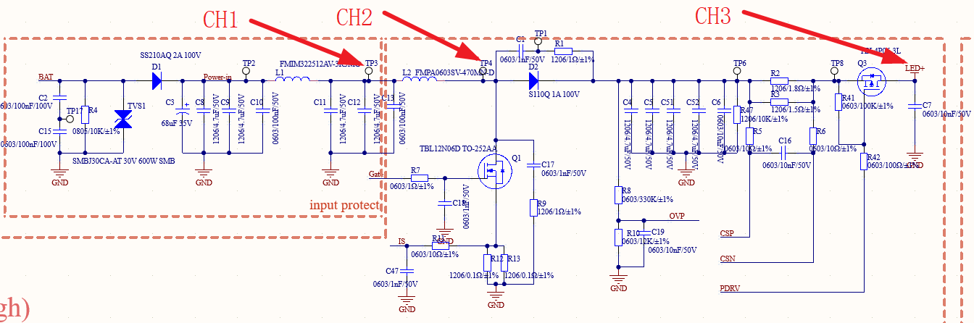
Spec requirements
Vin: 9V~16V typ., 6V min
Iout: 209mA typ.
Vout: 26V typ.
Fsw: 390kHz typ.

Slide 2
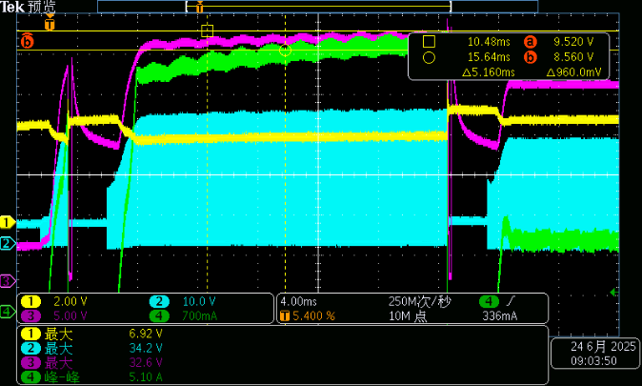
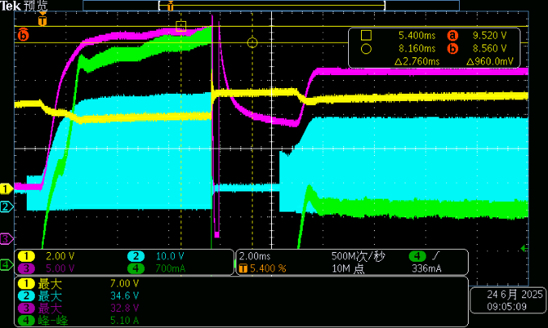
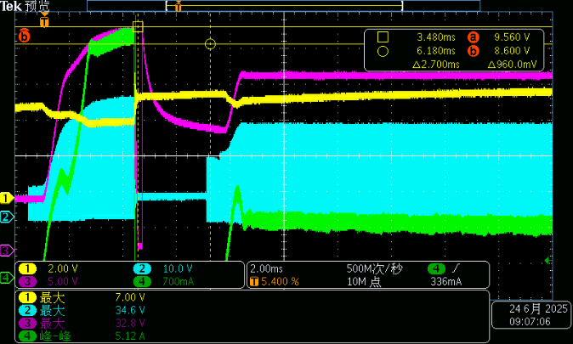
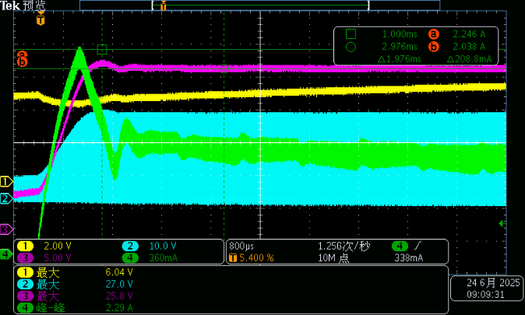
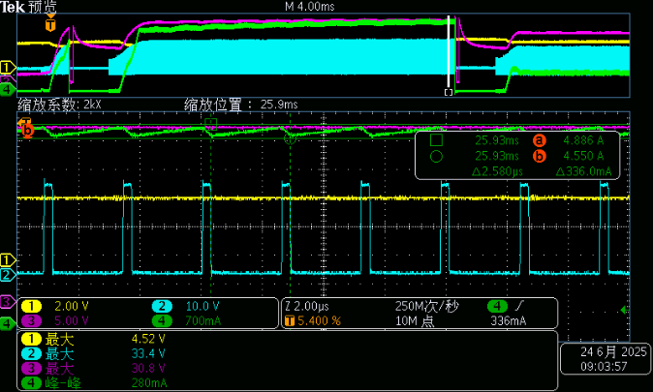
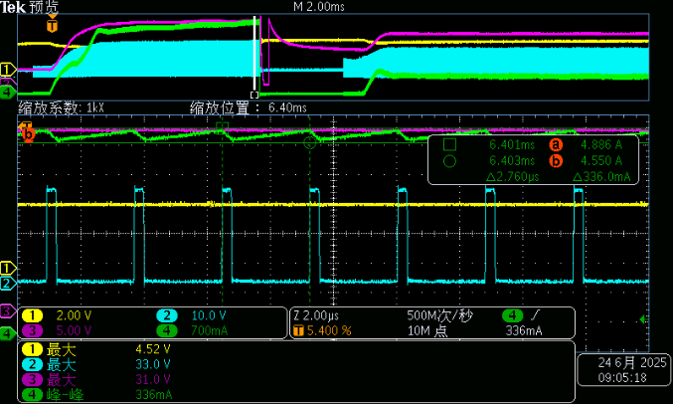
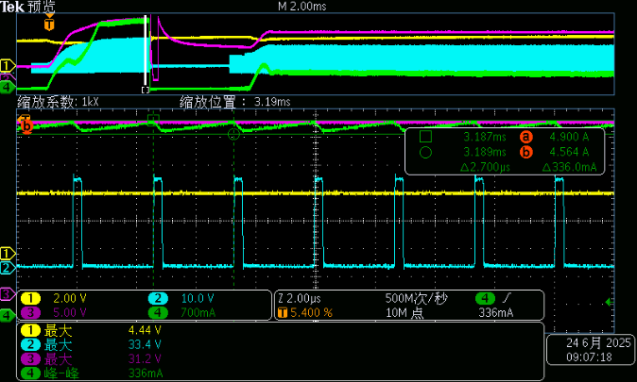
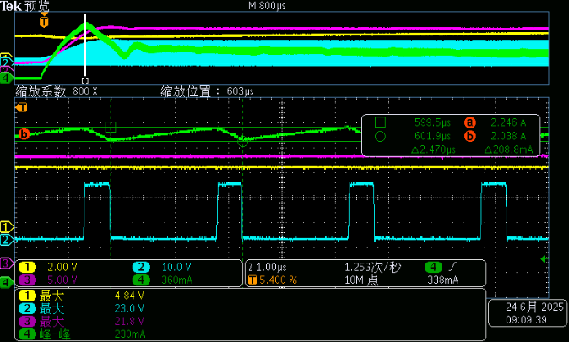
Test waveforms
IS OCP(250mV threshold)
Vin=6V
Vin=6.5V
Vin=7V
Vin=7.5V
CH1：Vin（after） CH2：Switch node voltage CH3：Vout CH4：Inductor current

Slide 3
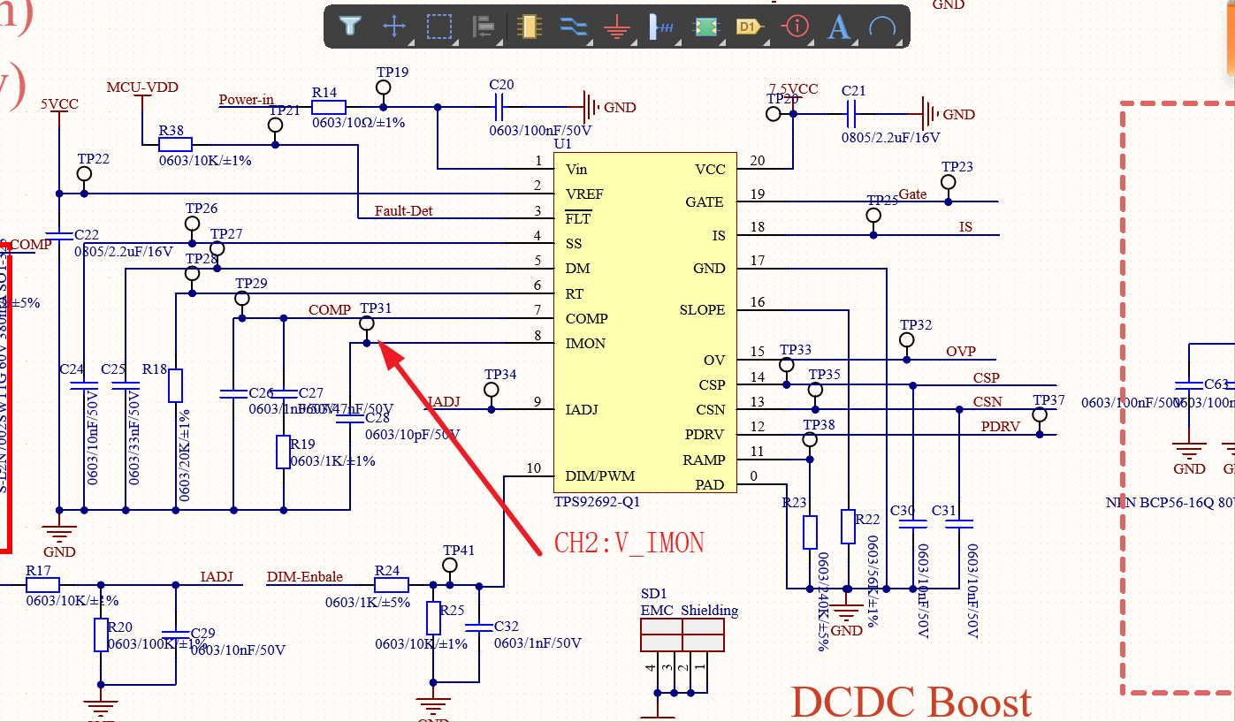
Schematic

Slide 4
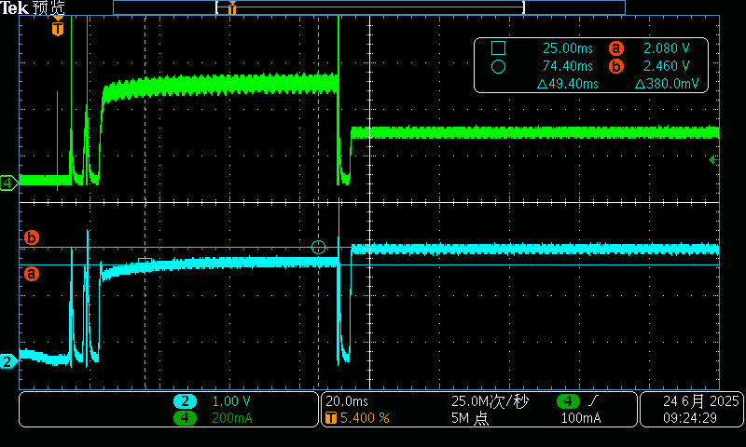
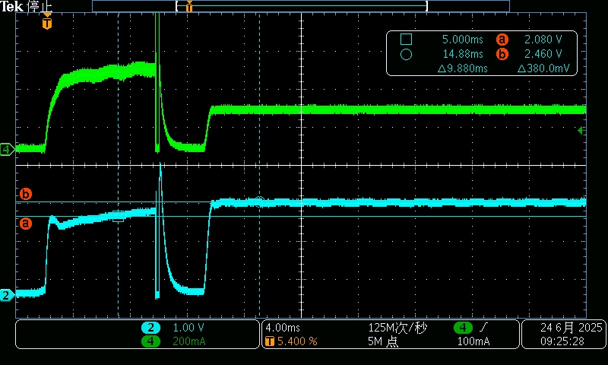
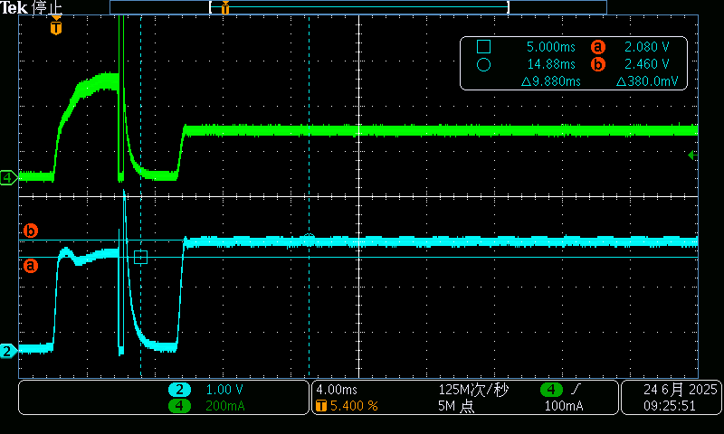
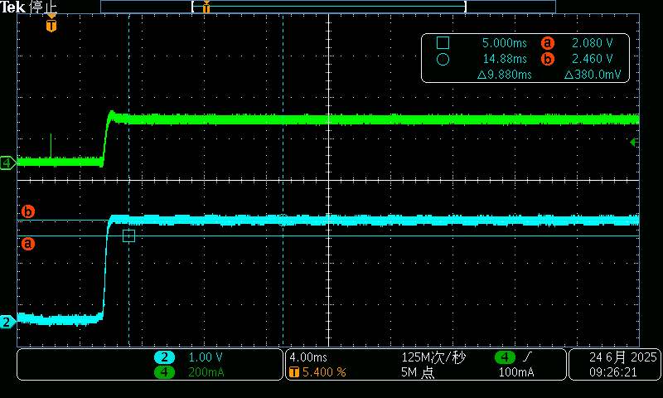
Test waveforms
Gain<14
Gain=14
Gain<14
Gain=14
b = 2.46V
a = 2.08V
b = 2.46V
a = 2.08V
Vin=6V CH2：V_IMON CH4：I_LED
Vin=6.5V CH2：V_IMON CH4：I_LED
Gain<14
Gain=14
Gain=14
b = 2.46V
b = 2.46V
a = 2.08V
Vin=7V CH2：V_IMON CH4：I_LED
Vin=7.5V CH2：V_IMON CH4：I_LED

Slide 5
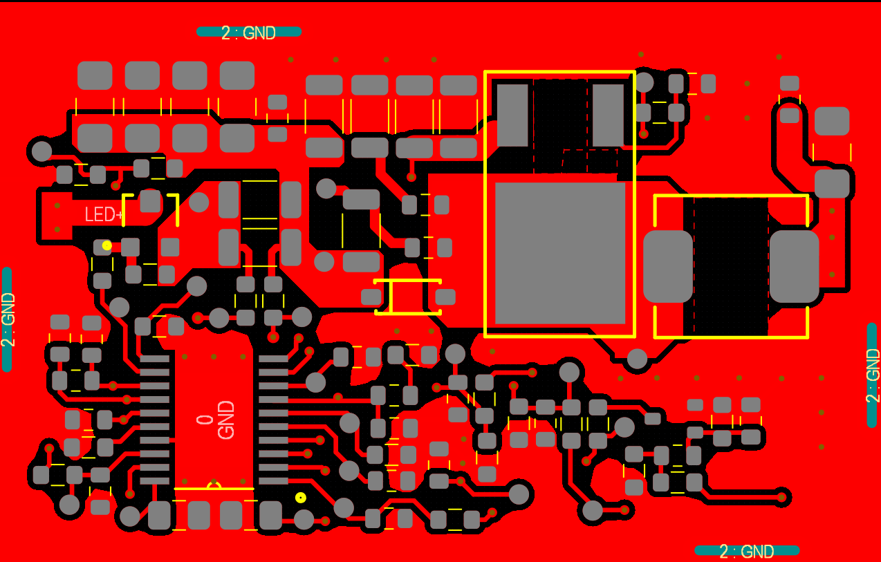

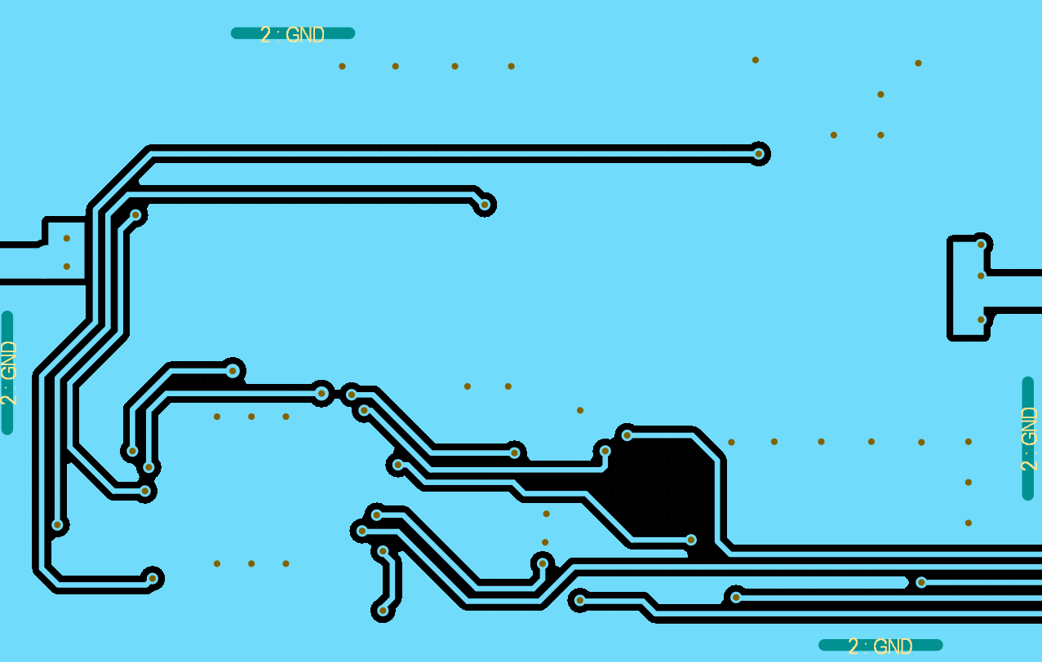

PCB layout
Top layer
Int1 layer
Int2 layer
Bottom layer
Top layer
Int1 layer
Int2 layer
Bottom layer

