Slide 2
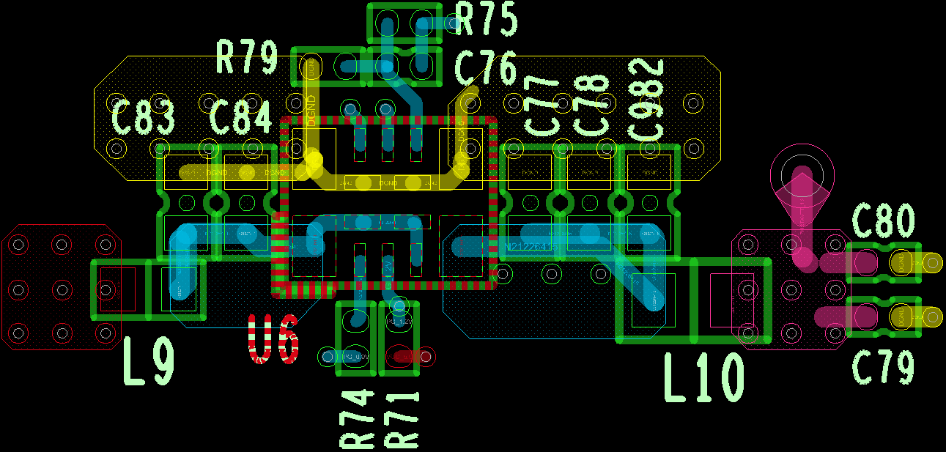
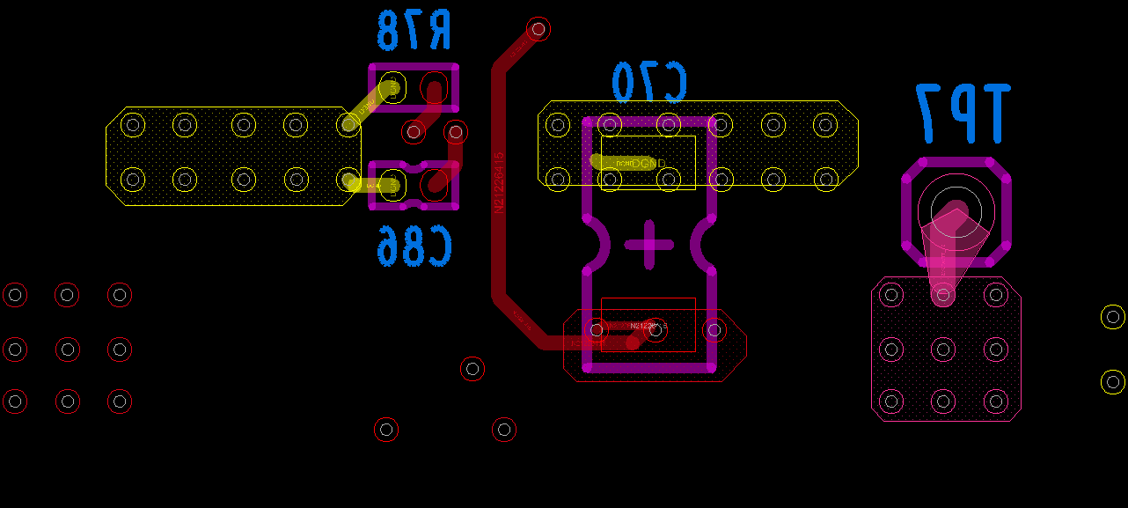
TPSM82810 Placement (U6)
TOP
BOTTOM

