Slide 1
Load current increment verse time Illustration
Current
Overshoot up to 25% of upper Limit
Ilim x (1 + 15%)x(1+25%)
Data sheet upper current limit Ilim x (1 + 15%)
Load current
Typical current limit Ilim
Data sheet lower current limit
Ilim x (1 -15%)
Time
Current creeping behavior
Overshoot duration
(load current over the data sheet limit)

Slide 2
Bench test measurement
Current limit response to different over current levels
VS = 13.5V
Ambient temperature = 25C
Current limit set = 0.36A
Scope probes: CH1 = VOUT, CH2 = FAULT, CH3 = Vcs and CH4 = load current
The current limit loop has an overshoot depending on the output voltage negative slope in overcurrent conditions.

Slide 3
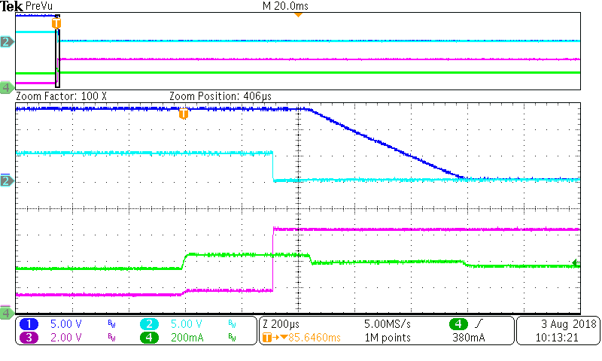
Load step 0.35A to 0.44A

Slide 4
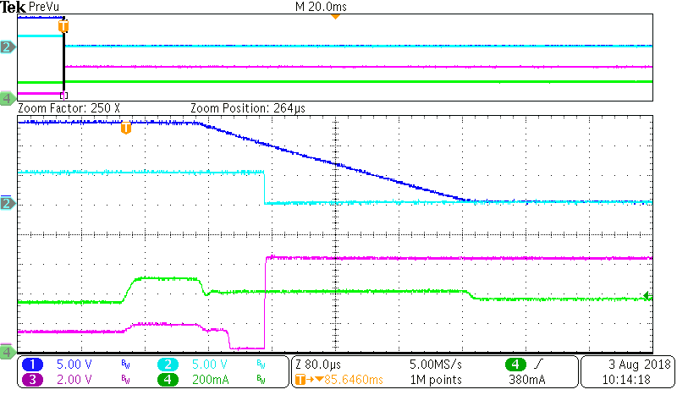
Load step 0.35A to 0.5A

Slide 5
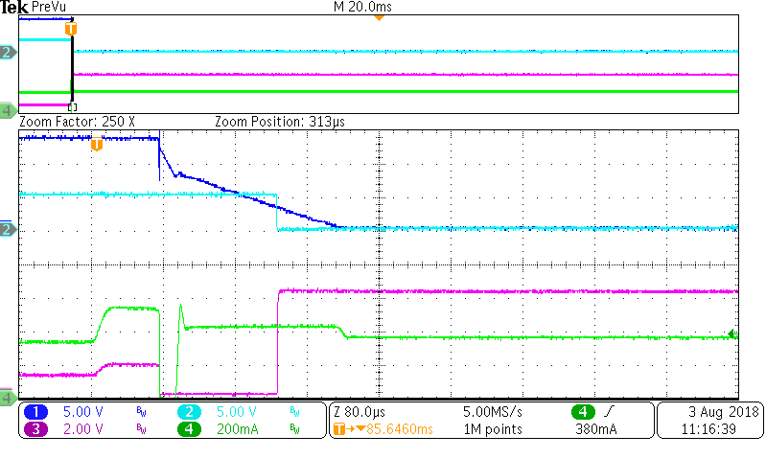
Load step 0.35A to 0.54A

Slide 6
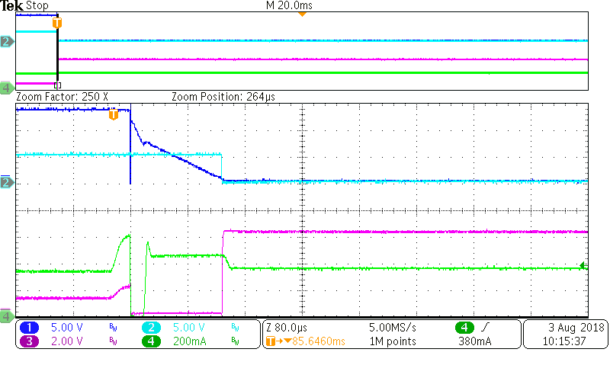
Load step 0.35A to 1A

Slide 7
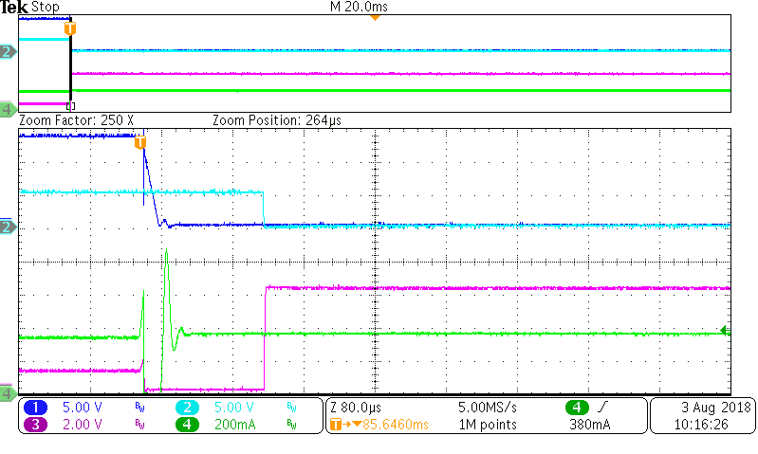
Load step 0.35A to 2A

Slide 8
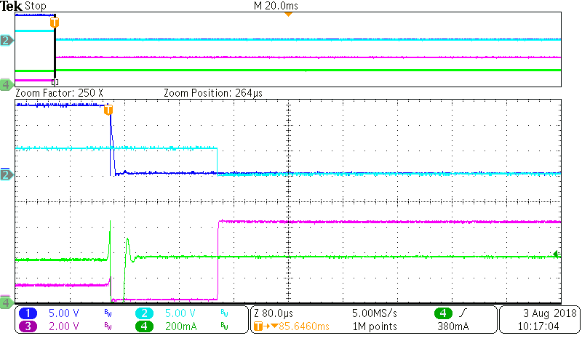
Load step 0.35A to 5A

Slide 9
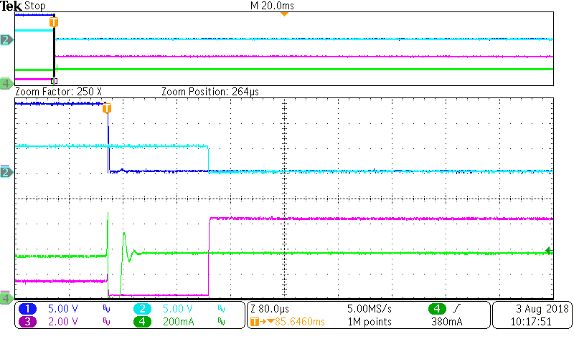
Load step 0.35A to short

