Slide 1
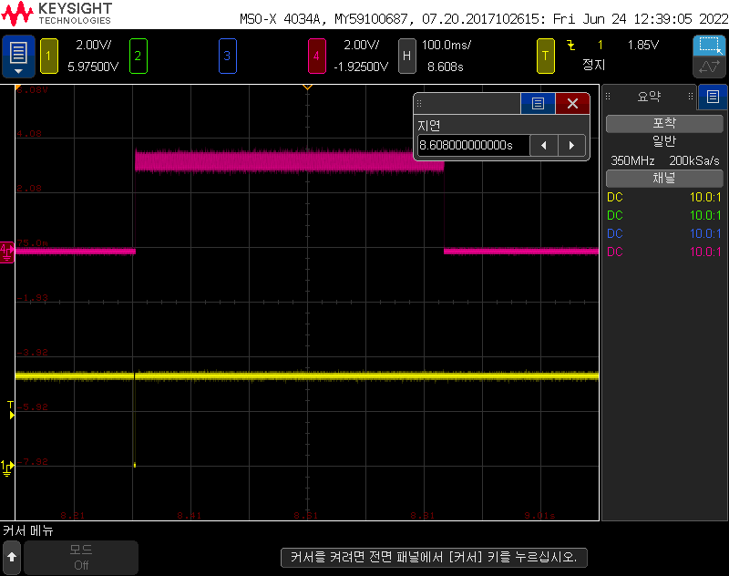
2ohm- Load Connected
2ohm- Load Disconnected
EN pin operates properly
CH1 : \OCS
CH4 : \EN

Slide 2
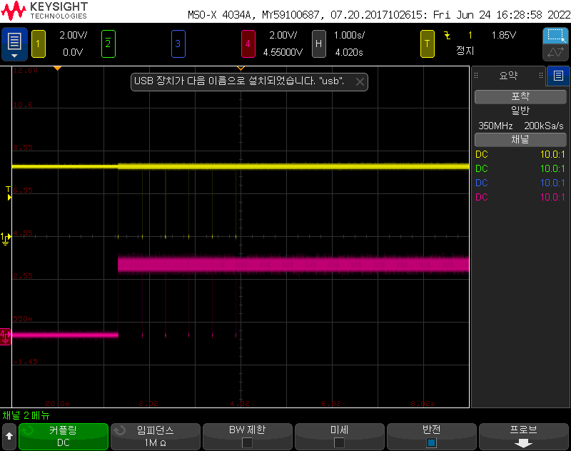
2ohm- Load Connected
2ohm- Load Disconnected
But, EN pin was not recovery
CH1 : \OCS
CH4 : \EN

