Slide 1
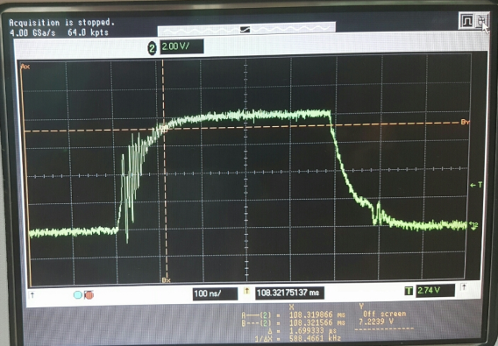
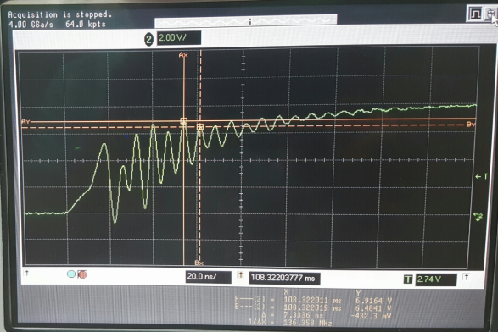
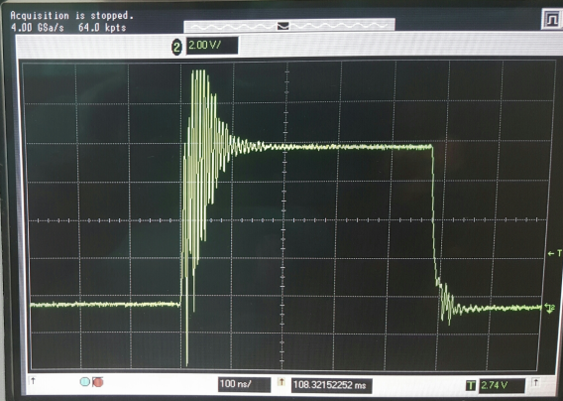
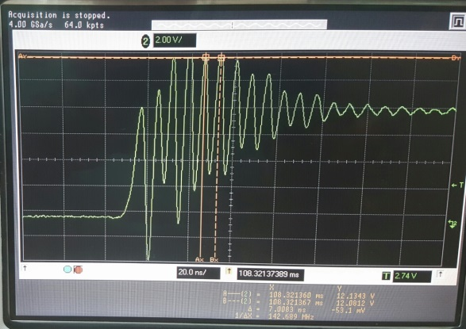
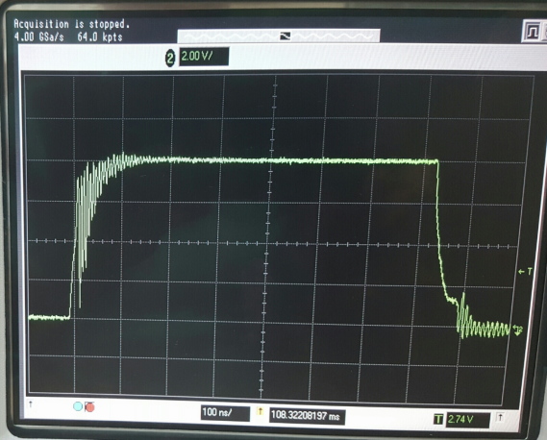
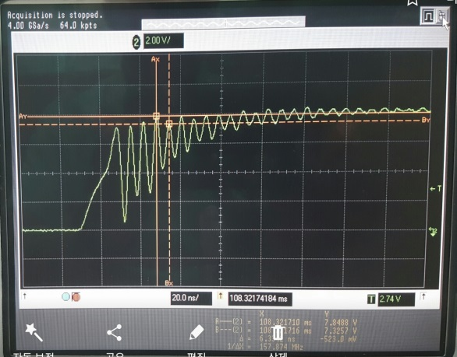
TPS40210 FET : CSD17577 (TI) Gate waveform
TPS40210 FET : Sis412DN(Vishay) Gate waveform
TPS40210 EVM FET : Si4386DY(Vishay) Gate waveform

