Slide 1
Texas_Instruments_LMR604305SRAKRQ1
Supplier Review

Slide 2
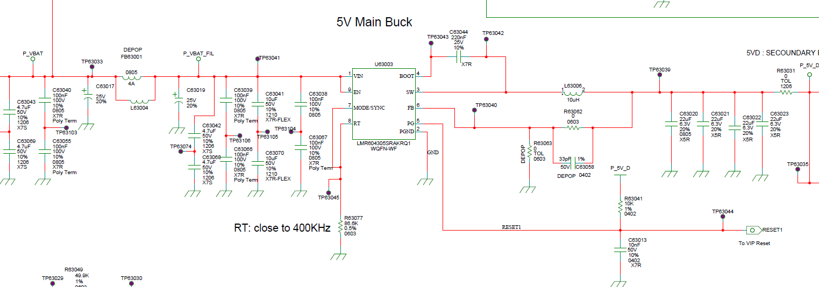
LMR604305SRAKRQ1-5V Primary Buck

Slide 3
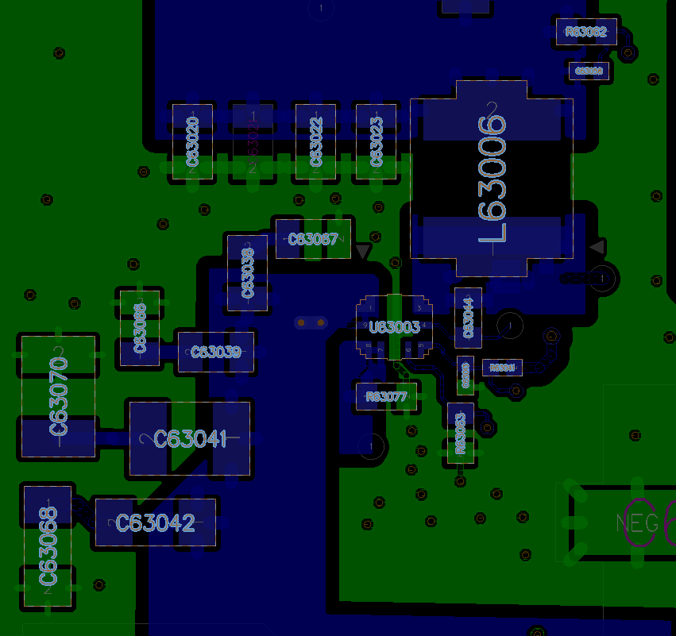
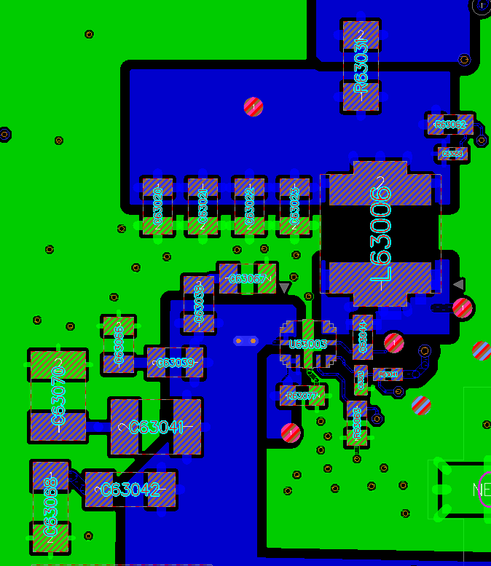
All routed in same layer

