Slide 1
Texas_Instruments_LMR604305SRAKRQ1_TPS628502QDRLRQ1_TPS628501QDRLRQ1
Supplier Review

Slide 2
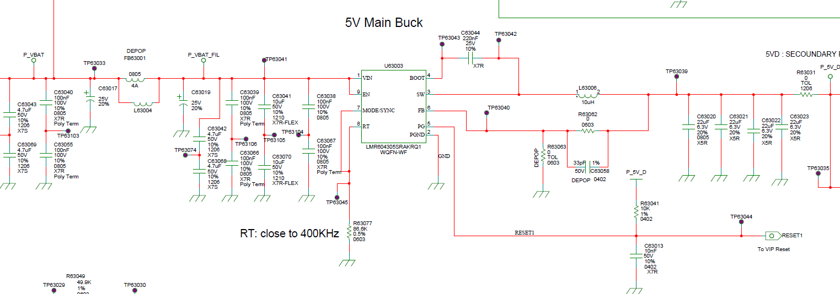
LMR604305SRAKRQ1-5V Primary Buck

Slide 3
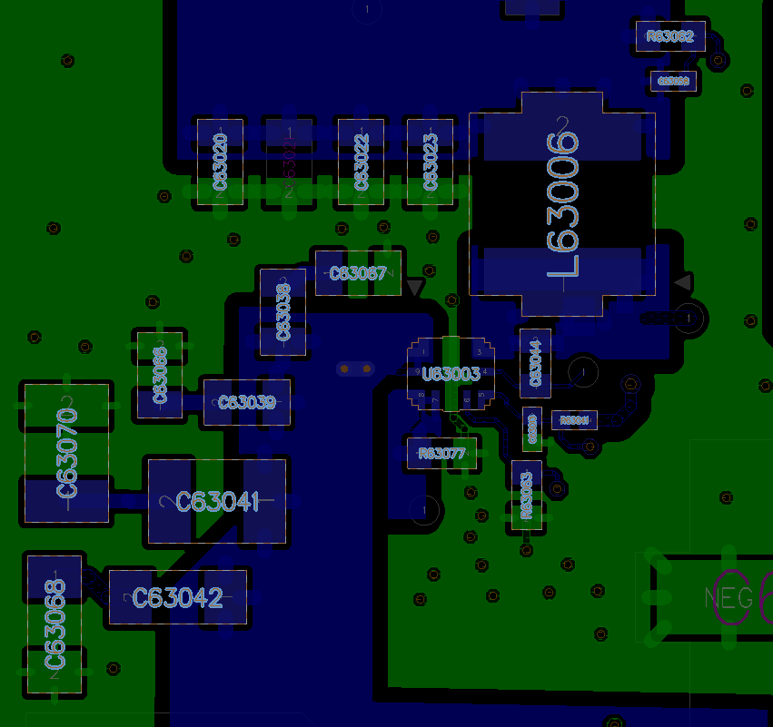
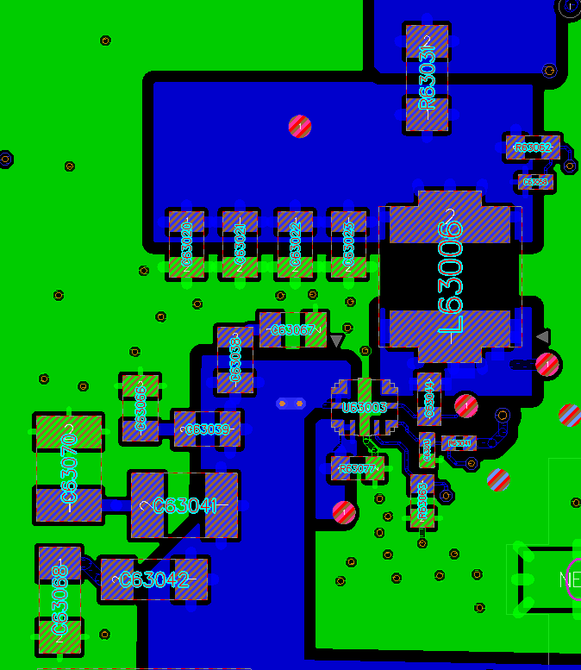
All routed in same layer

Slide 4
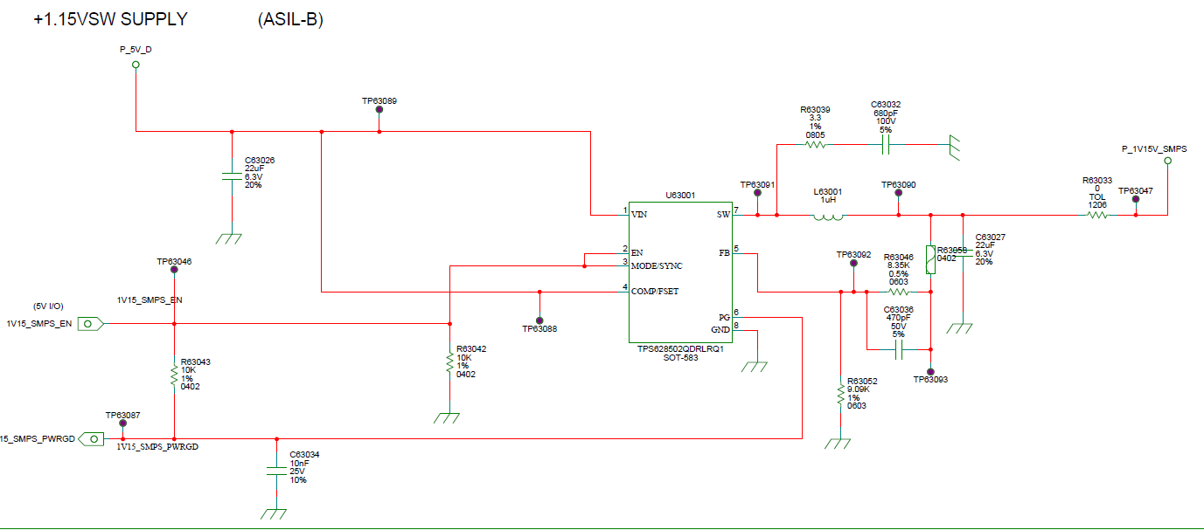
TPS628502QDRLRQ1

Slide 5
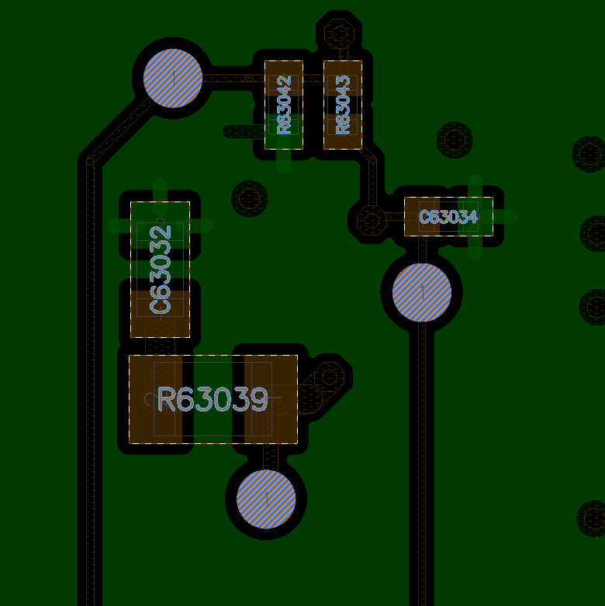
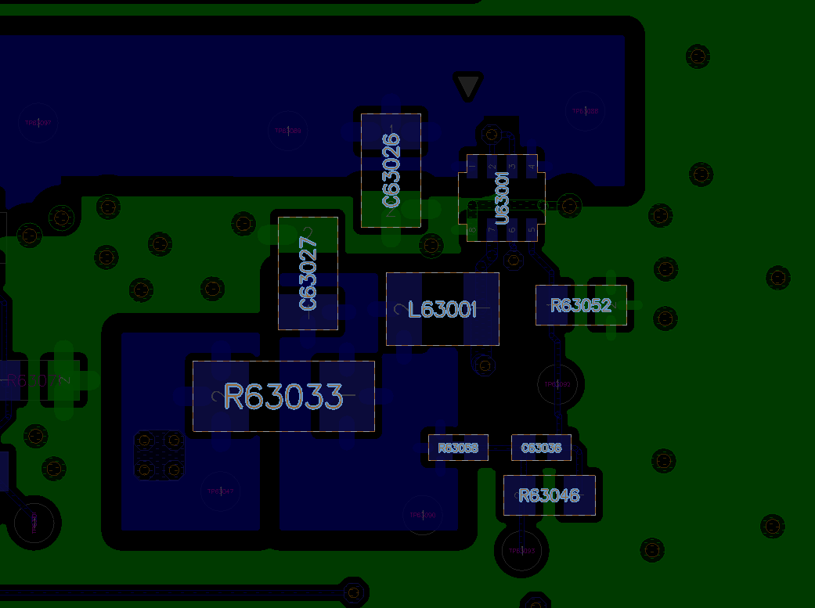
1st Layer
2nd Layer

Slide 6
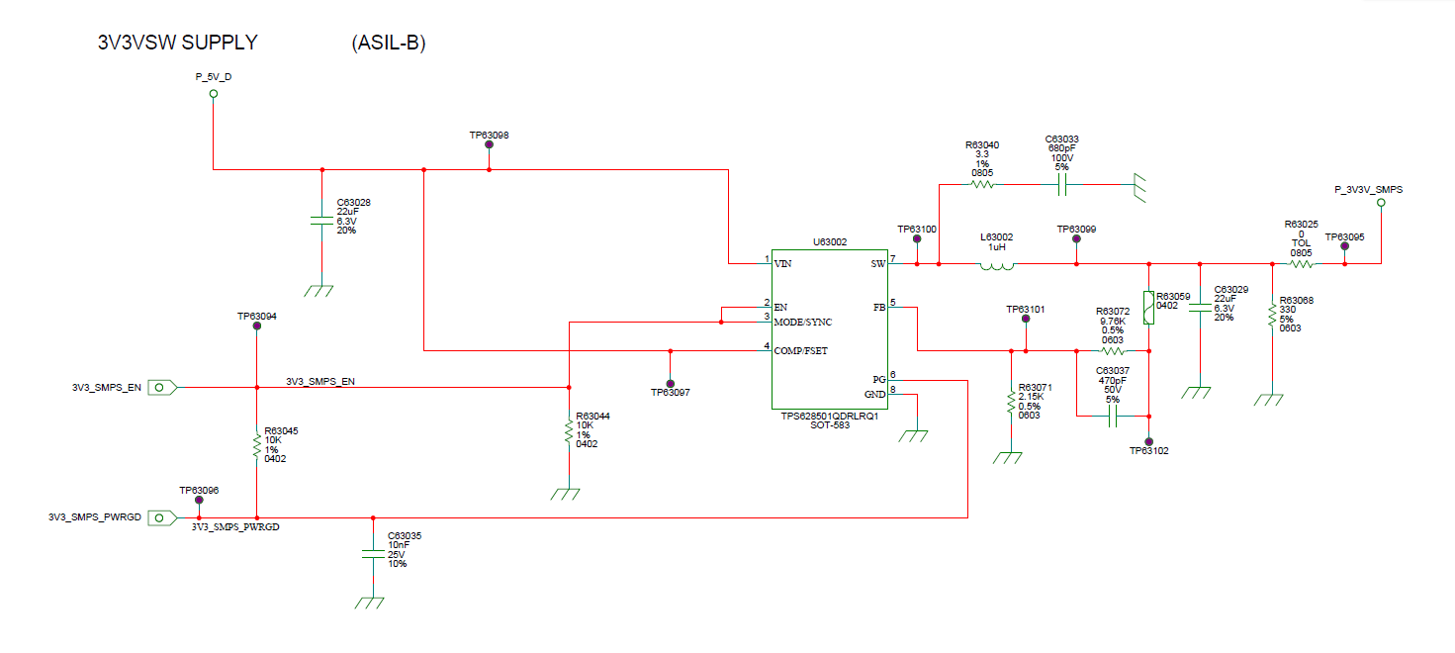
TPS628501QDRLRQ1

Slide 7
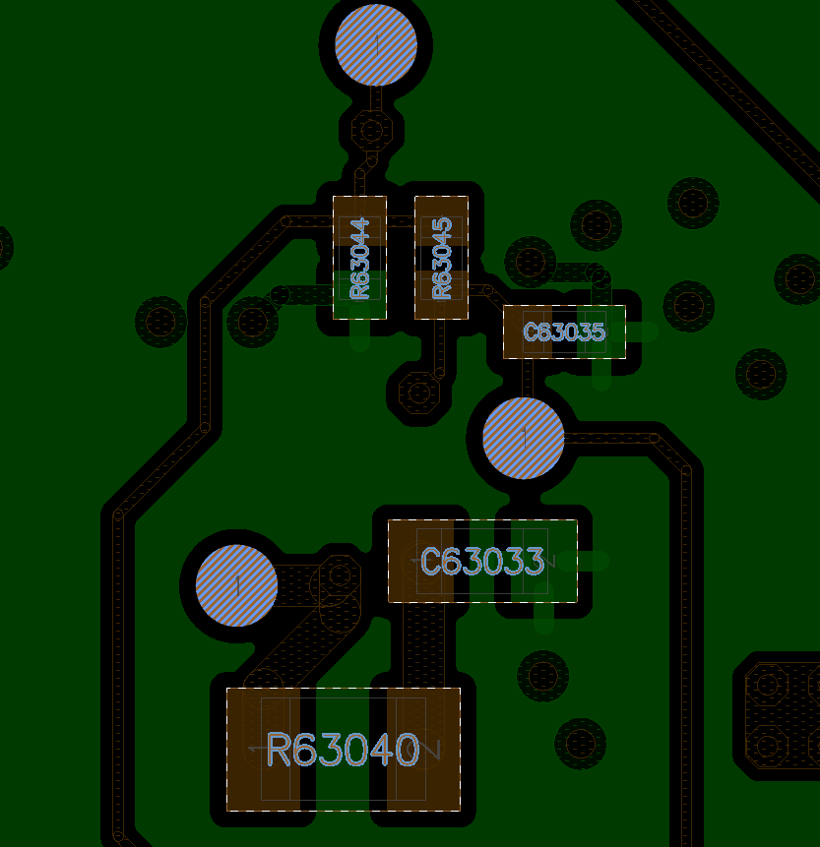
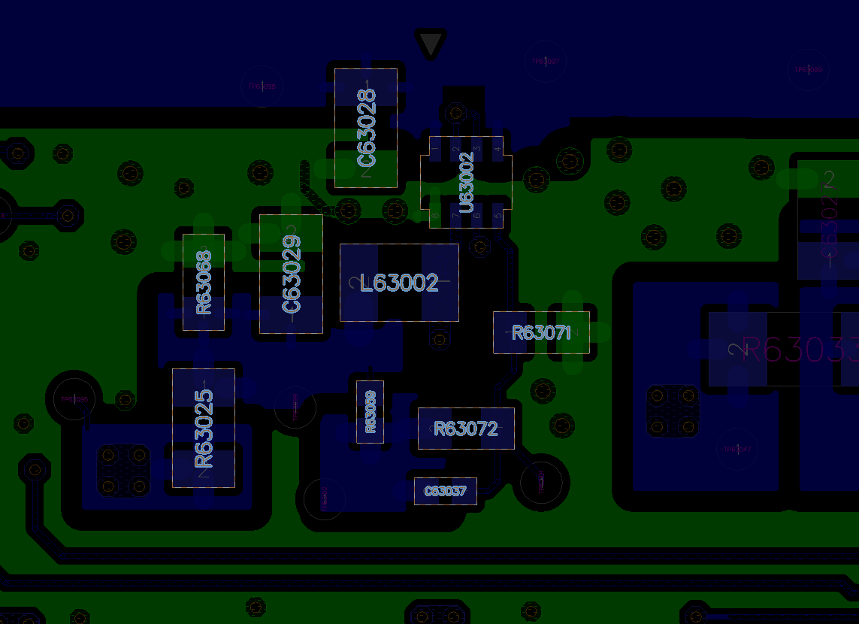
1st Layer
2nd Layer

