Slide 1
Texas_Instruments_LP8869CQPWPRQ1
Supplier Review

Slide 2
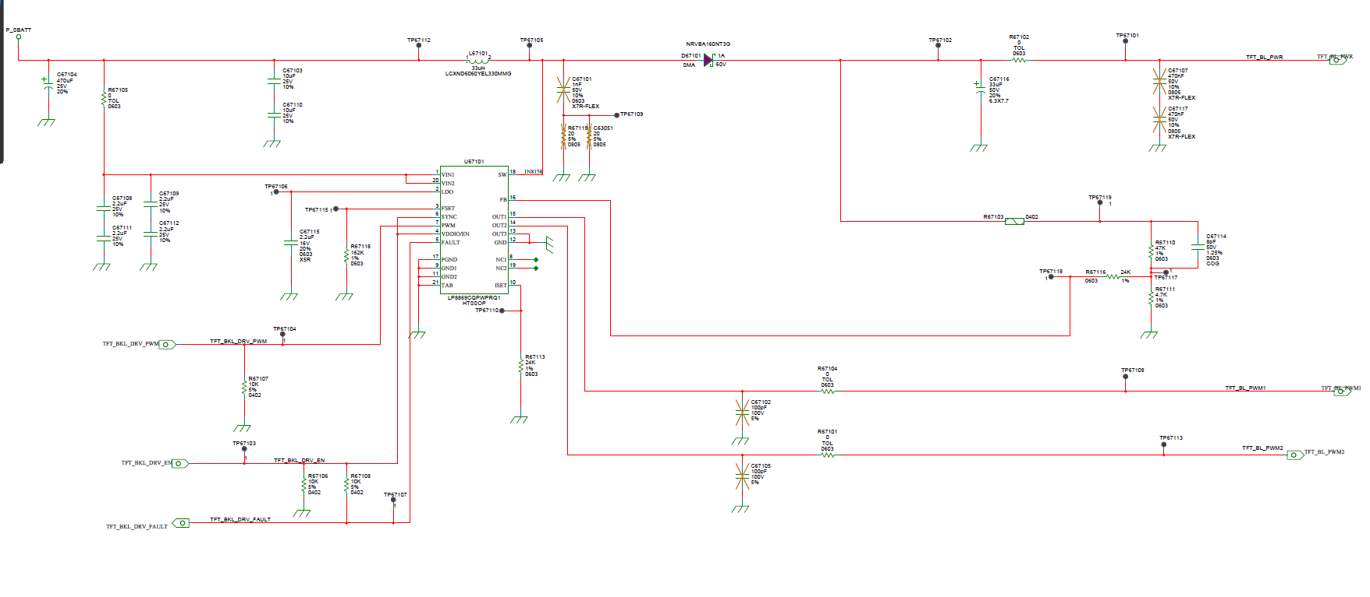
Schematics-also can check the attached pdf

Slide 3
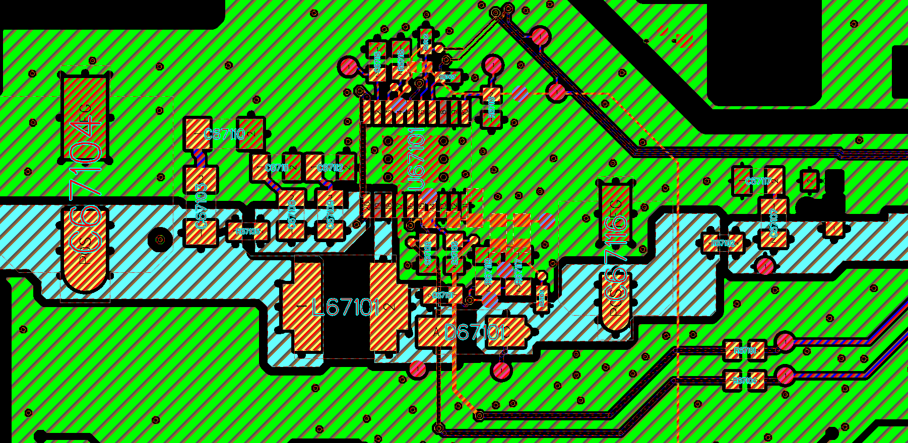
1st Layer

Slide 4
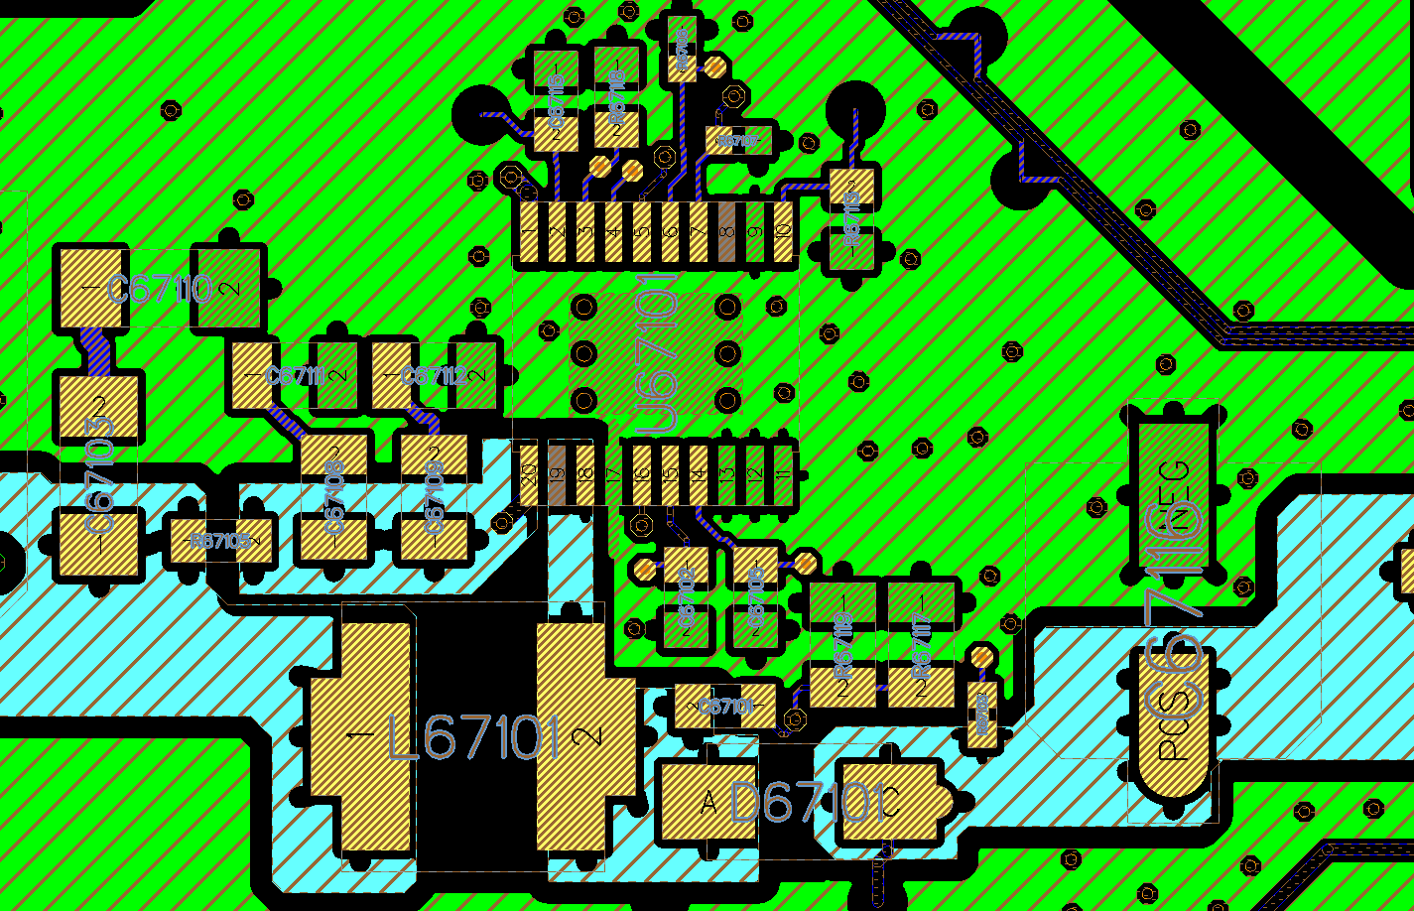
1st Layer

Slide 5
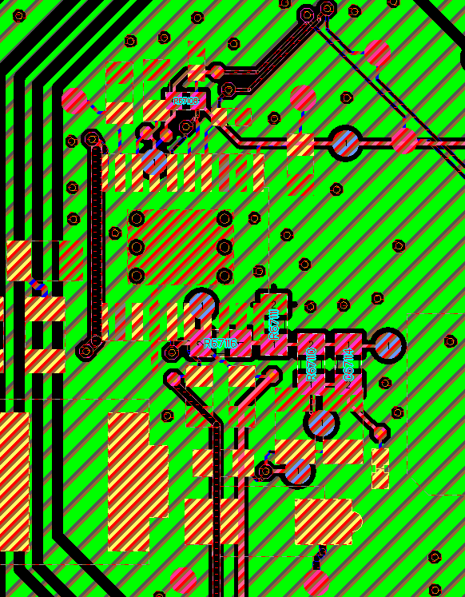
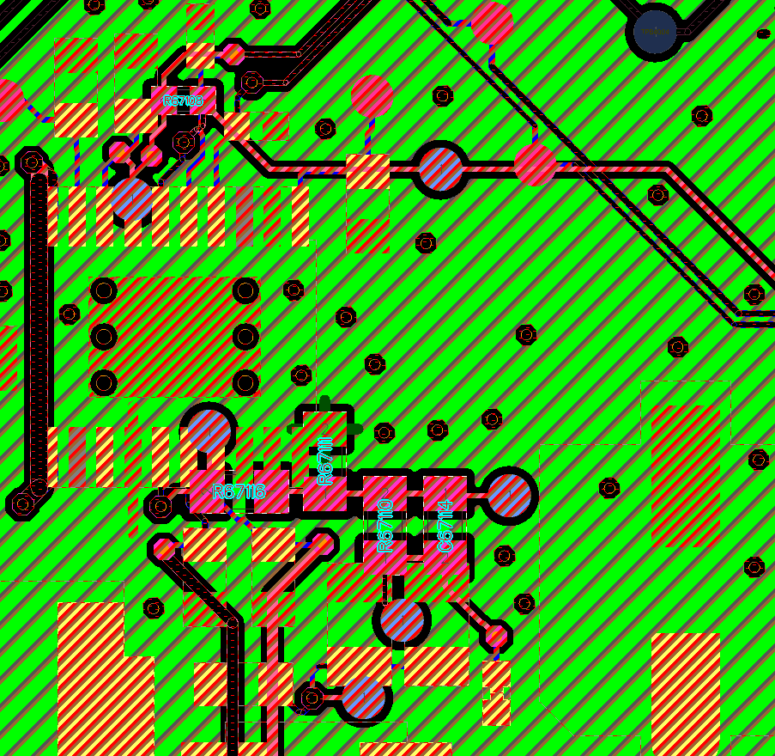
2nd Layer
LP8869CQPWPRQ1

Slide 6
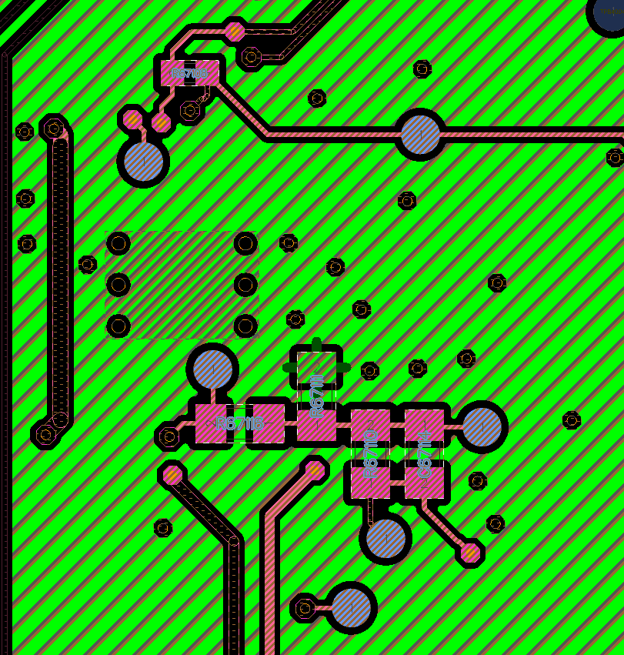
2nd Layer
LP8869CQPWPRQ1

