Slide 1
Texas_Instruments_TPS628502QDRLRQ1
Supplier Review

Slide 2
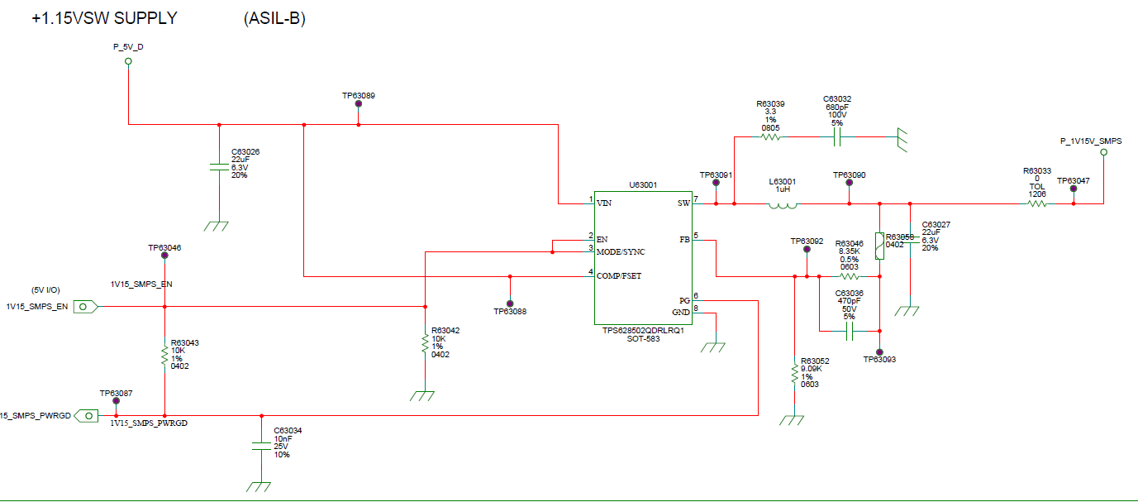
TPS628502QDRLRQ1

Slide 3
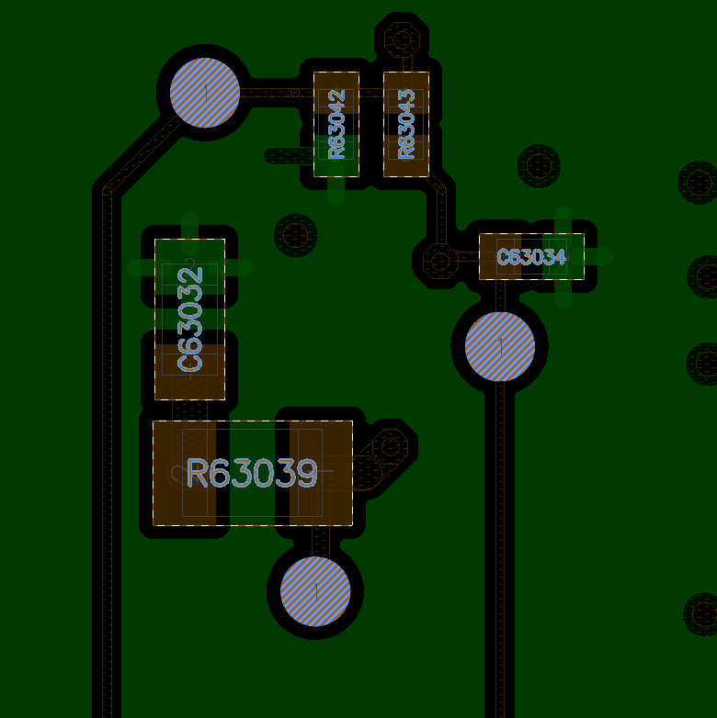
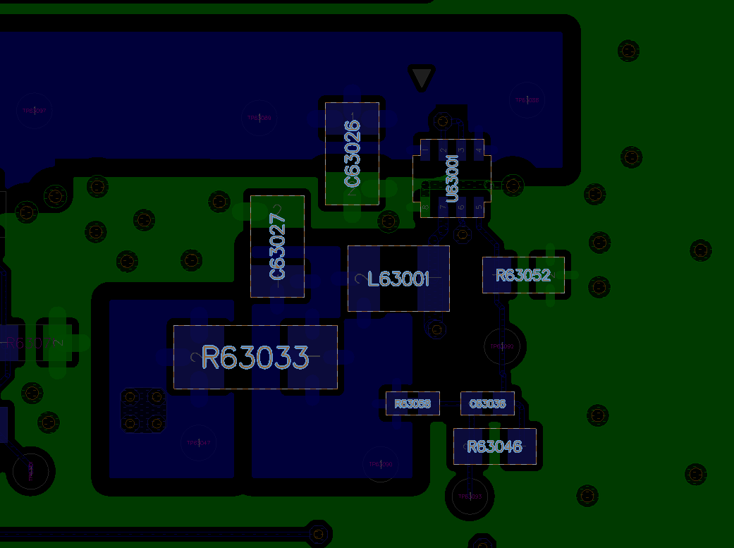
1st Layer
2nd Layer

