Slide 1
□ BQ25798 HVDCP recognition issues
20240708
1. Test Environment
. BQ25798 with Type-C connector & FUSB303B PD IC. refer to schematic.
. Probe of Osiloscope were connected USB port of BQ25798.
. The USB cable was connected to the charger first, and the cable was connected to TA when starting the test.
. Register set as following before USB power plug-in.
offset11h : 78h
. after USB power plug-in, capture osiloscope inage and then dump register of bq25798
2. Issue
. It does not go above 5V in a TA that supports 9V.
. Type-C PD TA is not recognized properly .
3. Request
ⓐ. What register should I set to increase VBUS above 9V (for HVDCP)?
ⓑ. What do I need to do to properly recognize Type-C PD TA?
ⓒ. Can the PD Chipset (FUSB303) connected to the USB type-C connector affect the recognition of the TA by the BQ25798 IC?
If yes, do we need to remove FUSB303B?
To use FUSB303B together, what value should be changed to which REGISTER of BQ25798?

Slide 2
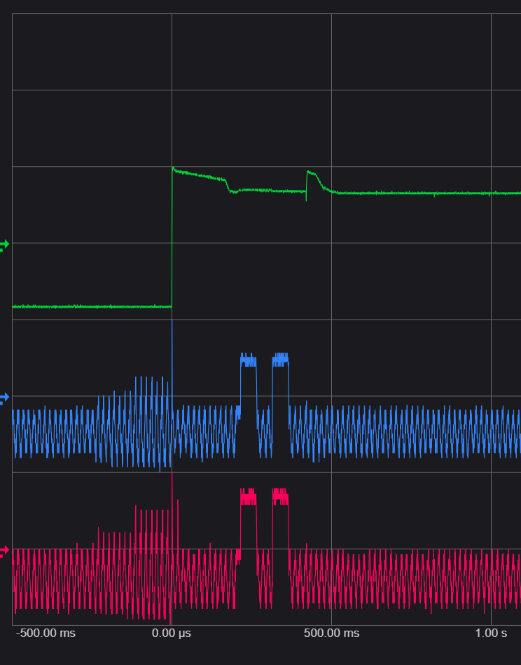
□ 1. USB Plug In. waveform. USB port of BQ25798 #13↔ TA50KWK 001 (Type-A TA. Non Type-C)
20240708
5.7Vmax
4.9V
51
mSec
51
mSec
215
mSec
48
mSec
0.55V
0.55V
0V
0.55V
0.55V
0V
CH2(B9, VBUS)
CH3(B6, D-)
CH4(B7, D+)
USB port of BQ25798 #13 ↔ Type-C/A Cable ↔ TA type A
▶ detected DCP (offset 1Ch : 67h)

Slide 3
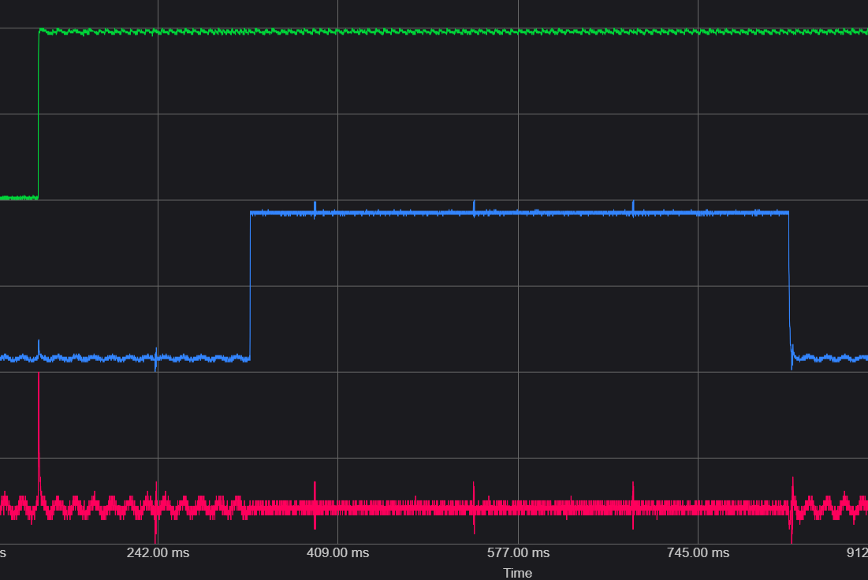
□ 2. USB Plug In waveform. USB port of BQ25798 #13 ↔ LG ADT-65DSU-D03-2 (Type-C PD TA)
20240708
5.1V
198mSec
500mSec
3.5V
0V
CH2(B9, VBUS)
CH3(B6, D-)
CH4(B7, D+)
USB port of BQ25798 #13 ↔ Type-C/C Cable ↔ TA type-C
▶ Un known 3A (offset 1Ch : 6Ah)

Slide 4
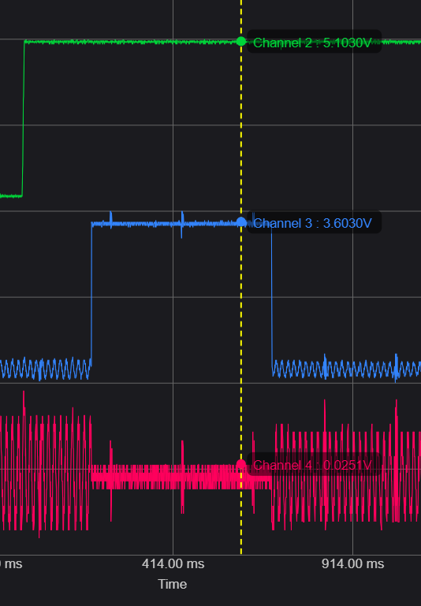
□ 3. USB Plug In waveform. USB port of BQ25798 #13 ↔ Samsung EP-T1510 Type-C fast charging 5V 2A, 9V 1.67A
20240708
5.1V
190mSec
500mSec
3.5V
0V
-0.2~0.18V
CH2(B9, VBUS)
CH3(B6, D-)
CH4(B7, D+)
USB port of BQ25798 #13 ↔ Type-C/C Cable ↔ TA type-C
▶ Un known 3A (offset 1Ch : 6Ah)

Slide 5
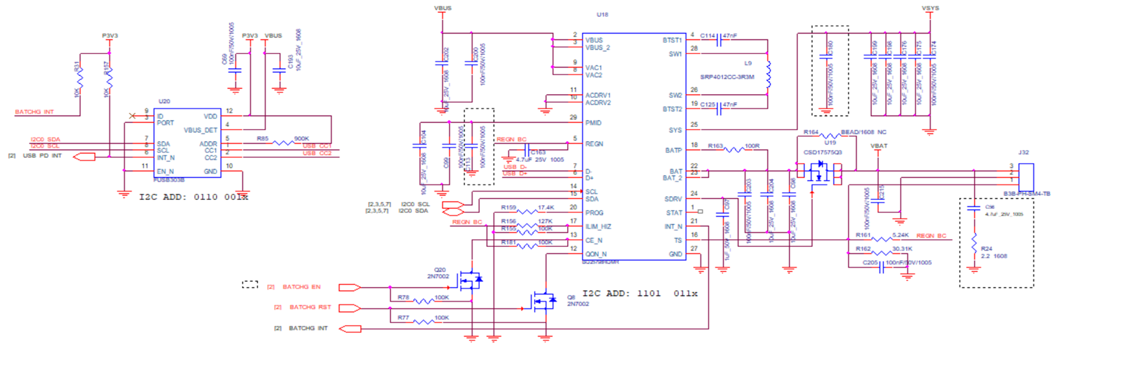
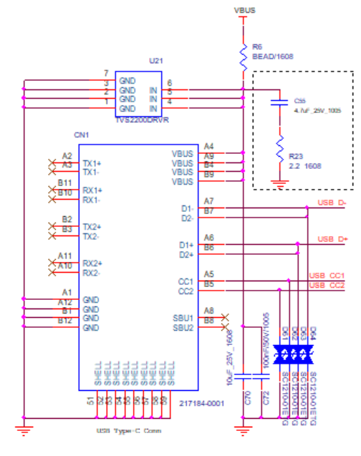
4. Charger schematic
※ The dotted boxes are pictures after rework.

