Slide 1
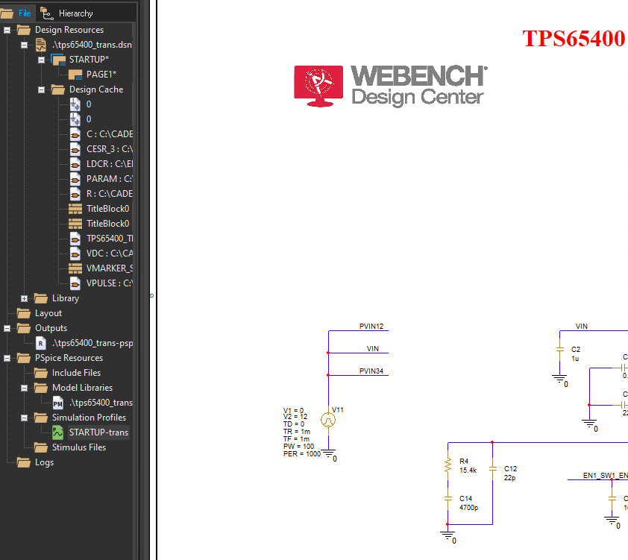
Step.1 Open TPS65400_trans Pspice, find the Sartup.Startup file

Slide 2
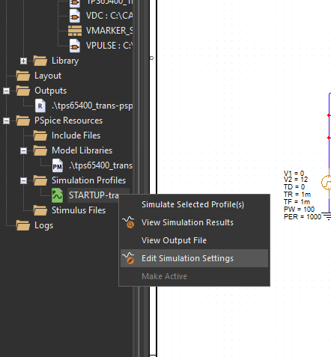
Step.2 Right click to open Edit Simulation Settings

Slide 3
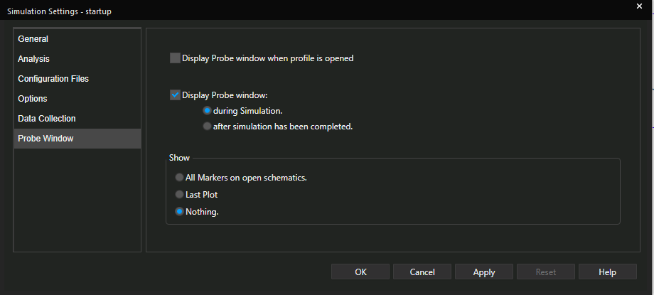
Step.3 Complete the following settings

Slide 4
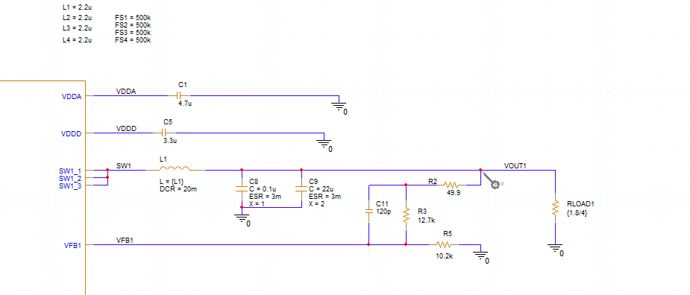
Step.4 Add the probe that you want to measure

Slide 5
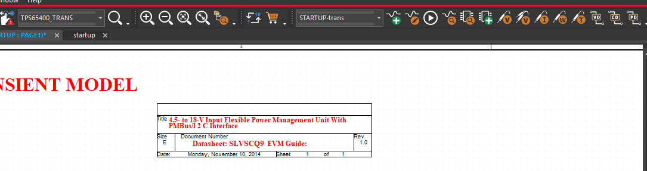
Step.5 Run (maybe need to try some times )

Slide 6
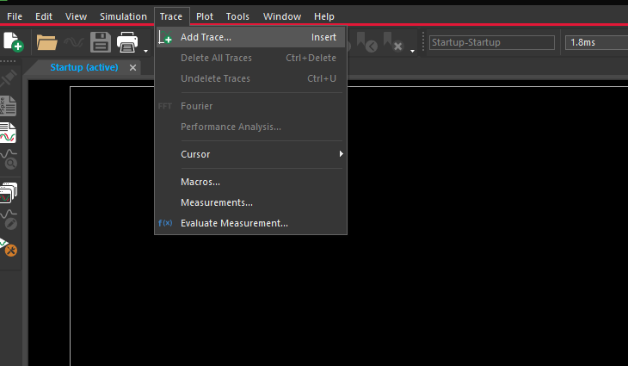
Step.6 Add traces that you need

Slide 7
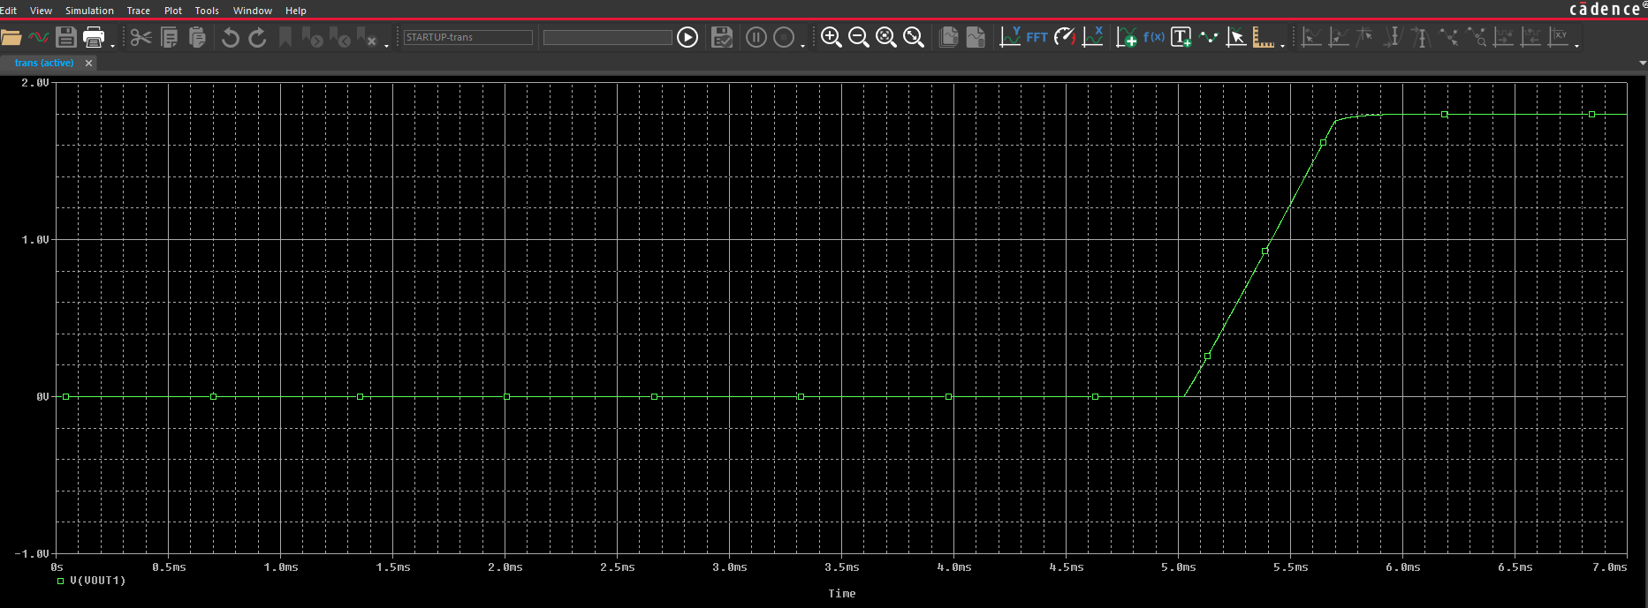
Like this

