Slide 1
UCC29002
Controlling load current for modules without a remote sense function
John Griffin Jun 2019

Slide 2
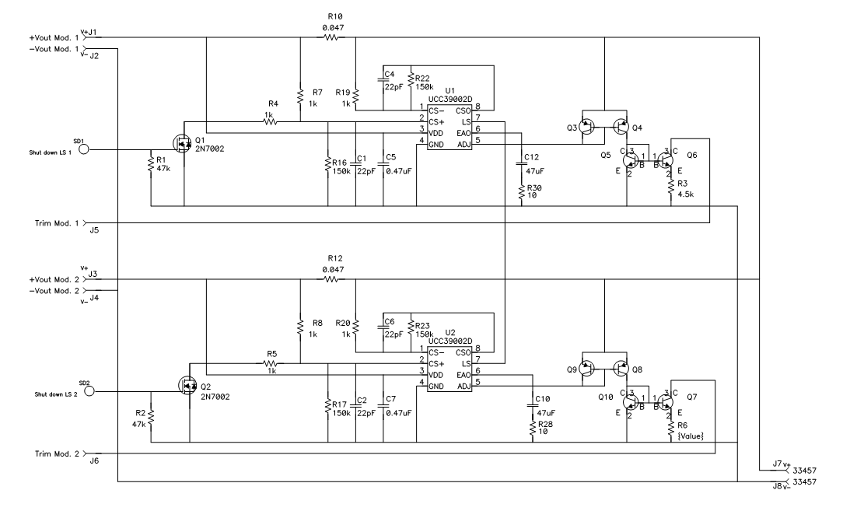
Trim Input
Module 2
Trim Input
Module 2

